Slide 1
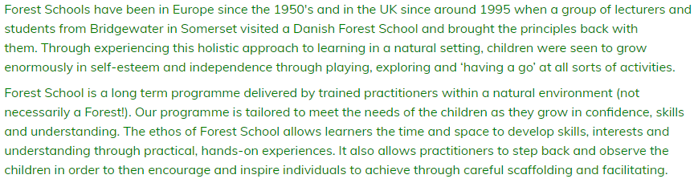

Slide 2
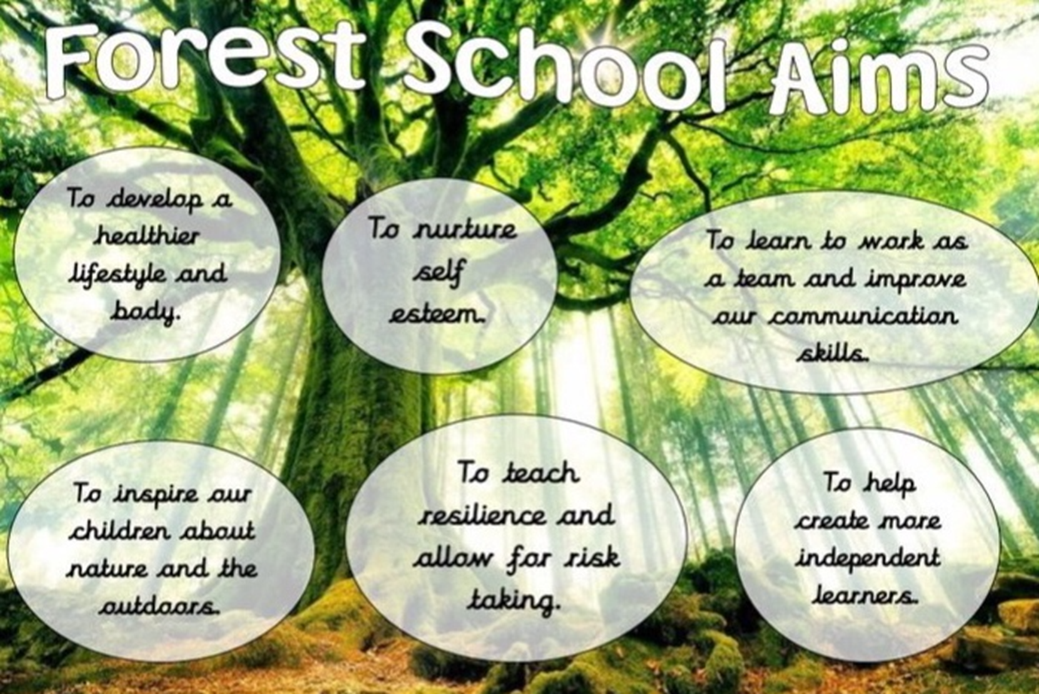

Slide 3
Minna Walters is our qualified forest school lead.
It started as a joint project with the juniors. We have been lucky to use fundraising from our Friends of Portway team, staff and parents which have allowed both schools to create our wonderful space

Slide 4
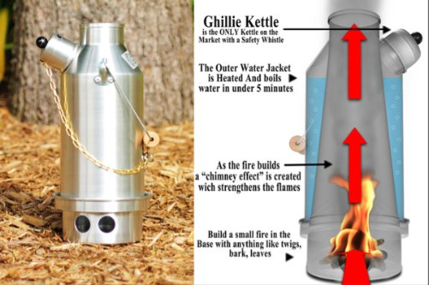

Slide 5
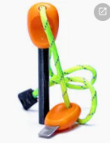
Flint and steel kits

Slide 6
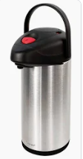
Thermos flasks

Slide 7
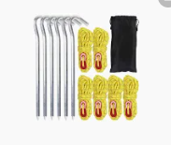
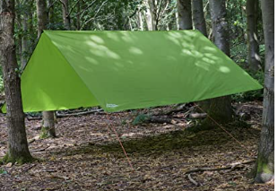
Tarps, pegs and cord

Slide 8
Waterproof outdoor clothing – only for a small number of children so far

Slide 9
There have been a variety of trees that have been carefully selected to show colours throughout the seasons – these have already been planted
Water tray to wash what we have used – sometimes this is done with big leaves

Slide 10
Favourite activities the children have
tree spotting
team games
mud activities (mud face, mud cakes etc)
den making
building shelters
minibeast hunting
gardening
art and craft activities
drinking hot chocolate

Slide 11
Trip for FS2 to Allestree park
To explore a larger woodland area

Slide 12
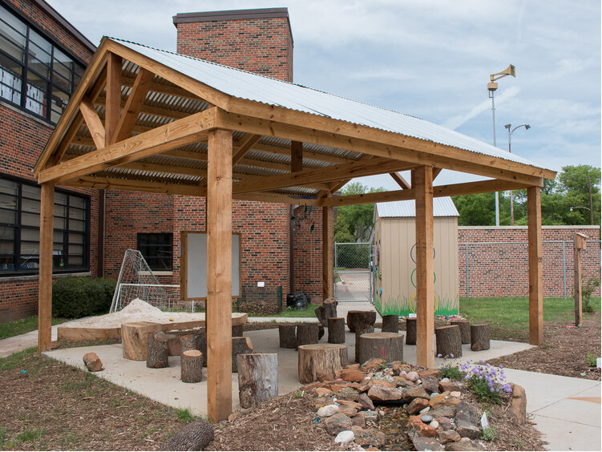
Ideas for next year

Slide 13
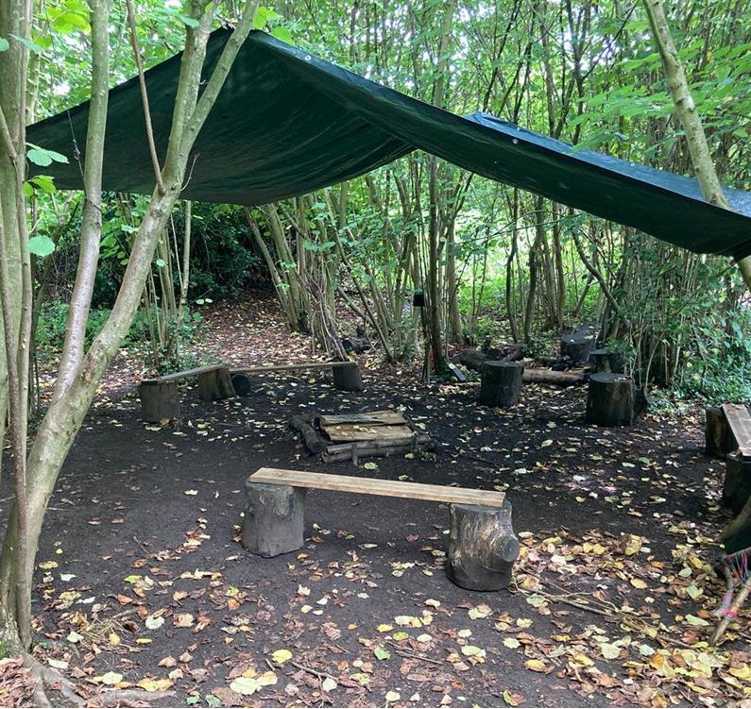
Ideas for next year

Slide 14
Trees
We have more trees coming in November to expand our mini woodland area

Slide 15
Things we would like to do next year
orienteering
a gardening club that runs from late April till July.
fires and campfire cooking
planting more trees

Slide 16
Do you have any ideas or fundraising ideas?

