Slide 1
Computing at Portway Infant School
Session aims:
Early years foundation stage curriculum
National curriculum programme of study
How we teach computing at school
Importance of online safety for ALL

Slide 2
Early years foundation stage
40-60 months
Completes a simple program on a computer. Uses ICT hardware to interact with age-appropriate computer software.
Early learning goal
Children recognise that a range of technology is used in places such as homes and schools. They select and use technology for particular purposes.
Exceeding
Children find out about and use a range of everyday technology. They select appropriate applications that support and identified need for example in deciding how best to make a record of a special event in their lives, such as a journey on a steam train.

Slide 3
KS1 computing programme of study
Subject content Key stage 1
Pupils should be taught to:
understand what algorithms are; how they are implemented as programs on digital devices; and that programs execute by following precise and unambiguous instructions
create and debug simple programs
use logical reasoning to predict the behaviour of simple programs
use technology purposefully to create, organise, store, manipulate and retrieve digital content
recognise common uses of information technology beyond school
use technology safely and respectfully, keeping personal information private; identify where to go for help and support when they have concerns about content or contact on the internet or other online technologies.

Slide 4
How are we teaching computing at school?
Beebots – programme the beebot in inputting a set of instructions
Programming apps on Ipad’s and laptops e.g. scratch
Email
Rising stars – switched on computing which is project based
2simple collection – EYFS part of continuous provision
Purple Mash https://www.purplemash.com/#tab/pm-home
Online safety – shut and tell (red riding hood)
https://youtu.be/-nMUbHuffO8
https://www.thinkuknow.co.uk/5_7/hectorsworld/

Slide 5
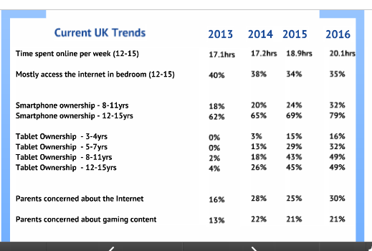
Children’s access to internet enabled devices is increasing.

Slide 6
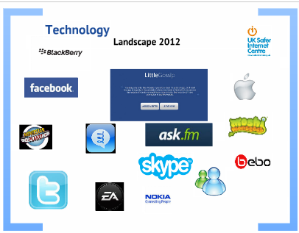
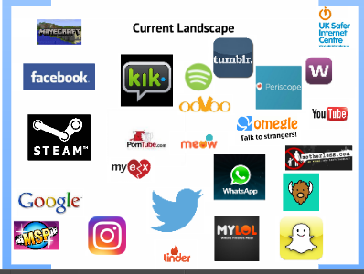
Online safety
UK safer internet centre

Slide 7
What can we do to keep our children safe?
Privacy settings for social networks
Ensuring children are accessing age appropriate content under supervision
Turning on parental settings
https://www.qustodio.com/en/help/whats-the-difference-between-qustodio-free-and-qustodio-premium/ Parents can sign up to Qustodio to receive an email with a break down of all the apps, websites, searches etc that your child has accessed and for how long. You can set your device to lock internet enabled apps.

