Slide 1
Session 1 flashback
Show your friend 4 on your fingers, what do you notice?
Mastering Number 2021/22 ncetm.org.uk

Slide 2
Session 2 flashback tell your friend what subitizing means
Mastering Number 2021/22 ncetm.org.uk

Slide 3
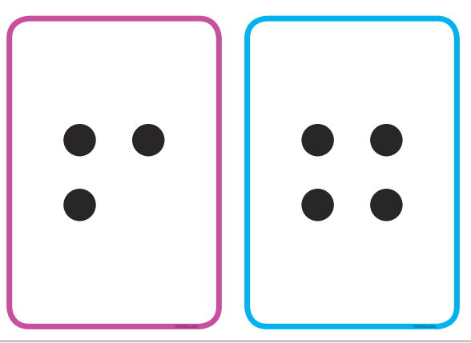
Flashback compare the purple and blue box which one has more and which has fewer?
Mastering Number 2021/22 ncetm.org.uk

Slide 4
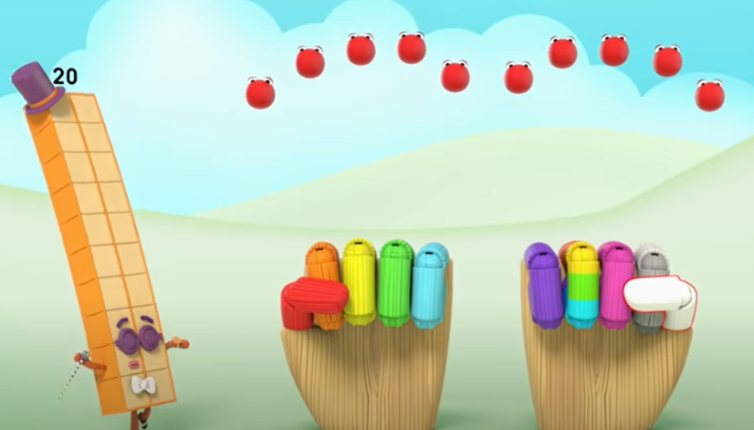
Numberblocks
Series 4, Episode 14: I Can Count to Twenty
Video © 2021 Alphablocks Ltd. All rights reserved. Mastering Number 2021/22 ncetm.org.uk

Slide 5
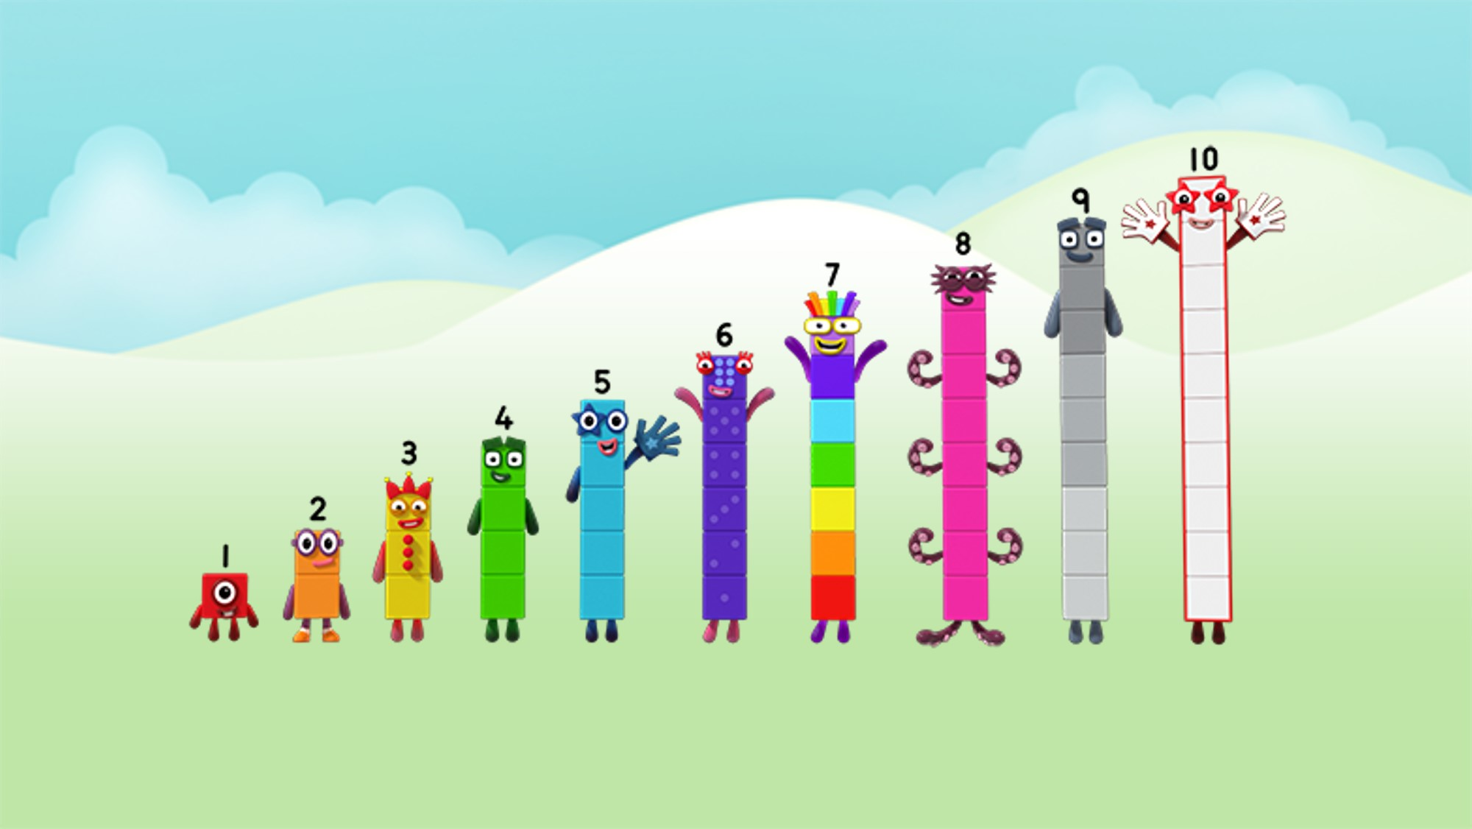
Can you count to 20?
Image © 2021 Alphablocks Ltd. All rights reserved. Mastering Number 2021/22 ncetm.org.uk

Slide 6
flash back
Are these numbers in the correct order?
3 1 4 5 2
Mastering Number 2021/22 ncetm.org.uk

Slide 7
Can you count the spots?
Mastering Number 2021/22 ncetm.org.uk

Slide 8
Mastering Number 2021/22 ncetm.org.uk

Slide 9
Session 5 – number recognition
10
Mastering Number 2021/22 ncetm.org.uk

Slide 10
Session 5 – number recognition
2
Mastering Number 2021/22 ncetm.org.uk

Slide 11
Session 5 – number recognition
9
Mastering Number 2021/22 ncetm.org.uk

Slide 12
Session 5 – number recognition
0
Mastering Number 2021/22 ncetm.org.uk

Slide 13
Session 5 – number recognition
1
Mastering Number 2021/22 ncetm.org.uk

Slide 14
Session 5 – number recognition
8
Mastering Number 2021/22 ncetm.org.uk

Slide 15
Session 5 – number recognition
3
Mastering Number 2021/22 ncetm.org.uk

Slide 16
Session 5 – number recognition
5
Mastering Number 2021/22 ncetm.org.uk

Slide 17
Session 5 – number recognition
7
Mastering Number 2021/22 ncetm.org.uk

Slide 18
Session 5 – number recognition
4
Mastering Number 2021/22 ncetm.org.uk

Slide 19
Session 5 – number recognition
6
Mastering Number 2021/22 ncetm.org.uk

