Slide 1


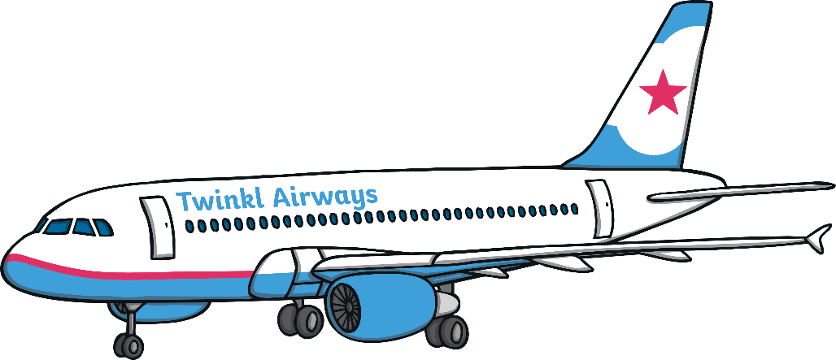

jet
jet
?
Next

Slide 2
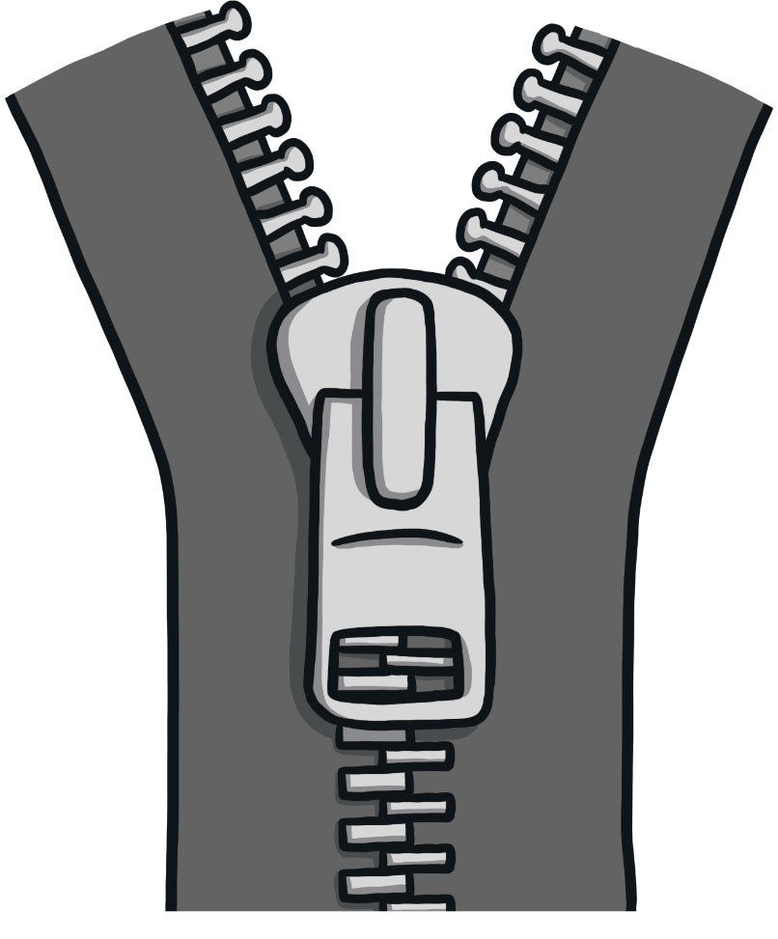
zip
zip
?
Next

Slide 3
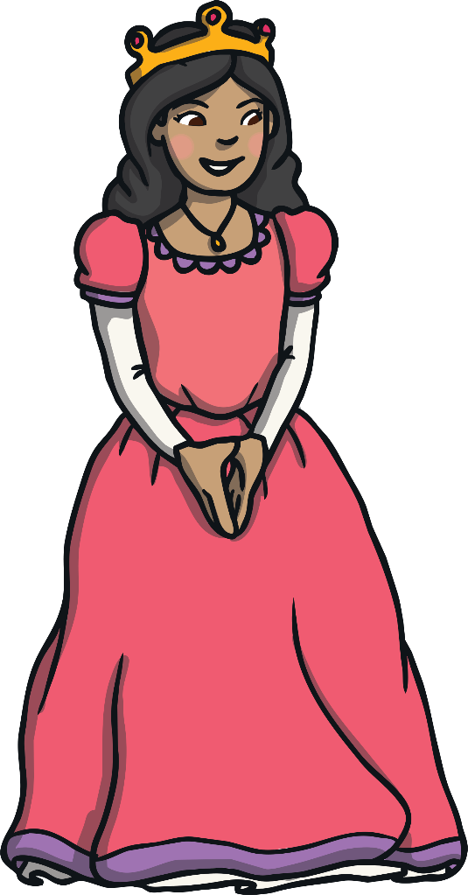
queen
queen
?
Next

Slide 4
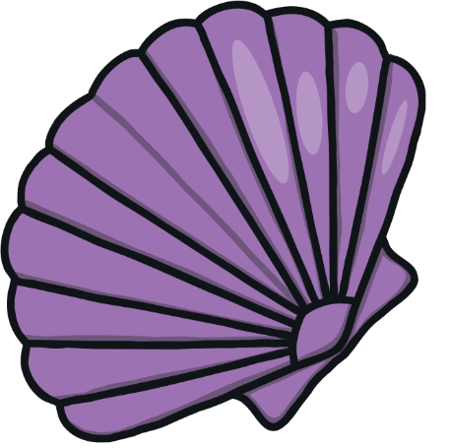
shell
shell
?
Next

Slide 5
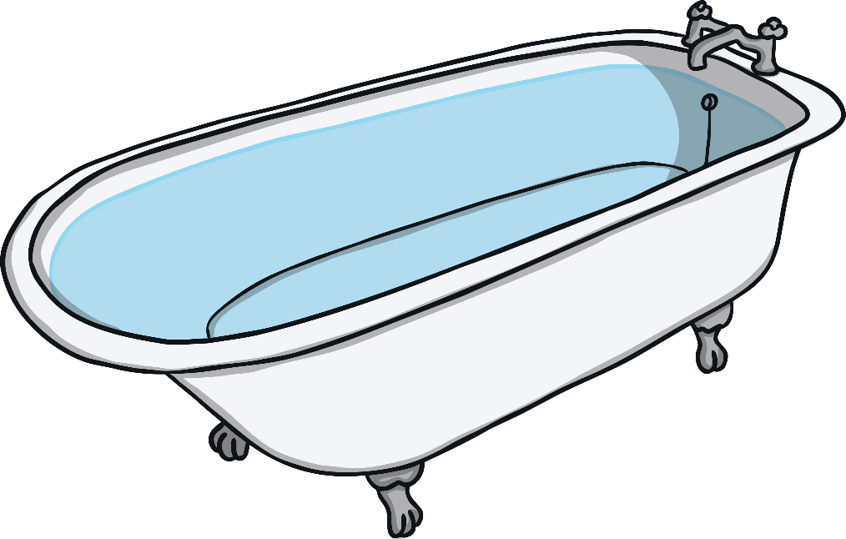
bath
bath
?
Next

Slide 6


tail
tail
?
Next

Slide 7
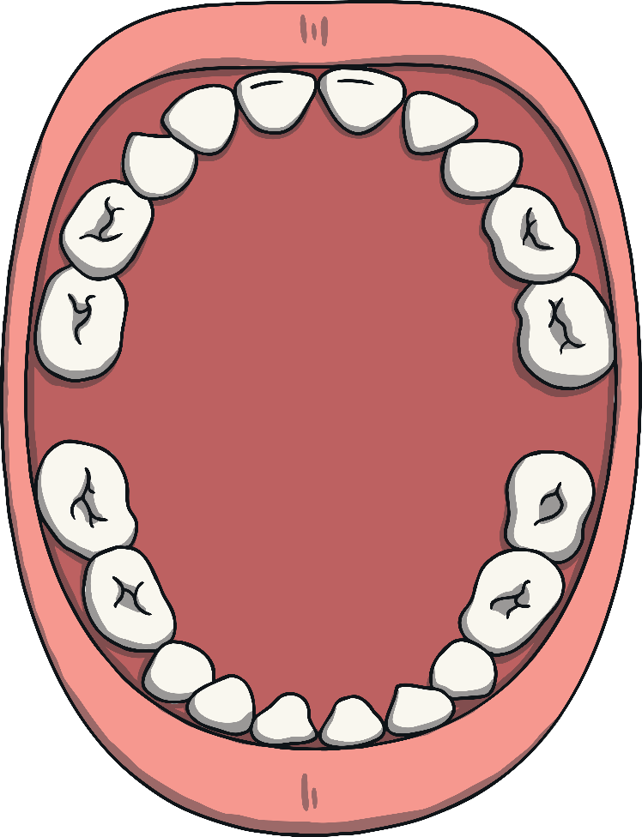
teeth
teeth
?
Next

