Slide 1

Quick Quiz :

Slide 2
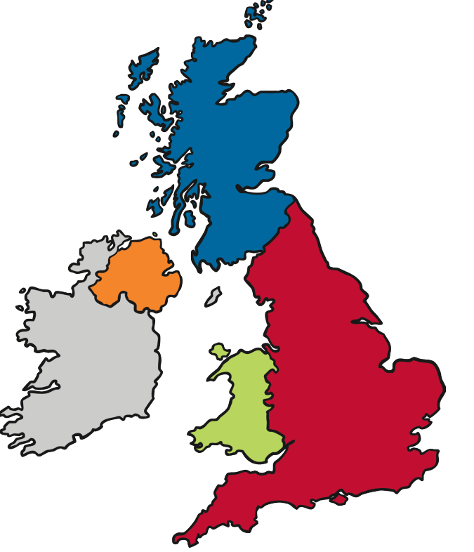
Can you name the four countries of the UK?

Slide 3
Scotland
Northern Ireland
England
Wales

Slide 4
Can you name each country’s capital city?

Slide 5
This Photo by Unknown Author is licensed under CC BY-SA-NC

Slide 6
Edinburgh
Belfast
London
Cardiff
This Photo by Unknown Author is licensed under CC BY-SA-NC

Slide 7
Scotland
?
Edinburgh
Northern Ireland
Belfast
?
England
Wales
London
Cardiff
Can you remember the names of the surrounding seas?
?
This Photo by Unknown Author is licensed under CC BY-SA-NC

Slide 8
Scotland
North Sea
Edinburgh
Northern Ireland
Belfast
Irish Sea
England
Wales
London
Cardiff
English Channel
This Photo by Unknown Author is licensed under CC BY-SA-NC

Slide 9
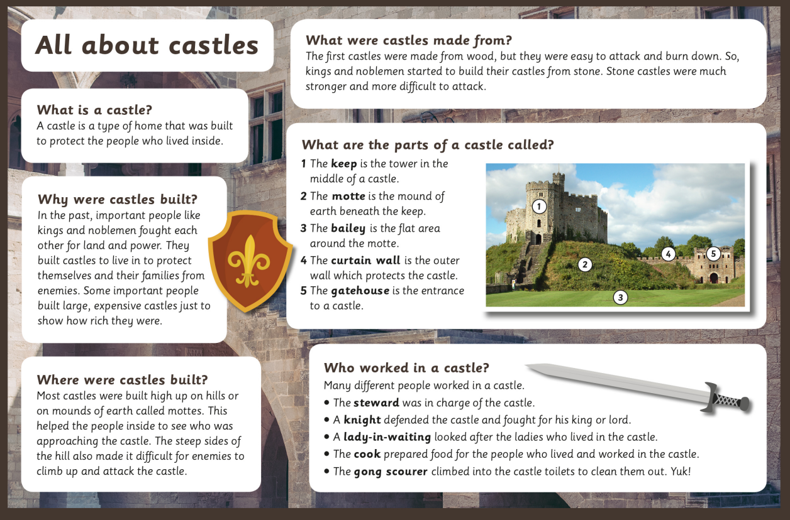
Echo read these castle facts with your teacher:

Slide 10

Use the information you have just learned about castles to make an information leaflet or booklet:
What is a castle?
Why were castles built?
Where were they built?
What are the parts of a castle called?
Who worked in a castle?

Slide 11
After you have talked about what you have learned with your class, have a castle life fashion show.
Create a catwalk in your classroom and strut your stuff to this music :
In the Night (2018 Remaster) - YouTube

Slide 12
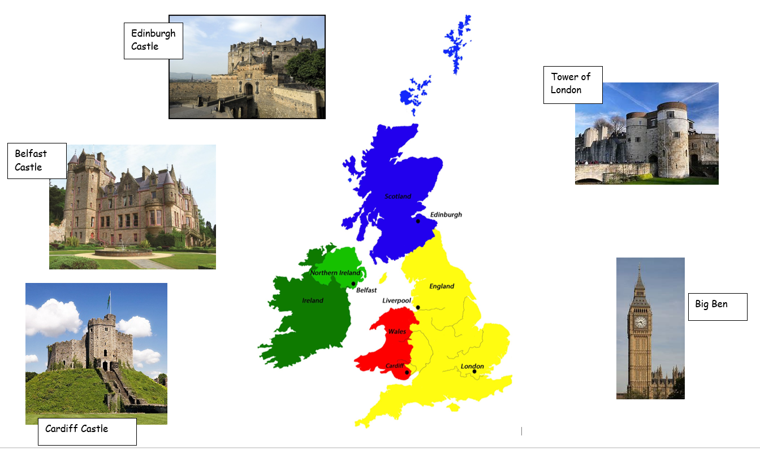
Plenary : Look at the capital cities on the UK map. Can you find where these castles should go?

