Slide 1

Quick Quiz :
Can you name some famous sea explorers from the past?

Slide 2
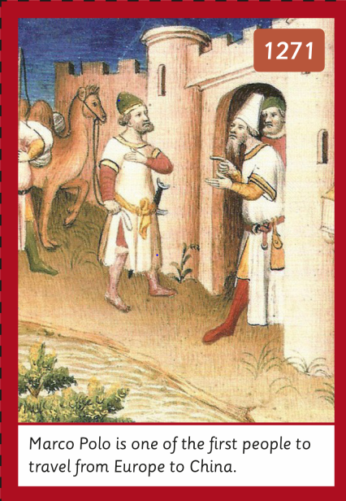
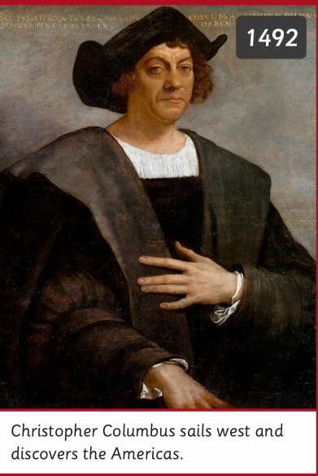
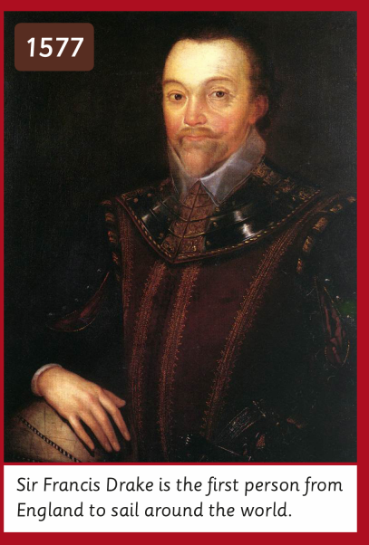
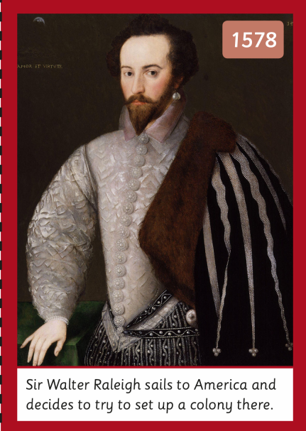
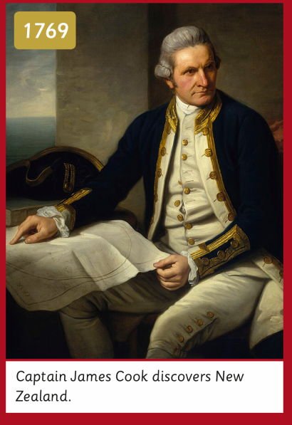
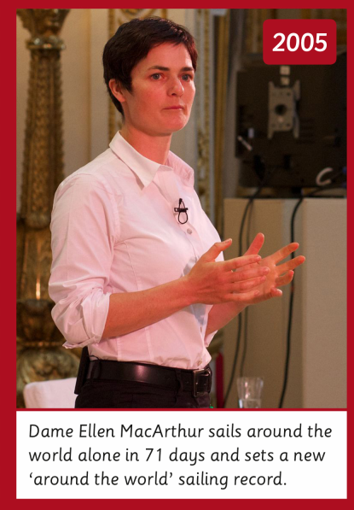

Slide 3
WALT – Design and make a castle with a drawbridge, choosing from a range of materials and parts.
WILF – I chose appropriate materials and parts so my drawbridge was strong and opened and closed.

Slide 4
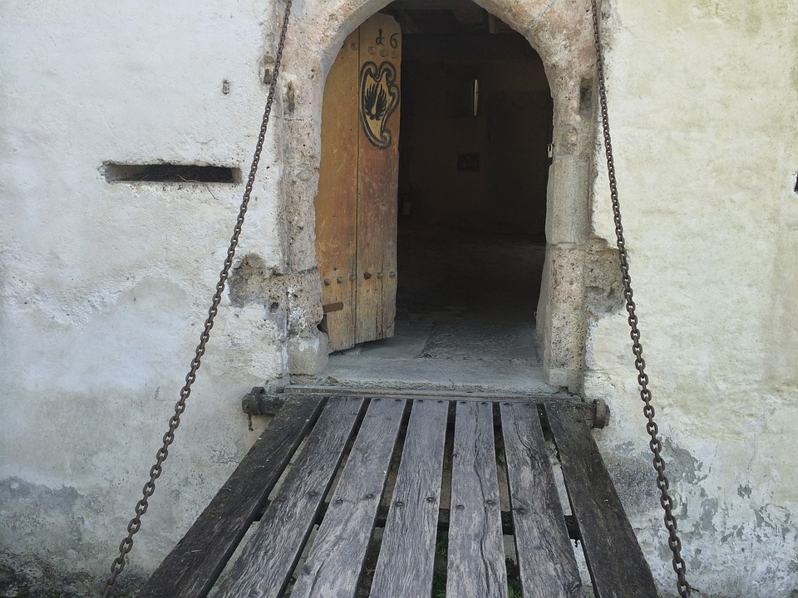
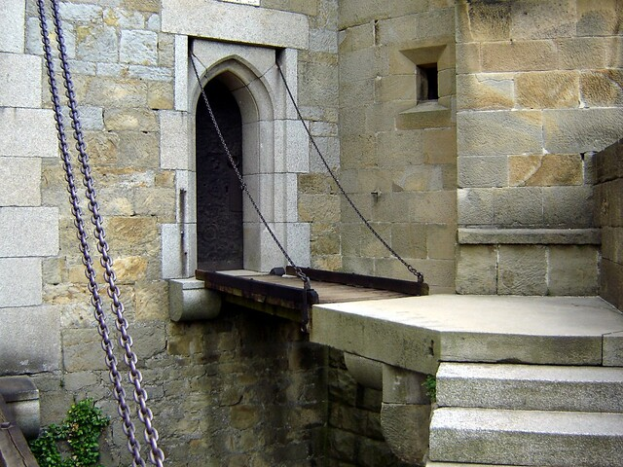
Here are some examples of drawbridges :

Slide 5
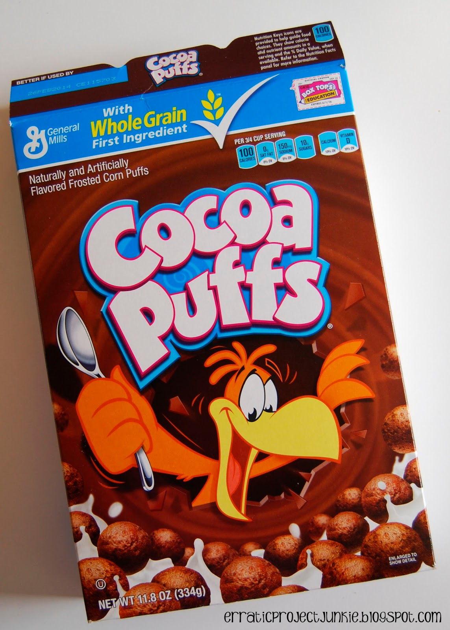

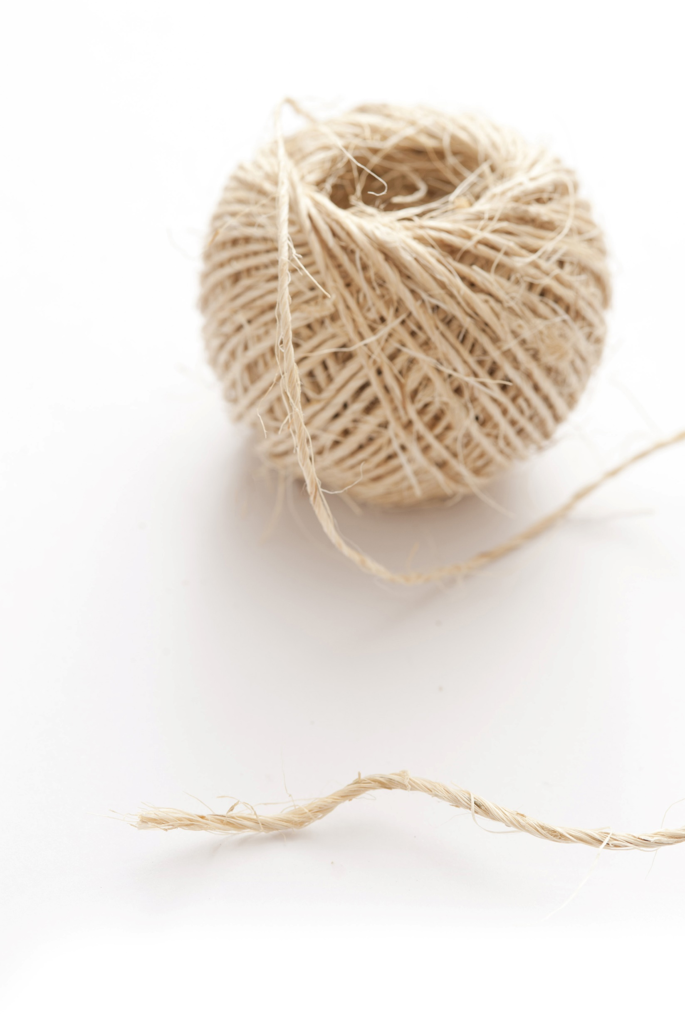
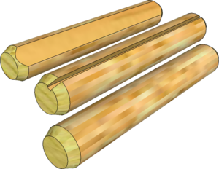
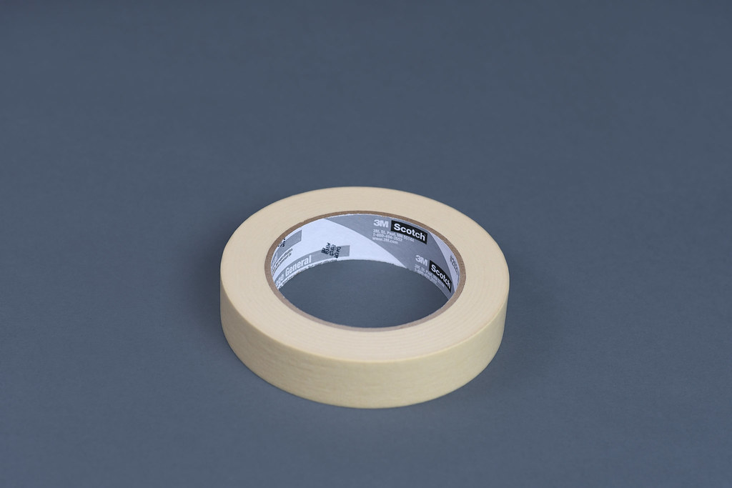
You can use :
a cereal box
scissors
string
dowelling
tape
How could you make a moving drawbridge with these materials?
If you don’t have a cereal box, work with a partner.

Slide 6
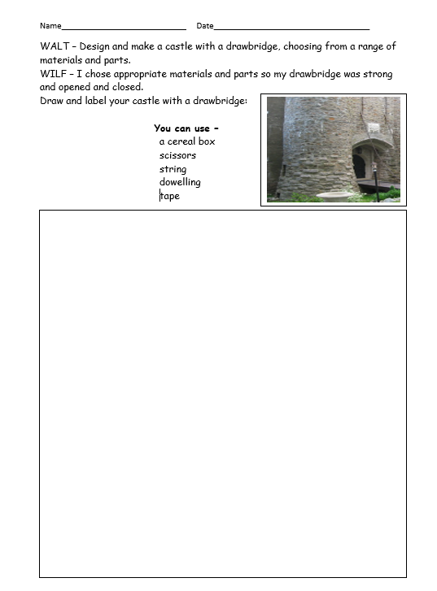
Use this plan :

Slide 7
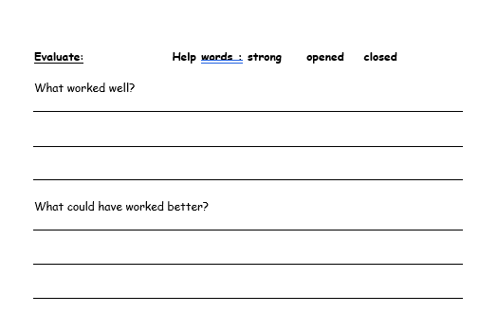
When you have made your drawbridge, evaluate it :
What worked well?
What could have worked better?

