Slide 1
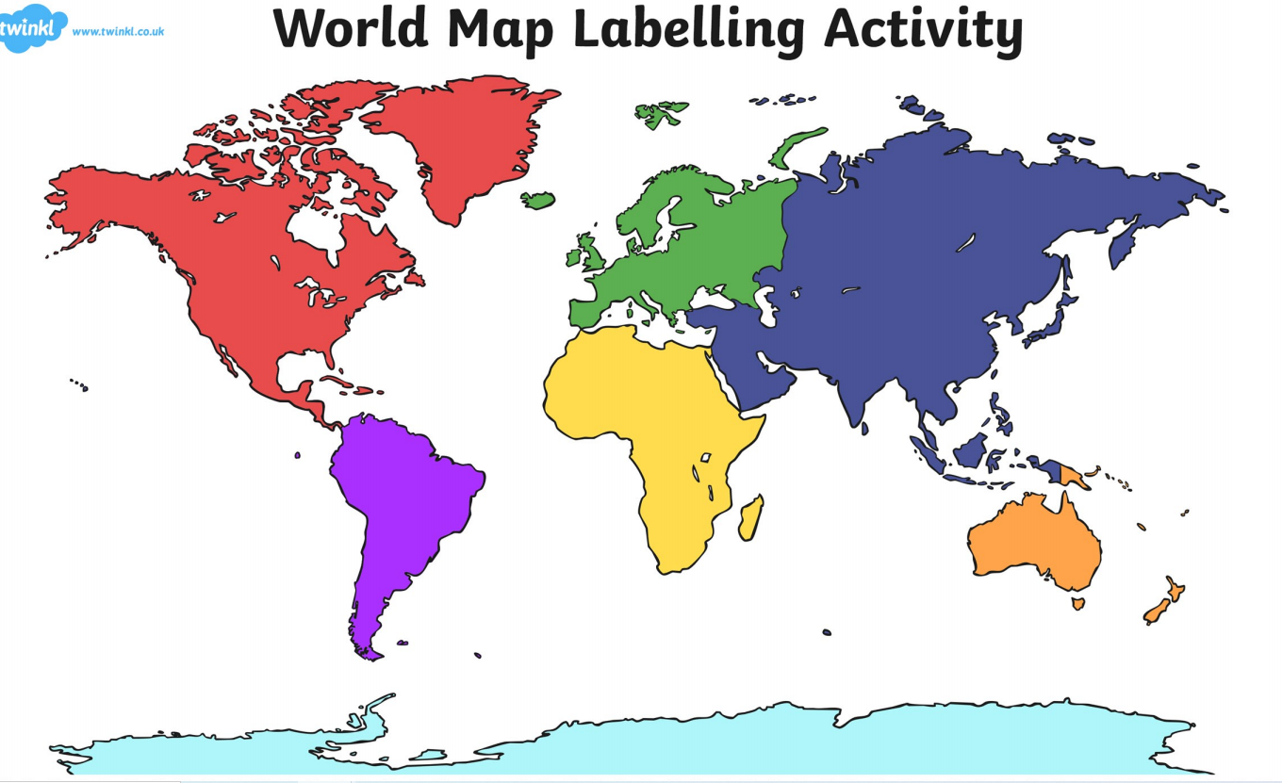

Quick Quiz : Sing the seven continents song
Seven Continents Song - YouTube

Slide 2
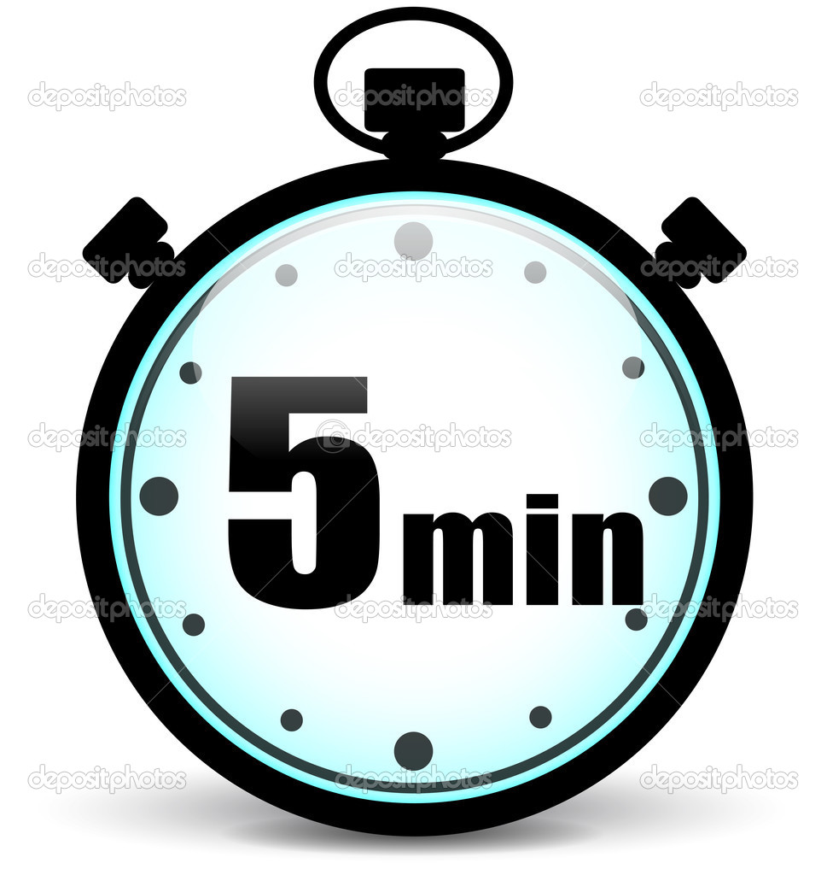
You have 5 minutes to label the continents of the World correctly. Good luck!

Slide 3
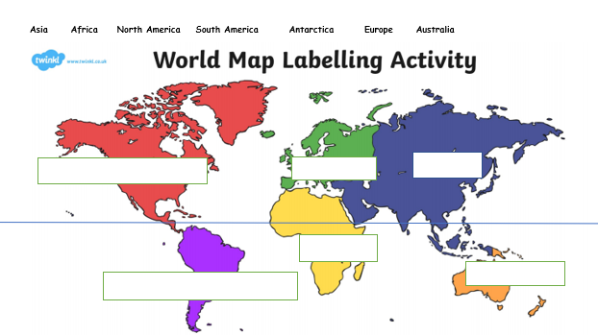

Slide 4
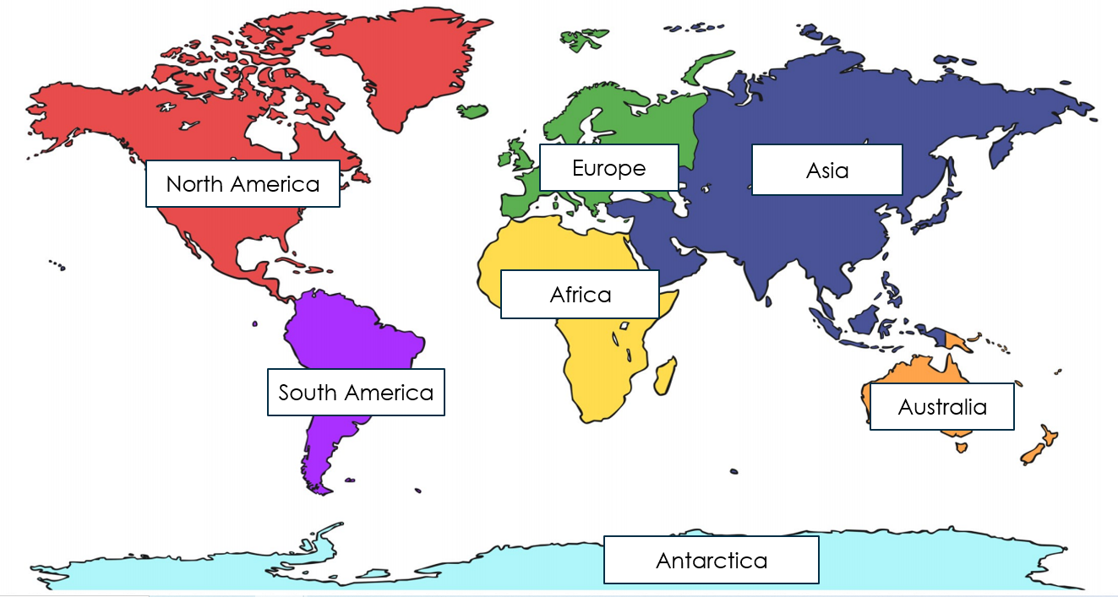
How many did you get right?

Slide 5
WALT - Learn about events beyond living memory.
WILF - Sequence information on a timeline in chronological order.
What is a timeline?

Slide 6
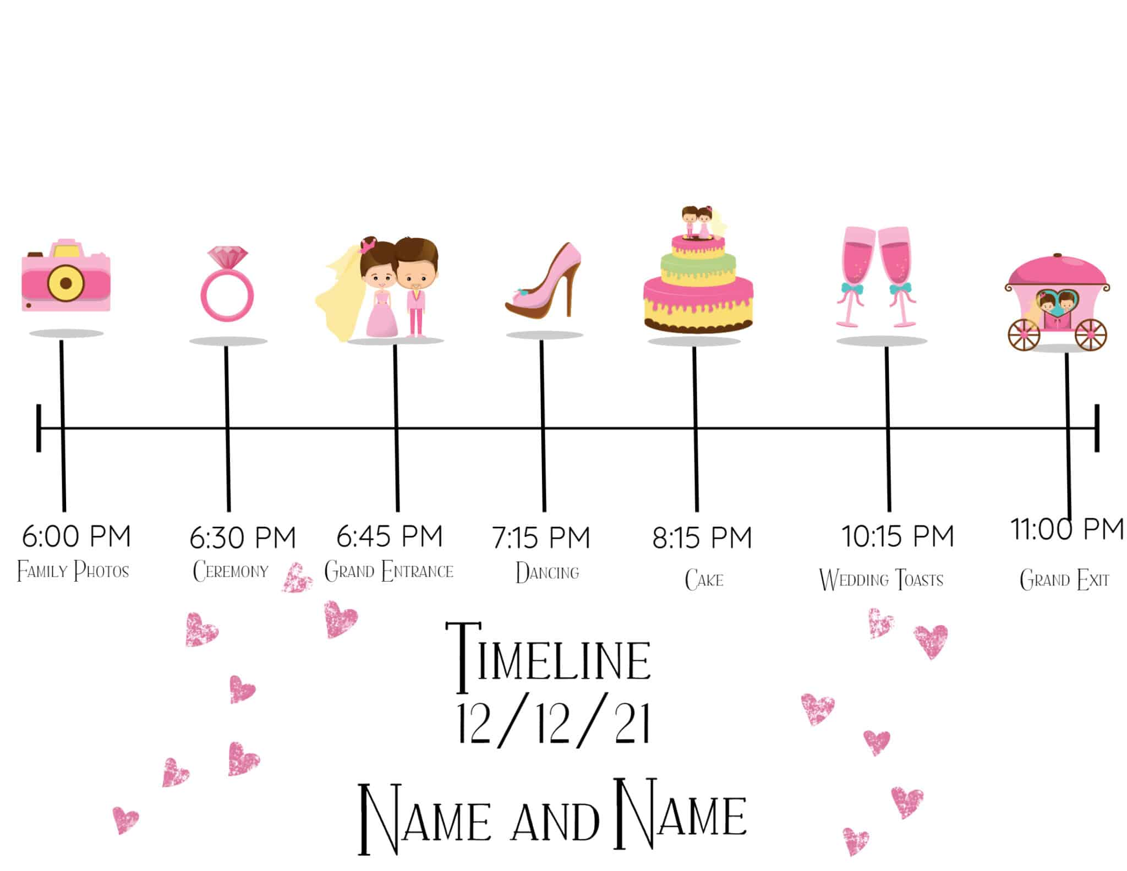
A timeline shows events, people or objects in chronological order. A timeline can show different periods of time, from a few years to millions of years.

Slide 7
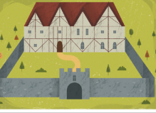
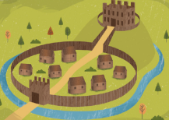
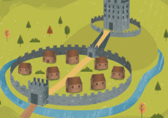
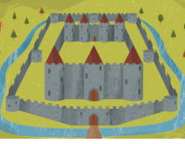
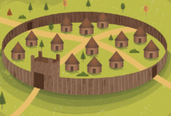
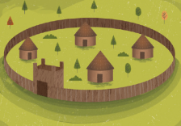
In groups, look at the pictures of castles through time and place them in order from oldest to newest.

Slide 8

Now watch this video clip to see if you were right :
Castles through the ages - YouTube

Slide 9

This is the correct order :

Slide 10
Now create your own timeline in your topic books .
Go across the top of two pages.
Use the information sheet to add the dates underneath.
Challenge - answer these questions underneath your timeline:
Why were the early castles built on hills?
Why were walls and ditches built around castles?
Why were castles later built of stone?
How did drawbridges give extra protection?
Why did walls have towers in them?

