Slide 1
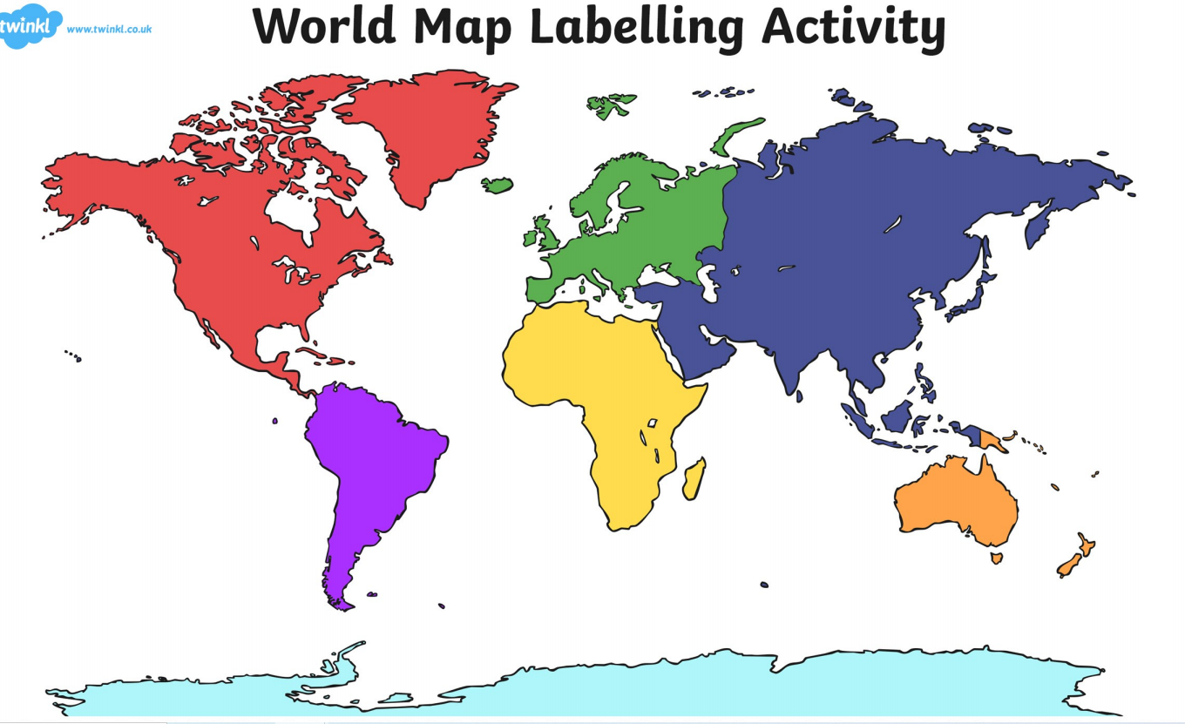

Quick Quiz : Sing the oceans of the world song
Five Oceans Song - YouTube

Slide 2
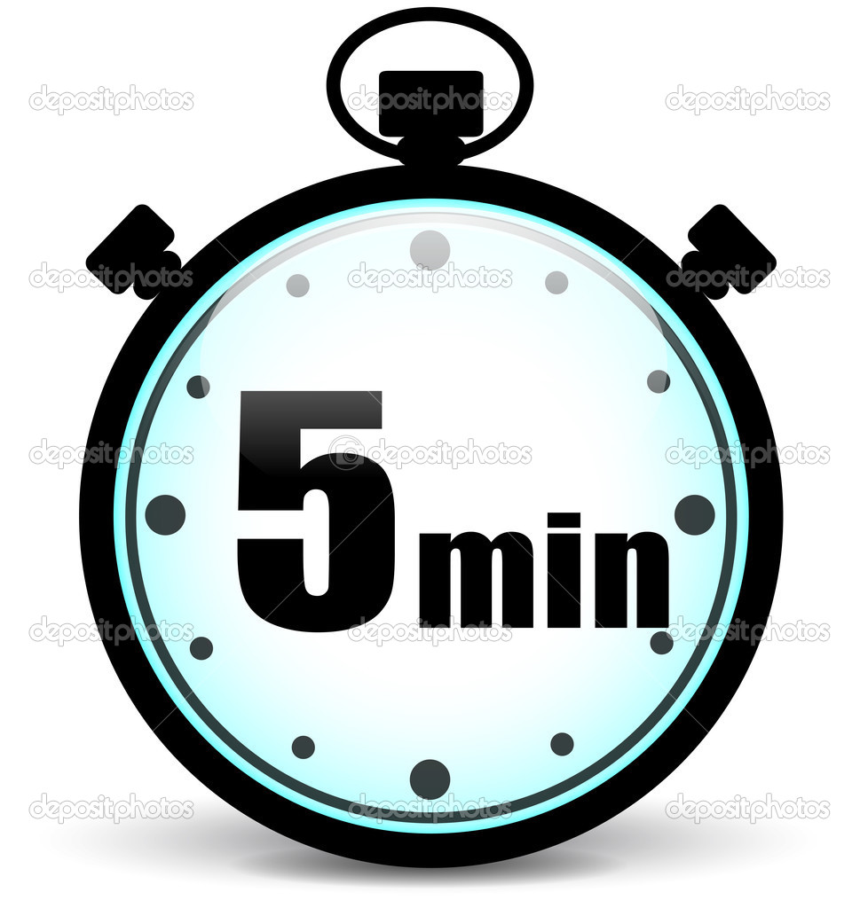
You have 5 minutes to label the oceans of the World correctly. Good luck!

Slide 3
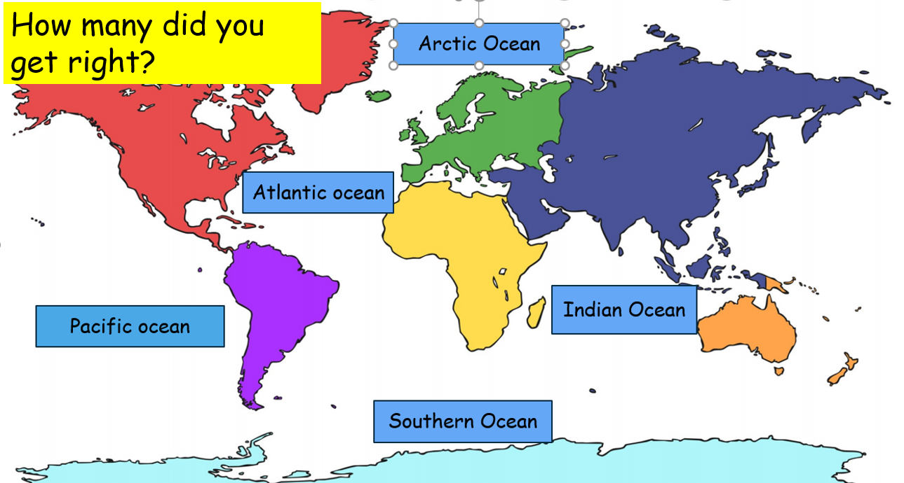

Slide 4
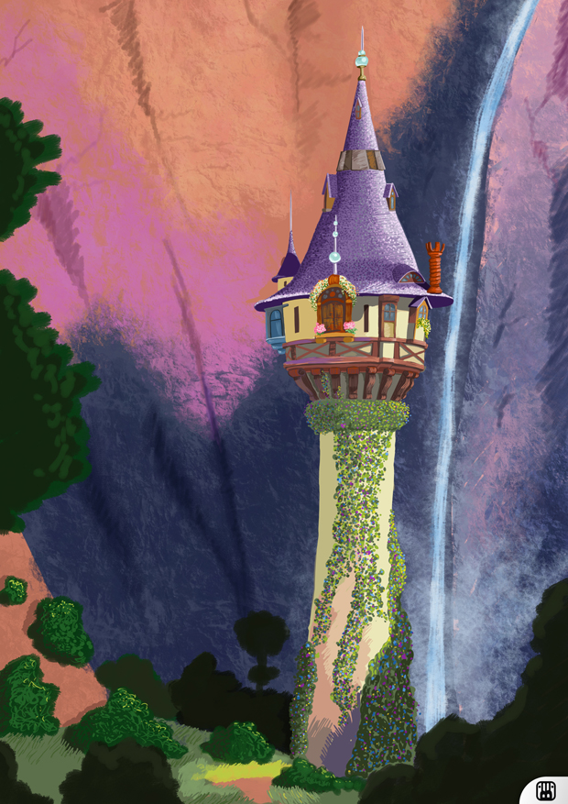
WALT – Explore how a structure can be made stronger, stiffer or more stable.
WILF- Using a range of construction kits such as Lego, K’nex or wooden blocks, I can build a strong tower for Rapunzel that will keep her safe.

Slide 5
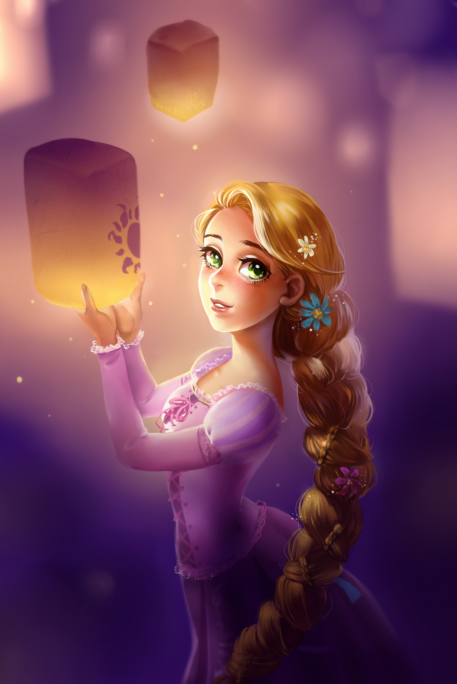
Watch this video clip from the Tangled film, based on the story of Rapunzel.
Look at the tower in the clip-does it look strong and stable? How could you build a stronger, more stable tower? What would it need?
Tangled - Official Trailer 2 - Bing video
This Photo by Unknown Author is licensed under CC BY-SA-NC

Slide 6
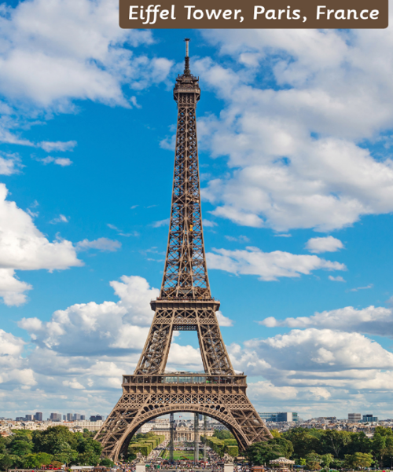
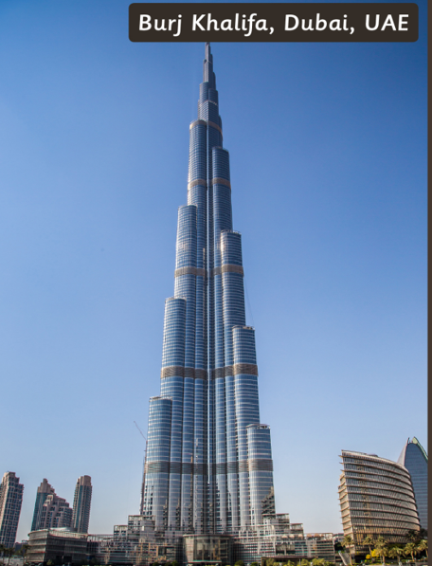
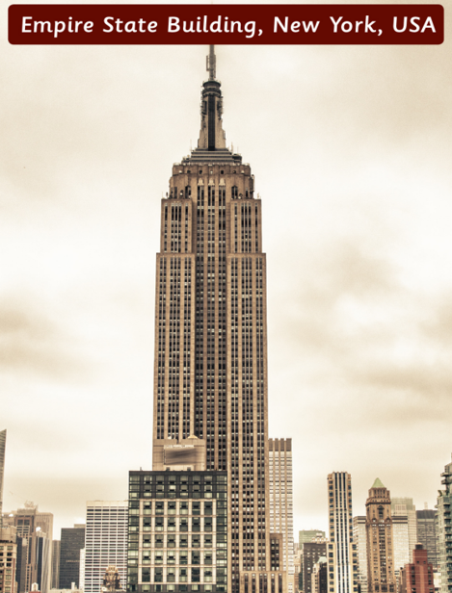
Think about real-life towers you have seen.
How did the engineers make sure they are strong and stable?

Slide 7
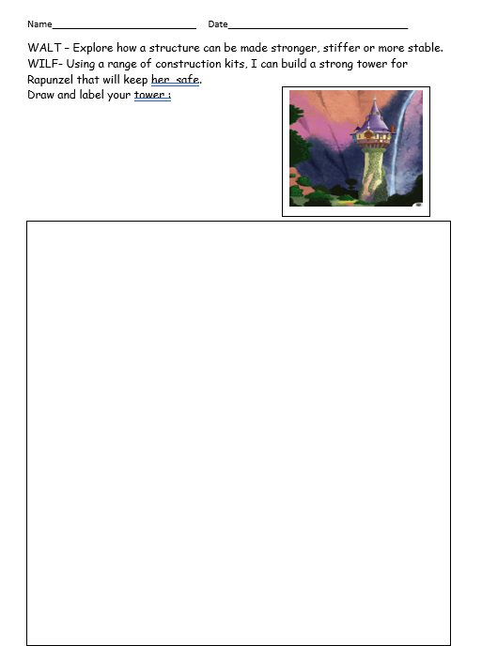
Now plan you tower with your group :
Decide which materials you will use.
Draw and label your tower – the base, the windows, the roof.

