Slide 1
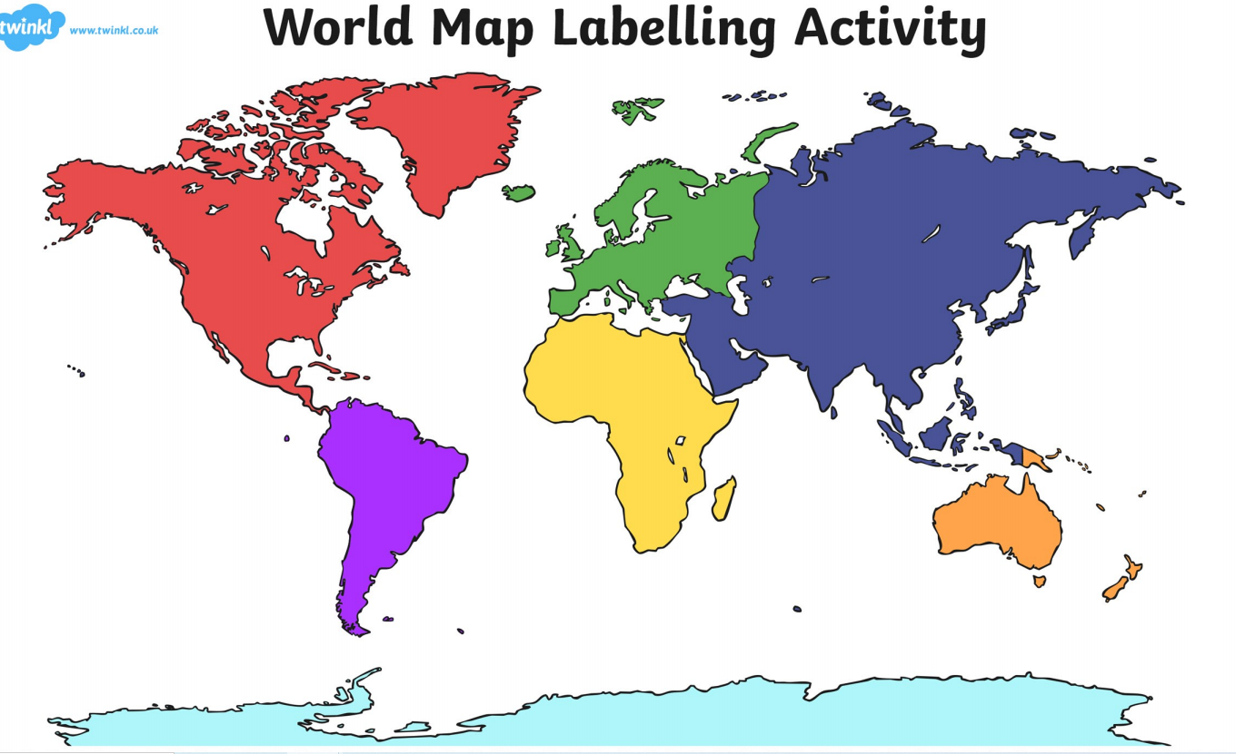
Quick Quiz : Sing the Oceans of the World Song
Five Oceans Song - YouTube

Slide 2
Are these labels correct?
Indian
Pacific
Arctic
Atlantic
Southern

Slide 3
Challenge : Create an army of ants!
Antz - Trailer - YouTube

Slide 4
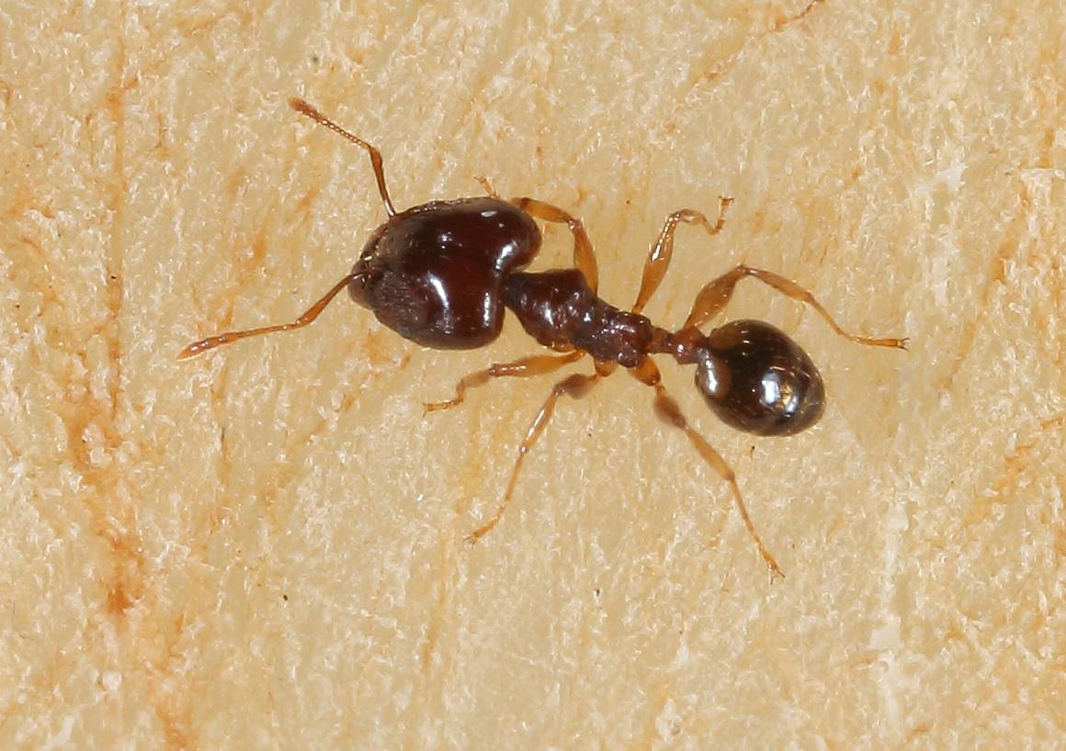
WALT -
WILF – I can choose the best materials and techniques to develop an idea.
The idea: Create a 3d ant. You can choose from :
Pipe cleaners
Egg boxes
Masking tape
Hole punch
Brown paint
Together we can create an army of ants!
Use different materials to design and make products.

Slide 5
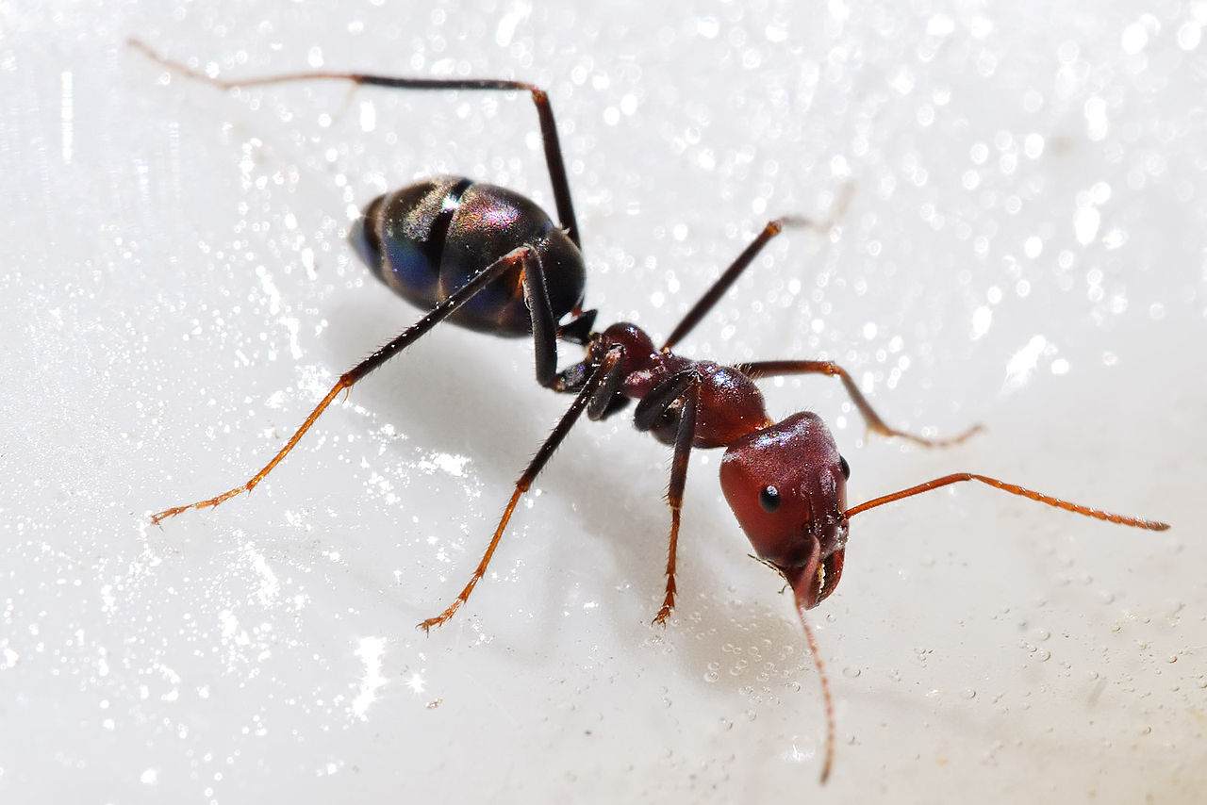
Look very closely at this ant.
How many legs can you count?

Slide 6
Yes six legs!
So what are the two parts on it’s head called?

Slide 7
That’s right!
It has two antennae.
How many body parts can you see?

Slide 8
Yes it has three body parts :
head
thorax
abdomen

Slide 9
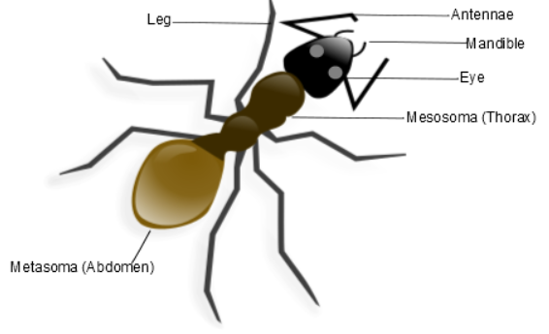
Have you noticed that all the legs are attached to the thorax?
The mandibles are part of the mouth and are for biting,
cutting or chewing food.
An ant also has two eyes.

Slide 10
Remember we have:
Pipe cleaners
Egg boxes
Masking tape
Hole punch
Brown paint
What do you think we could use for the legs and antennae ?
The head, thorax and abdomen?
How would we attach the legs and antennae to the body parts?
What do you think the brown paint is for?

Slide 11
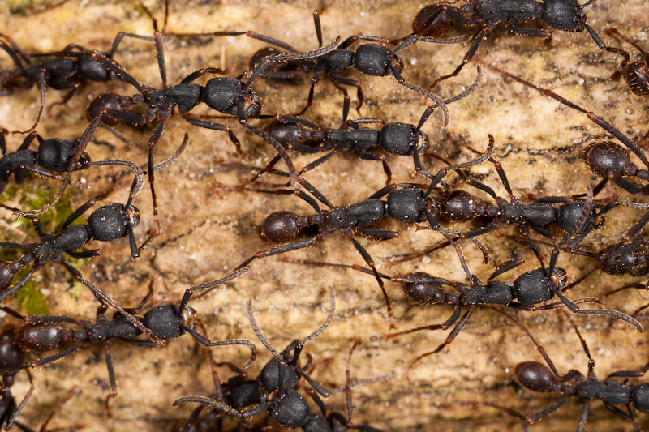
Challenge- create mandibles and eyes as well.
Find something in your classroom that you could use.
This Photo by Unknown Author is licensed under CC BY-NC-ND

