Slide 1
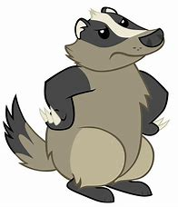
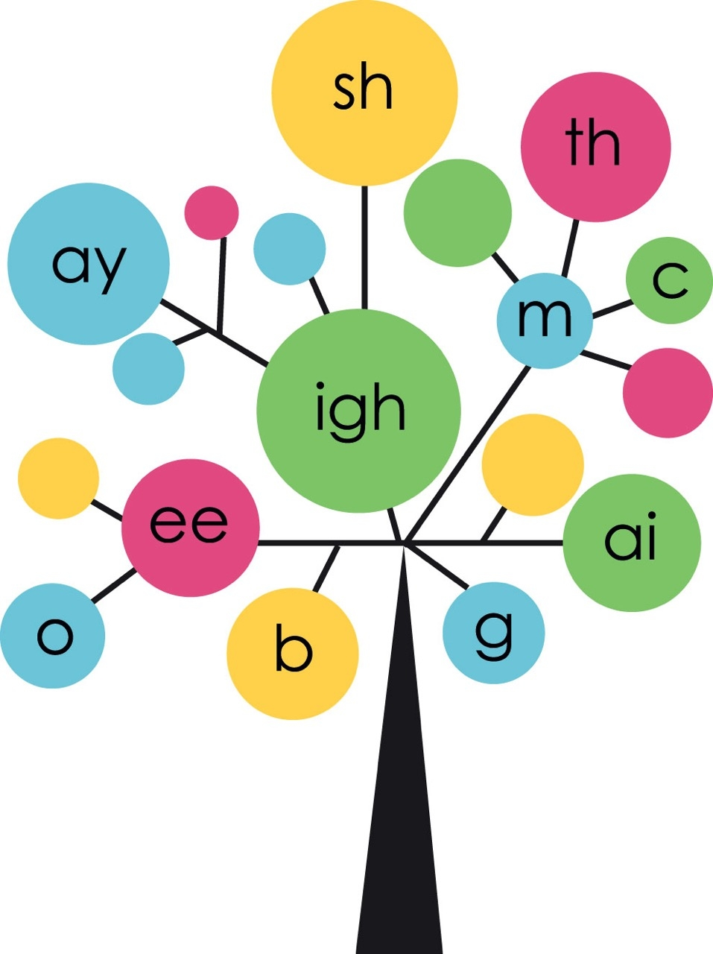
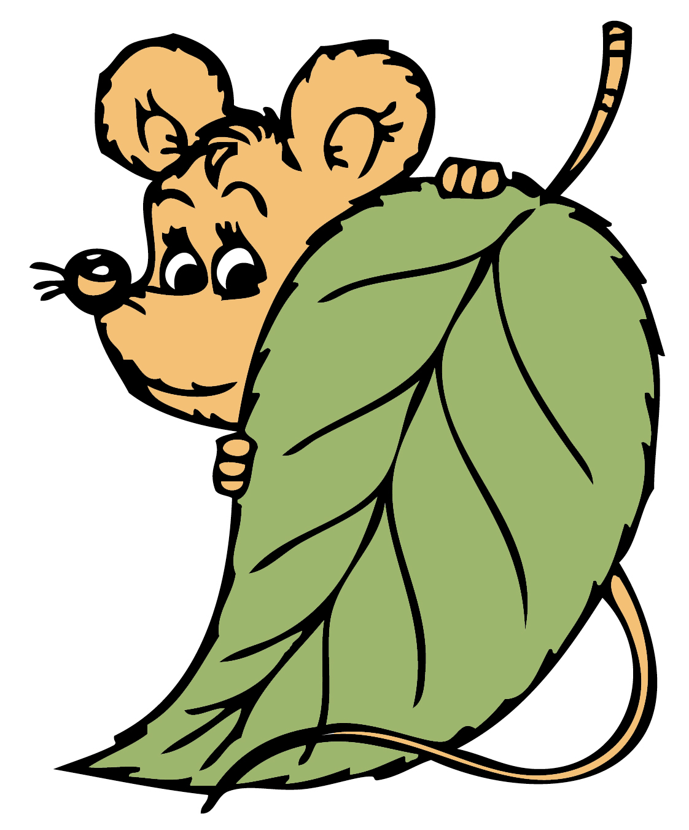
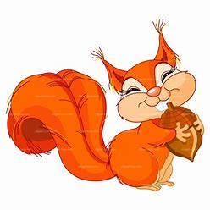

Year 2
Phonics
Past Tense
Use Phonicsplay and games to print out if time allows to support sounds being taught

Slide 2

Monday
Play Phoneme Spotter. Read the Phoneme Spotter text as a class
Alternative Spellings /ai/ (phonicsplay.co.uk)
Write down all the different ways that you find in your phonics books.
How many did you spot?
ay ea a-e a ai eigh ey

Slide 3
Monday
We are going to learn about the past tense. Some words change completely.
Write the matching pairs in your book.
go looked
come said
look came
say went

Slide 4
Monday
Finish the sentences and change it to past tense
Today Yesterday
I go to the park. I……
We come to school. We ……
You say jump. You…..

Slide 5

Tuesday
Play Word Sort as a class
Alternative Spellings /ai/ (phonicsplay.co.uk)
Write down a word for each spelling
ay ea a-e a ai eigh ey

Slide 6
Tuesday
-ed
Read these words together. Say each one in the past tense too. Write the words in your book.
Can you add -ed?
jump walk ask play
turn want wash sort

Slide 7
Tuesday
Finish the sentences and change it to past tense
Today Yesterday
I walk slowly. I …..
I jump high. I …
I wash my hands. I…

Slide 8
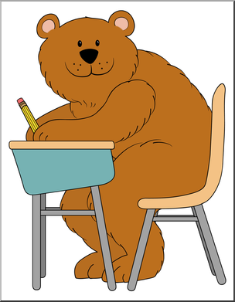
Wednesday
Can you read these words?
Can you spot any digraphs?
Mrs Mr hour parents
Everybody every whole who

Slide 9

Wednesday
How well do you know these words?
today was are
you my they

Slide 10
Wednesday
Today we are going to write the words we sent home for you to learn. You can choose to write the whole sentence or just the words.
I am happy _____.
I ___ outside.
Where ___ we?
Thank ___.
This is __ book.
____ want it!

Slide 11

Play Best Bet as a class
Alternative Spellings /ai/ (phonicsplay.co.uk)

Slide 12
Thursday
-ed
Read these words together. Say each one in the past tense too. Write the words in your book.
Can you add -ed?
if the word has 1 syllable, 1 vowel and it ends in 1 consonant, you double the final consonant before you add -ed
beg hum rob jog rub

Slide 13
Thursday
Finish the sentences and change it to past tense
Today Yesterday
I drop the ball. I …..
I hug my mum. I …
I shop for sweets. I…

Slide 14
Friday
Play Phonics Play Past Tense Penguins
Past Tense Penguins (phonicsplay.co.uk)

Slide 15
Friday
Add –ed to words already end in ‘e’.
Drop it and add -ed
trade traded
rate rated
hope hoped
love loved

Slide 16
Friday
Finish the sentences and change it to past tense
Today Yesterday
I love my dog. I …..
I arrange the books. I …
I smile at my friend. I…

