Slide 1
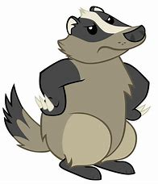
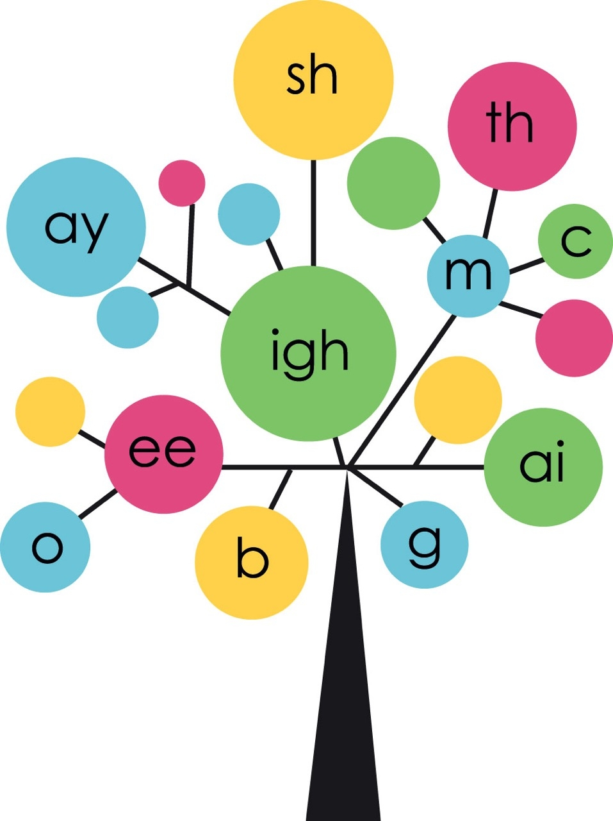
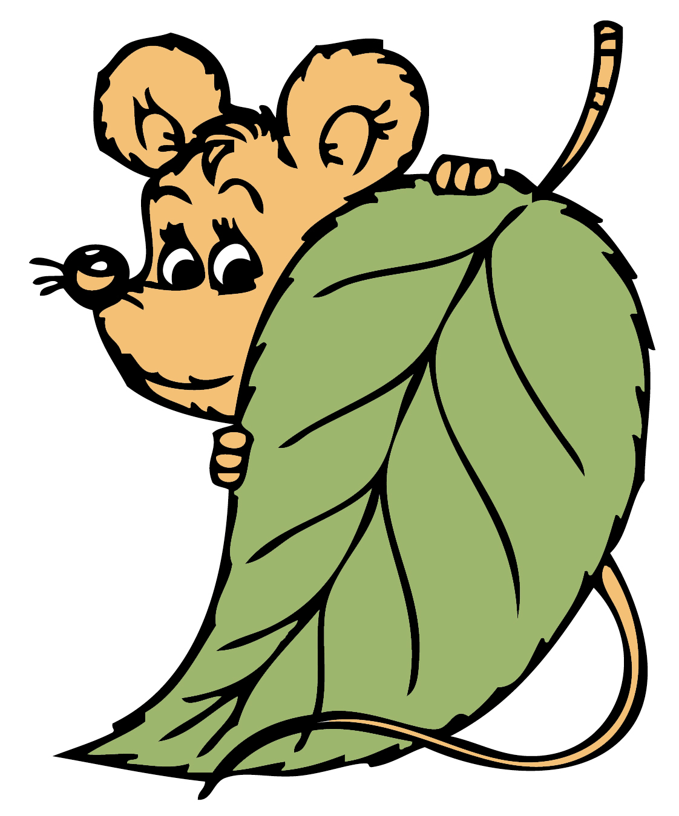
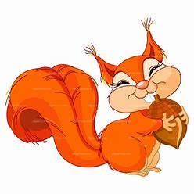
Year 2
Phonics
We are learning about adding un- to words
Use Phonicsplay and games to print out if time allows to support sounds being taught

Slide 2

Monday
Play Phoneme Spotter. Read the Phoneme Spotter text as a class
Alternative Spellings /or/ (phonicsplay.co.uk)
Write down all the different ways that you find in your phonics books.
How many did you spot?
au aw al a or aught ough our

Slide 3
Monday
We are learning about prefixes words.
Listen to the words. The prefix can change the meaning of a word.

Slide 4
Monday
.
What does adding the prefix un- do to a word?
It makes the word mean the opposite.
Click the slide to reveal the answer!
Can you add the prefix un- to these words?
safe happy tidy kind locked

Slide 5
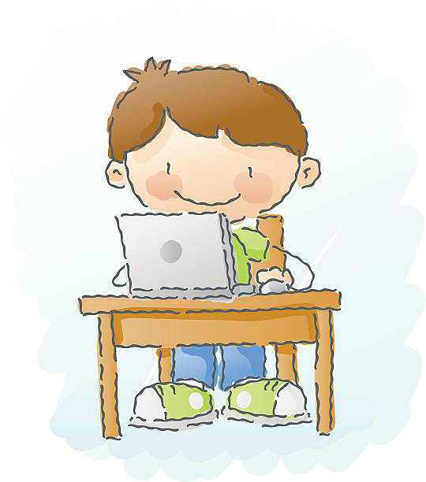
Tuesday
Play Word Sort as a class
Alternative Spellings /or/ (phonicsplay.co.uk)
Write down a word for each spelling
au aw al a or aught ough our

Slide 6
Tuesday
Adding the prefix un- English - Learning with BBC Bitesize - BBC Bitesize
Can you get all the answers right to this quiz.

Slide 7
Tuesday
Write the words in your books or on whiteboards. Remember to add un-
afraid excited
helpful clean
lucky hurt

Slide 8
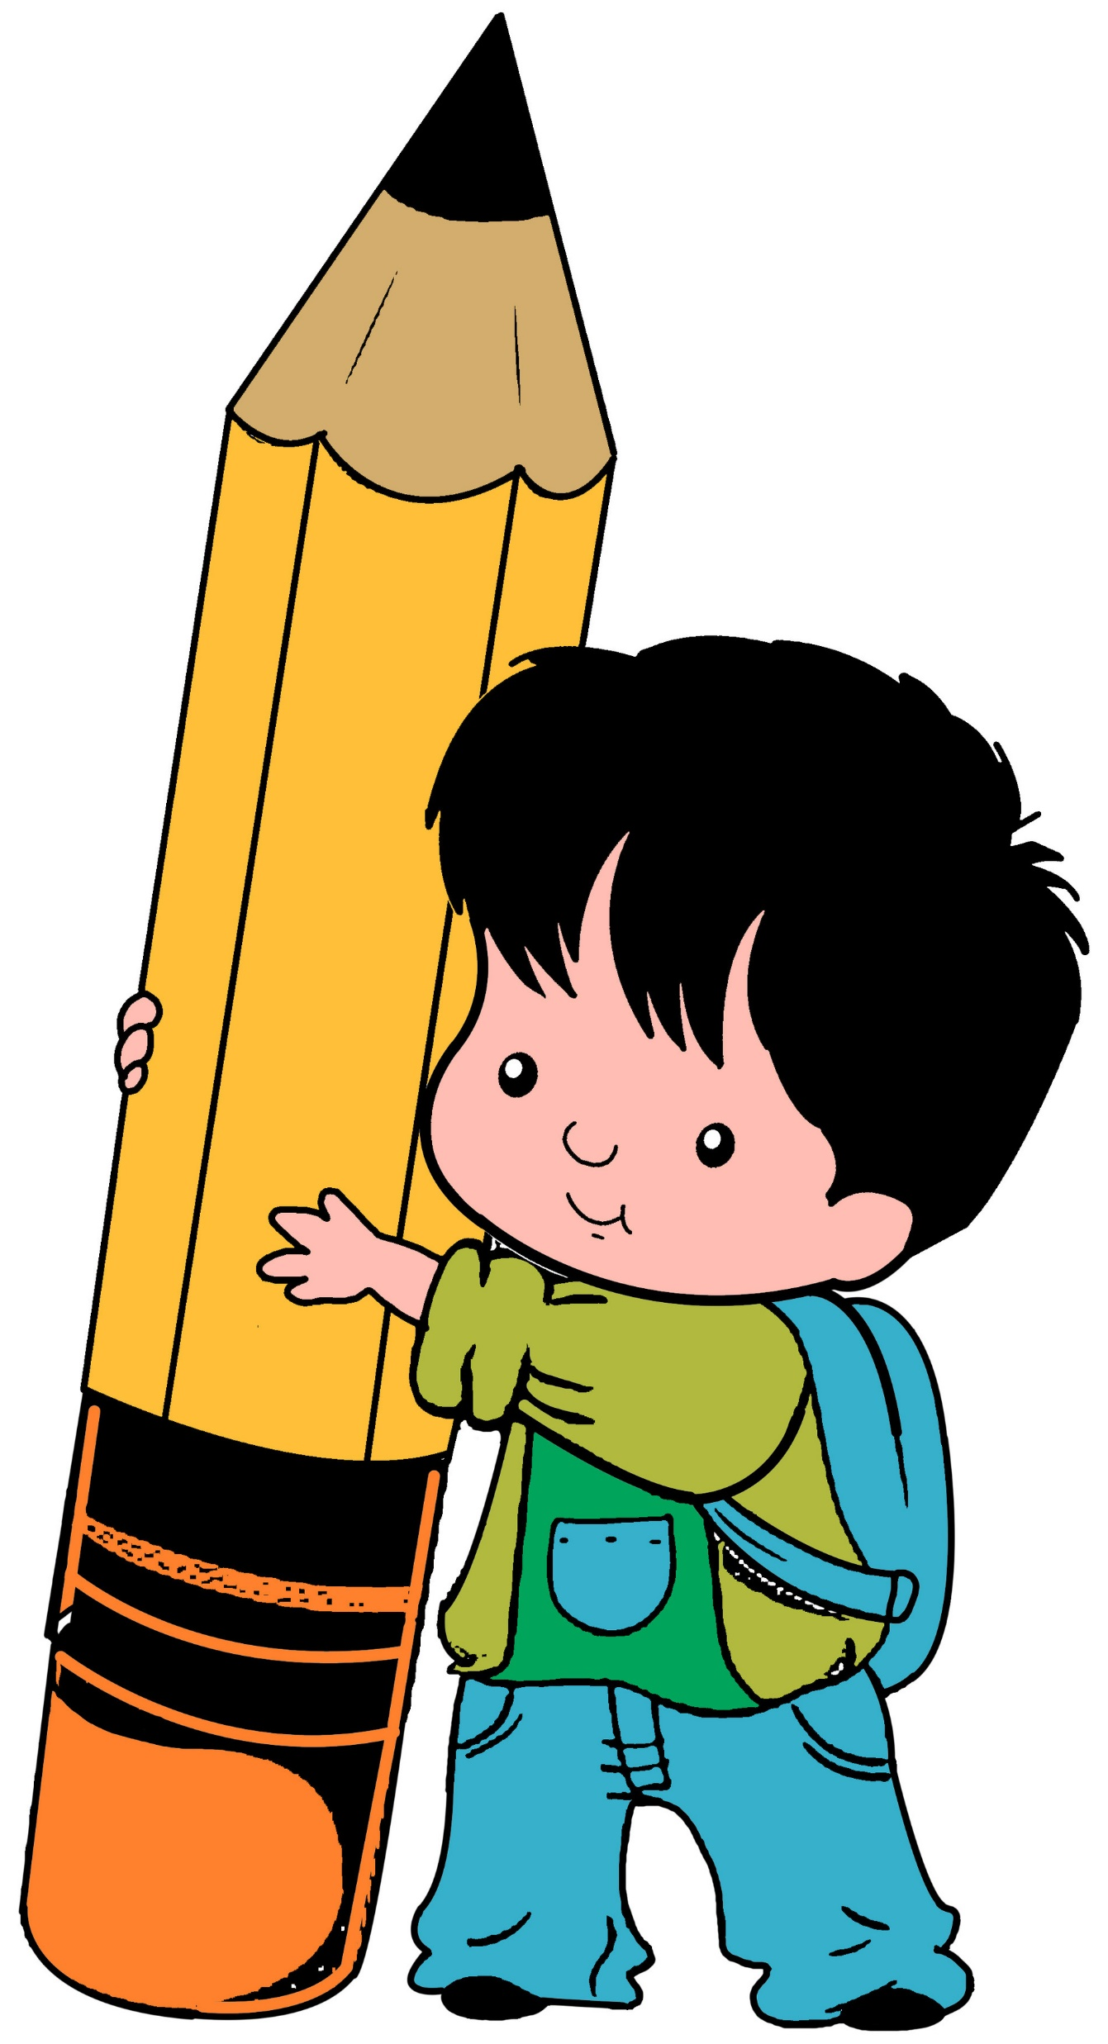
Wednesday
Can you read these words?
Can you spot any diagraphs?
pass grass past last
fast father again water

Slide 9
Wednesday
How well do you know these words?
money butterfly elephant
busy dinosaur peacock

Slide 10
Wednesday
Today we are going to write the words we sent home for you to learn. You can choose to write the whole sentence or just the words.
I have lots of _____
A beautiful _______
An enormous _______
The _______ is big
We are keeping ____
See the tail on the ______

Slide 11

Thursday
Play Best Bet as a class
Alternative Spellings /or/ (phonicsplay.co.uk)
au aw al a or aught ough our

Slide 12
Thursday
Can you take off the prefix un- to change the meaning?
Unloved
Unseen
Unsolved
Undo
Untie

Slide 13
Thursday
Make two sentences for the words. Add un-. One is done for you.
tie
Untie the shoe lace. Tie up the string
unable untidy unknown uncover
.

Slide 14
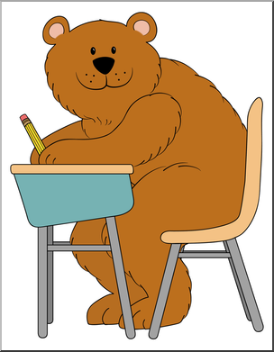
Friday
Compound Word Splat (phonicsplay.co.uk)
Text 3

Slide 15
Friday
KS1 English: Prefixes and Suffixes with Monty Mole - BBC Teach
Get Moving!

Slide 16
Friday
Make two sentences for the words. Just like yesterday, but this time add the un-.
fit happy made worn

