Slide 1
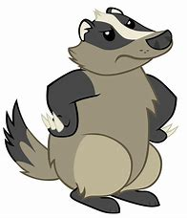
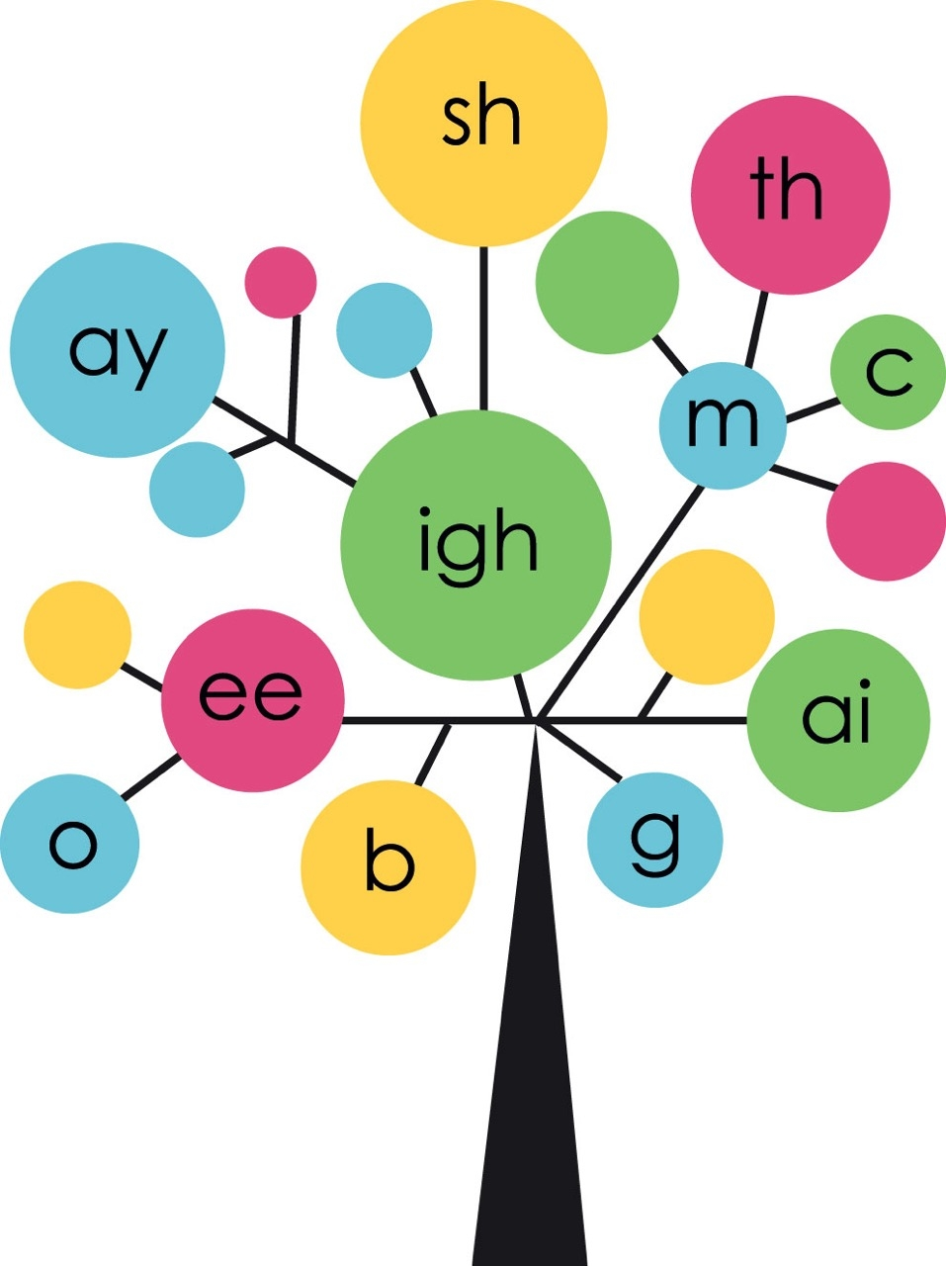
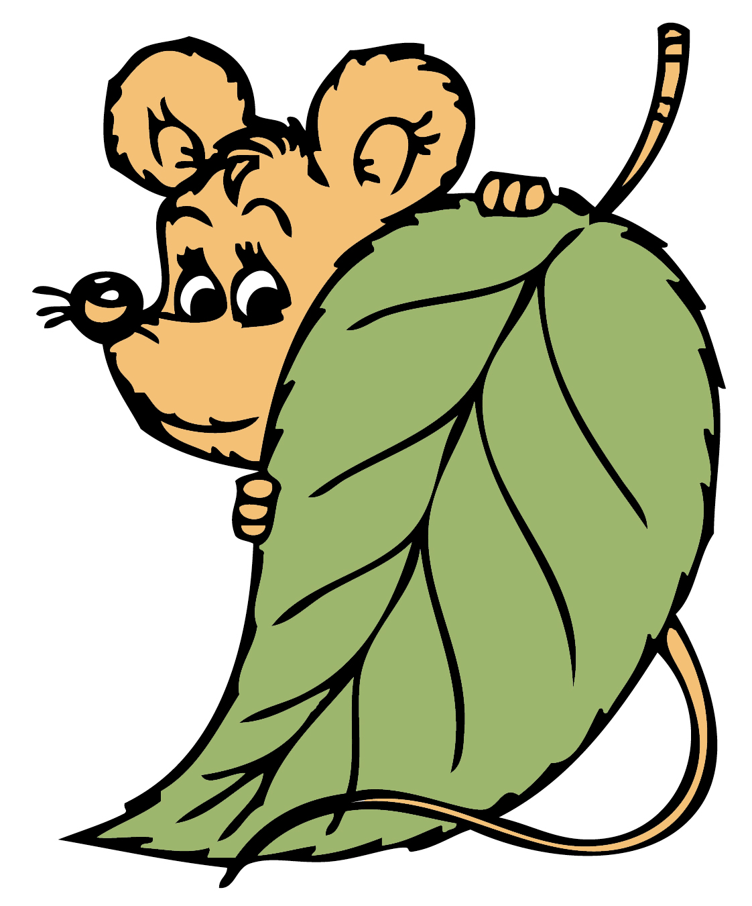
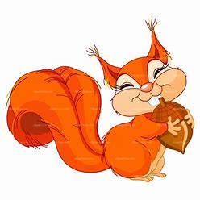

Year 2
Phonics
Adding -ing
Use Phonicsplay and games to print out if time allows to support sounds being taught

Slide 2

Monday
Play Phoneme Spotter. Read the Phoneme Spotter text as a class
Alternative Spellings /ee/ (phonicsplay.co.uk)
Write down all the different ways that you find in your phonics books.
How many did you spot?
ee e y ea ie ey

Slide 3
Monday
We are going to learn about adding -ing
Write the matching pairs in your book.
go walking
walk saying
look going
say looking

Slide 4
Monday
Finish the sentences, change it and add -ing
I go to the park. I am
We learn at school. We are
You jump. You are

Slide 5

Tuesday
Play Word Sort as a class
Alternative Spellings /ee/ (phonicsplay.co.uk)
Write down a word for each spelling
ey ee e y ea ie

Slide 6
Tuesday
-ing
Read these words together. Say each one by adding –ing too. Write the words in your book.
Can you add -ing?
jump walk ask play
turn want wash sort

Slide 7
Tuesday
Finish the sentences and change it by adding -ing
We walk slowly. We are …
You jump high. You are …
I wash my hands. I am …

Slide 8
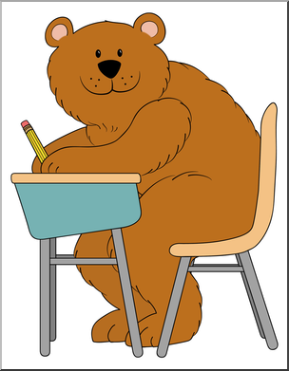
Wednesday
Can you read these words?
Can you spot any diagraphs?
Mrs Mr hour parents
Everybody every whole who

Slide 9

Wednesday
How well do you know these words?
jumped wanted hopped
jogged smiled loved

Slide 10
Wednesday
Today we are going to write the words we sent home for you to learn. You can choose to write the whole sentence or just the words.
I _____ up.
I ______ a dog.
We ______ around.
You ______ to the shop.
We ______ at each other.
I _____ my cat.

Slide 11

Play Best Bet as a class
Alternative Spellings /ee/ (phonicsplay.co.uk)

Slide 12
Thursday
-ing
Read these words together. Say each one with –ing too. Write the words in your book.
Can you add -ing?
Short vowel, double the consonant then add -ing.
beg hum rob jog rub

Slide 13
Thursday
Finish the sentences and change it by adding -ing
We run with a ball. We are …
I hug my mum. I am …
You shop for sweets. You are …

Slide 14
Friday
Play Phonics Play Tumbling Tumbleweed
Tumbling Tumbleweeds (phonicsplay.co.uk)

Slide 15
Friday
Add –ing to words already end in ‘e’.
Drop it and add -ing
trade trading
rate rating
hope hoping
love loving

Slide 16
Friday
Finish the sentences and change it by adding -ing
You love my dog. You are …
I arrange the books. I am …
We smile at my friend. We are …

