Slide 1
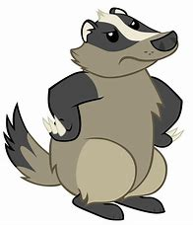
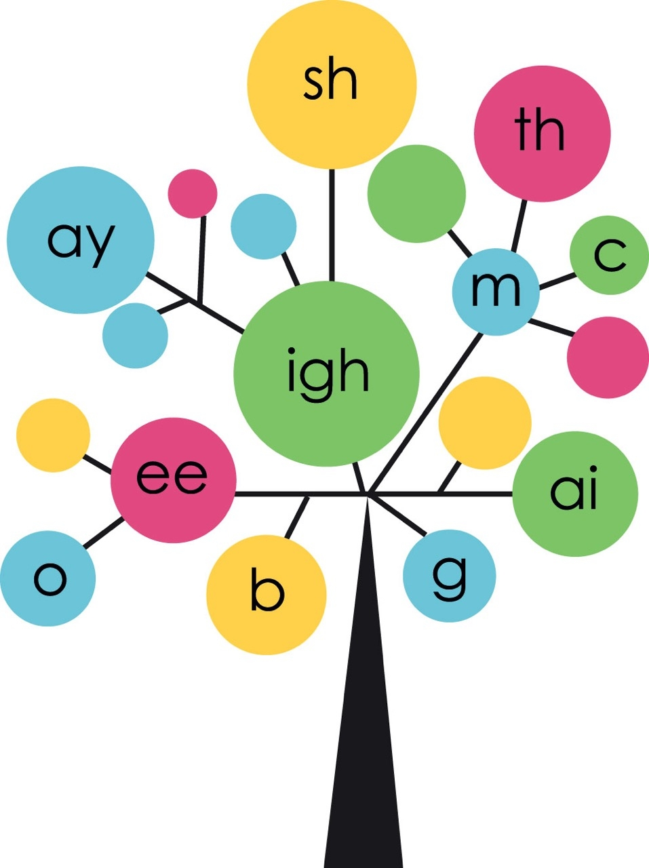
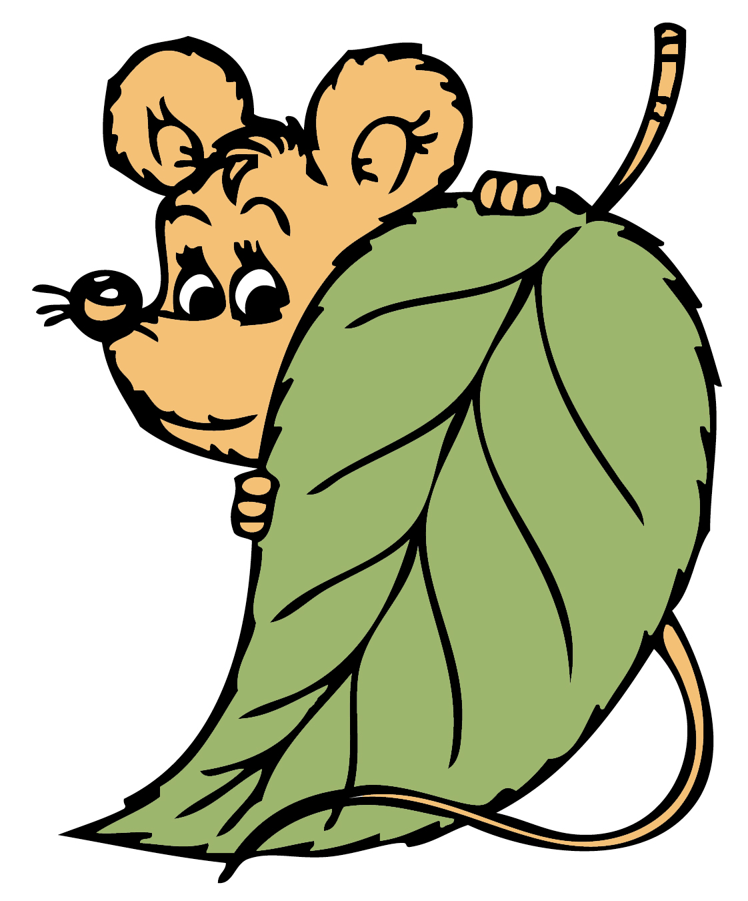


Year 2
Phonics
Adding – ful and -ly
Use Phonicsplay and games to print out if time allows to support sounds being taught

Slide 2

Monday
Play Phoneme Spotter. Read the Phoneme Spotter text as a class
Phoneme Spotter (phonicsplay.com)
Write down all the different ways that you find in your phonics books.
How many did you spot?
ow oe oa ough o_e o

Slide 3
Monday
We are going to learn about adding –ful
Write the matching pairs in your book.
              wonder playful
                care painful
                play wonderful
                pain careful

Slide 4
Monday
Finish the sentences, by changing the noun to an adjective by adding –ful
She cares for her things because she is…
I like to play with my friend because I am…
We help my teacher because we are…

Slide 5
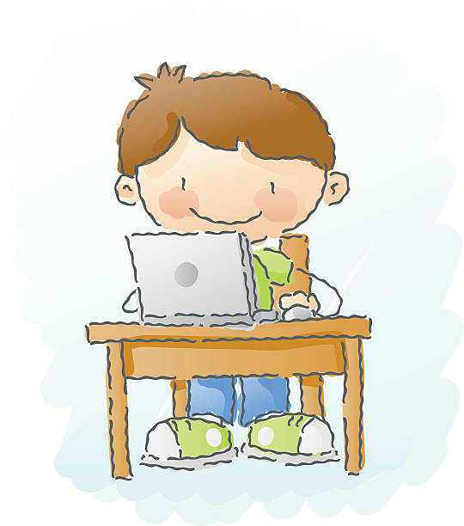
Tuesday
Play Word Sort as a class
Phoneme Spotter (phonicsplay.com)
Write down a word for each spelling
ow oe oa ough o_e o

Slide 6
Tuesday
Add –ly to adjectives to make adverbs
Write the matching pairs into your books
sad lately
bright sadly
late brightly
happy happily
What is different about this?

Slide 7
Tuesday
Write sentences for these words by changing them into adverbs ending in –ly
quick She walked quickly.
loud We talk…
fair He won …
love Your smile is…

Slide 8
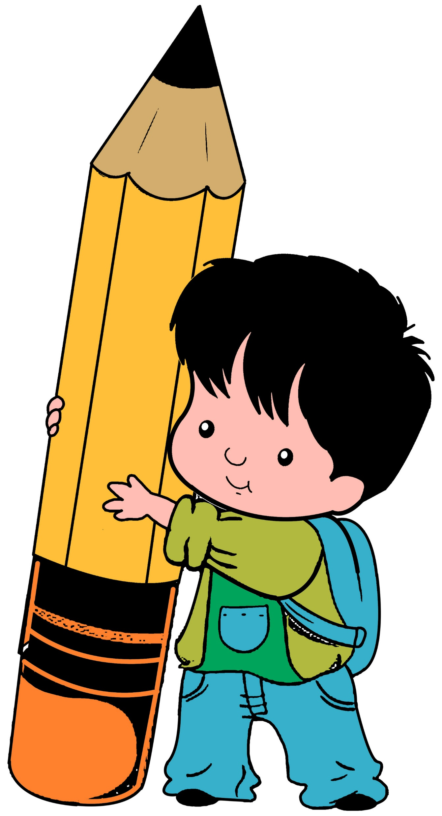
Wednesday
Can you read these words?
Can you spot any diagraphs?
should house only many
another know said looking something

Slide 9
Wednesday
How well do you know these words?
Faster darkest braver
closest thinner biggest
happier heaviest

Slide 10
Wednesday
Today we are going to write the words we sent home for you to learn. You can choose to write the whole sentence or just the words.
She is ______ than me.
It is ______ at night.
The knight is _____ braver than the cook.
My house is ______ to school.
My pencil is _____ than yours.
That van is the _____ I have seen!
I am ____ with my friends.
Your bag is the ____.

Slide 11

Thursday
Play Compound word splat as a class
Compound Word Splat (phonicsplay.com)

Slide 12
Thursday
-ful and -ly
Read these words together. Add –ly onto the words ending in –ful from Monday.
Say each one and write the words in your book.
wonderful wonderfully
careful carefully
playful playfully
painful painfully

Slide 13
Thursday
Finish the sentences and change them by adding –ful and –ly onto each word
The man jumped joyfully.
She help___ closed the door.
I cheer___ laughed.
We ran play___.

Slide 14
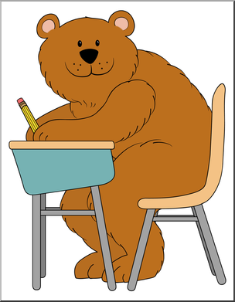
Friday
Play Compound Word Splat as a class
Compound Word Splat (phonicsplay.com)

Slide 15
Friday
Adverbs can be put at the beginning, middle, or end of a sentence. Read these sentences, find the adverb then rearrange the sentence.
I quietly put my books away.
We put on our shoes quickly.
She finally finished her homework.
Carefully, Sam washed the car.

