Slide 1

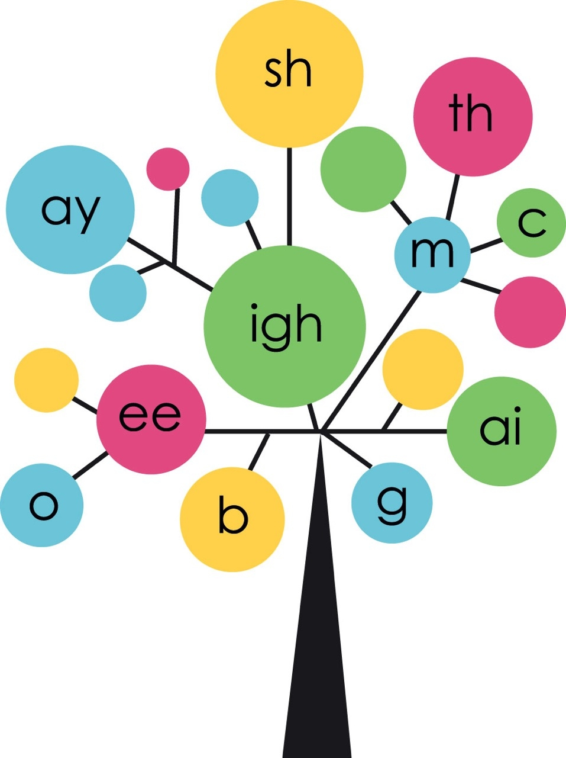

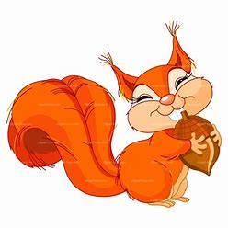

Year 2
Phonics
Adding –er / -est
Use Phonicsplay and games to print out if time allows to support sounds being taught

Slide 2

Monday
Play Phoneme Spotter. Read the Phoneme Spotter text as a class
Alternative Spellings /igh/ (phonicsplay.co.uk)
Write down all the different ways that you find in your phonics books.
How many did you spot?
igh i y ie i_e eye

Slide 3
Monday
We are going to learn about adding –er and -est
Write the matching pairs in your book.
full darker fastest
fast fuller darkest
dark faster fullest

Slide 4
Monday
Finish the sentences, change it and add –er or -est
It is bright. She is strong.
This is …. They are…
That is the…. We are the….

Slide 5

Tuesday
Play Word Sort as a class
Alternative Spellings /igh/ (phonicsplay.co.u
Write down a word for each spelling
igh i y ie i_e eye

Slide 6
Tuesday
Add –er/ -est to words already end in ‘e’.
Drop it and add -er/est
nice closer wisest
wise nicer closest
close wiser nicest

Slide 7
Tuesday
Finish the sentences and change it by adding –er/ est
Your car is wide but my car is…
My house is large but my school is…
We are brave but my dad is the…

Slide 8
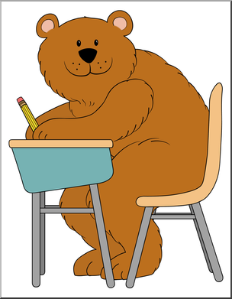
Wednesday
Can you read these words?
Can you spot any diagraphs?
Can you spot any suffixes?
oh their people looked
called asked could again

Slide 9

Wednesday
How well do you know these words?
walking saying jumping
playing humming begging

Slide 10
Wednesday
Today we are going to write the words we sent home for you to learn. You can choose to write the whole sentence or just the words.
What is he _____?
We are______ my dog.
Mr Smith was ______ loudly.
I am ______ with my toys.
The dog was ______.
She was _____ up and down.

Slide 11

Thursday
Play Best Bet as a class
Alternative Spellings /igh/ (phonicsplay.co.uk)

Slide 12
Thursday
-er -est
Read these words together. Say each one with –er then /est too. Write the words in your book.
Can you add –er and -est?
Short vowel, double the consonant then add –er / -est.
big red sad thin

Slide 13
Thursday
Finish the sentences and change it by adding –er or -est
I am big. She is bigger. He is the biggest.
She is fit. He is… I am the…
It is wet. That is… This is the…

Slide 14
Friday
Play Phonics Play
Look to identify compound words
Compound Word Splat (phonicsplay.co.uk)

Slide 15
Friday
When a word ends in y, it changes to i.
Then add –er/ -est
happy earlier dizziest
dizzy happier earliest
early dizzier happiest

Slide 16
Friday
Finish the sentences and change it by adding –er or –est
(don’t forget to change y to i)
This paint is dry. This paint is….
These boxes are heavy. That box is the….
My cushion is fluffy. My cushion is….

