Slide 1
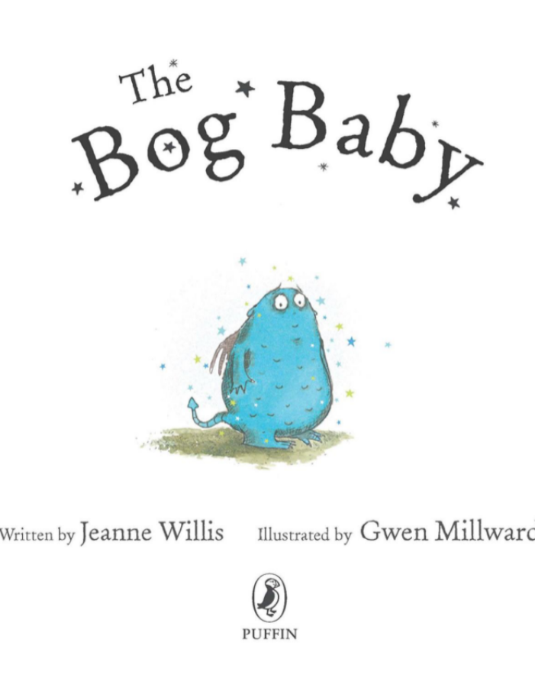

4.4.22

Slide 2
Session 1
WALT - - Read aloud books closely matched to their improving phonic knowledge.
Discuss the sequence of events in books.

Slide 3
Recap what has happened so far in ‘The Bog Baby’.
Read the whole story on the
slides or the book.
Share the tricky words on the next slide.

Slide 4
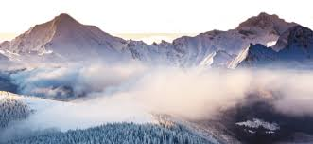
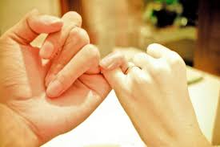
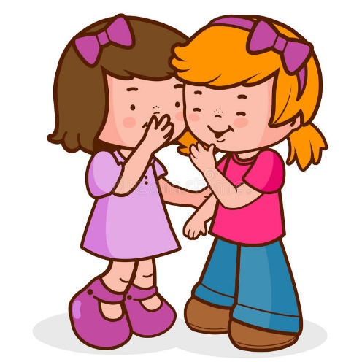
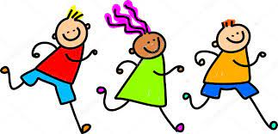
Tricky Words
misty
promised
blabbed
followed

Slide 5
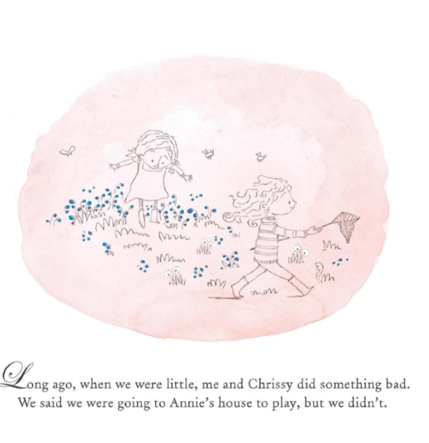

Slide 6
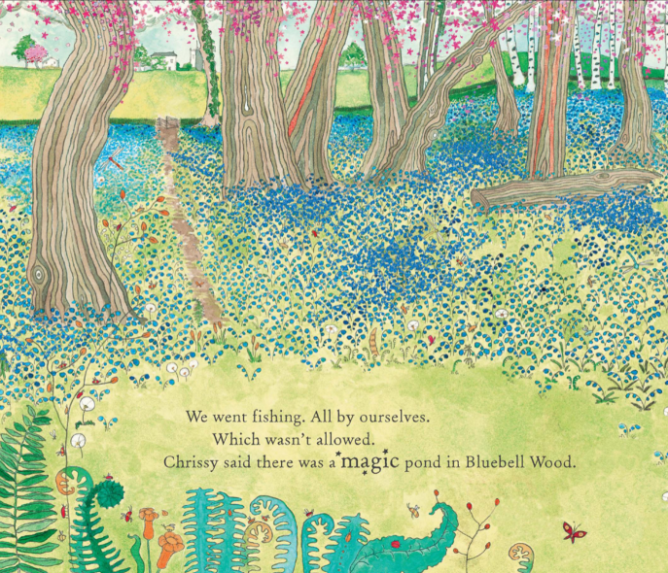

Slide 7
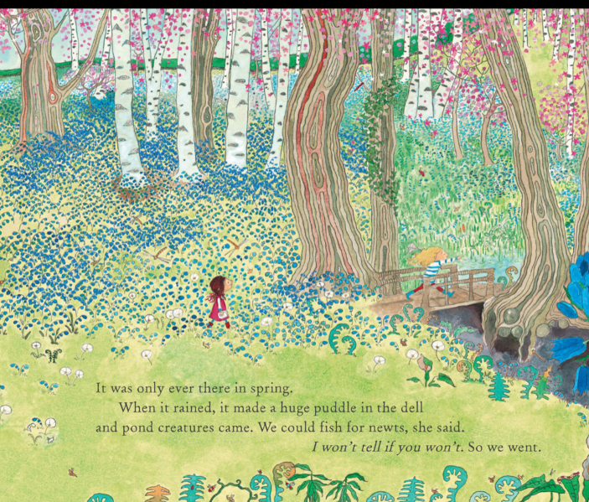

Slide 8
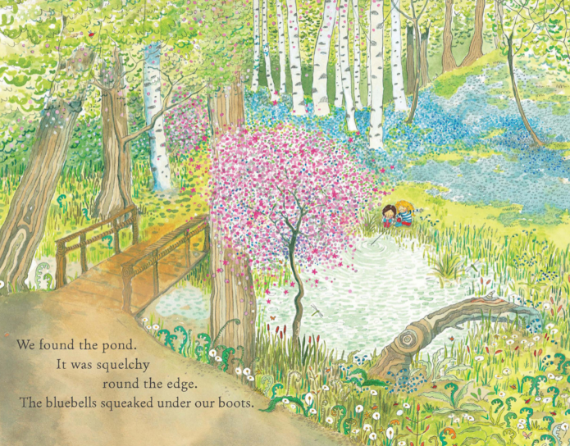

Slide 9
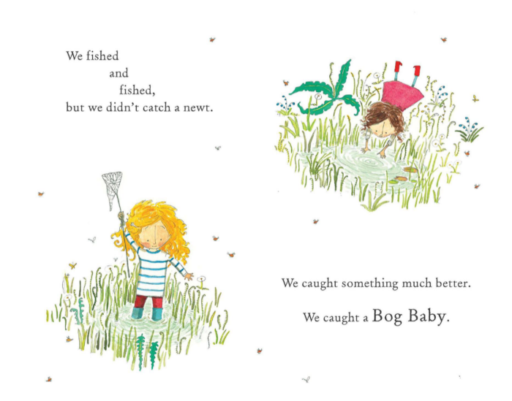

Slide 10
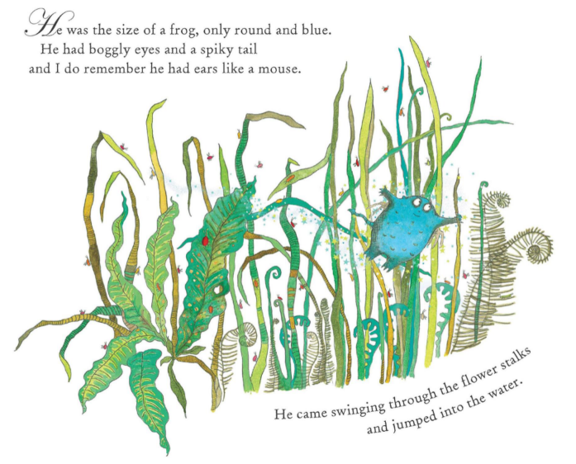

Slide 11
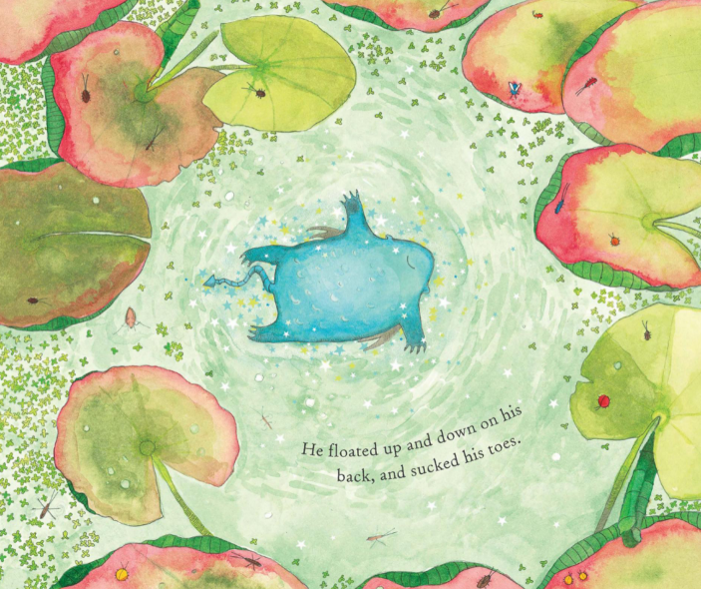


Slide 12
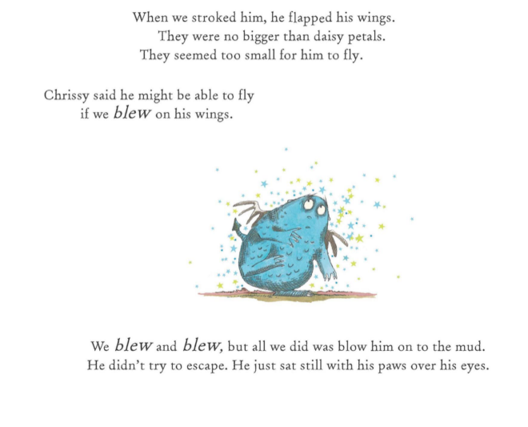

Slide 13
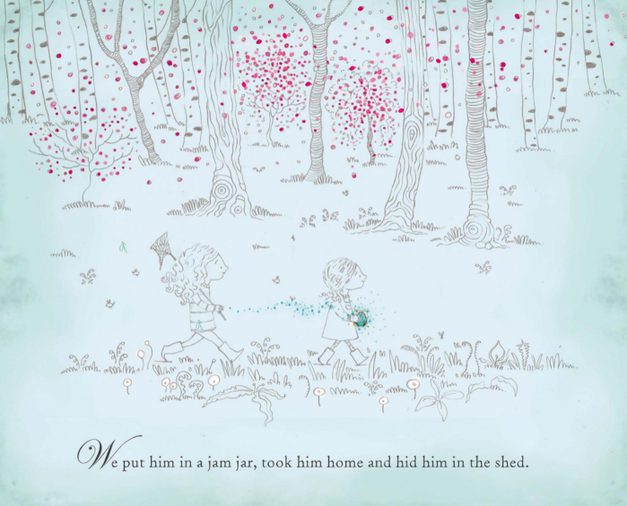

Slide 14
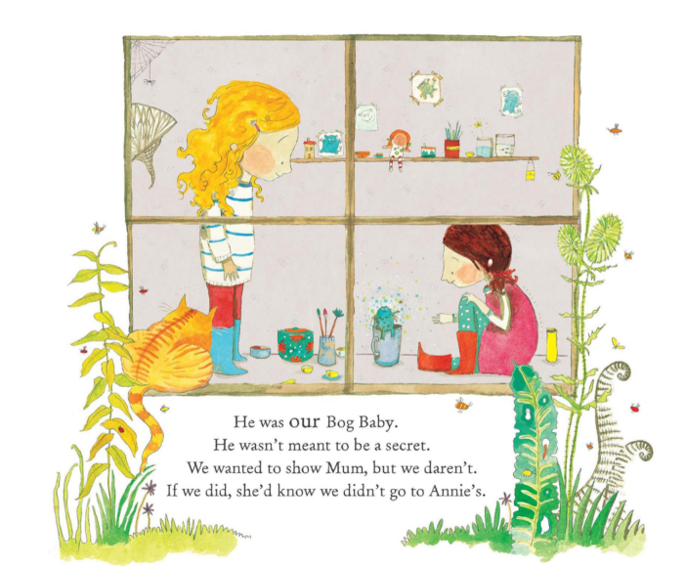

Slide 15
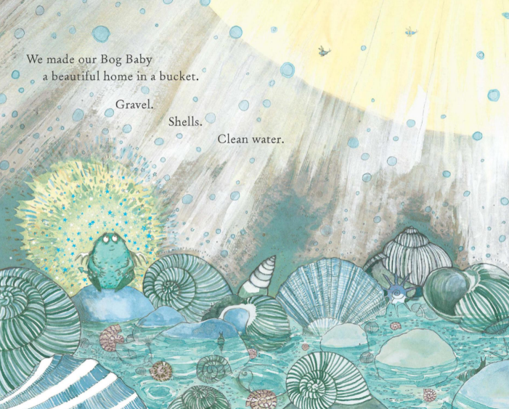

Slide 16
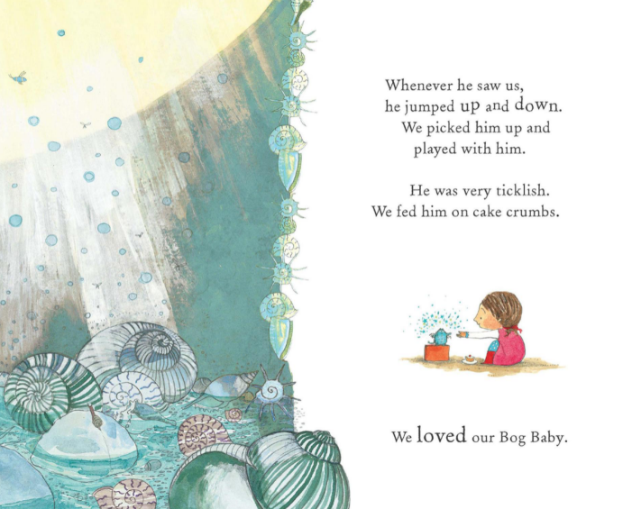

Slide 17
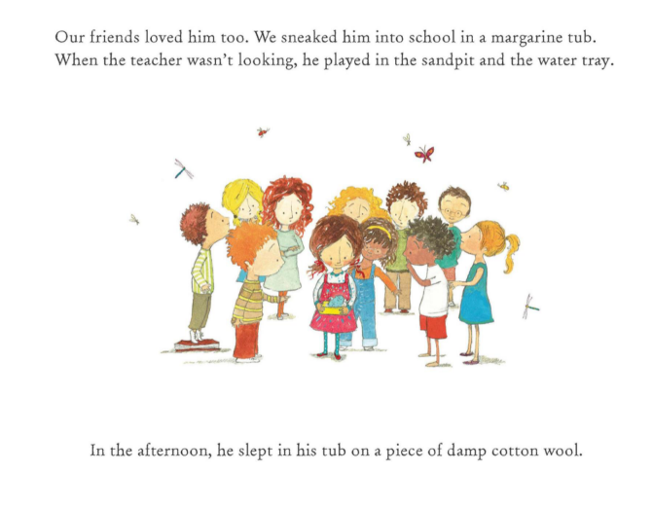

Slide 18
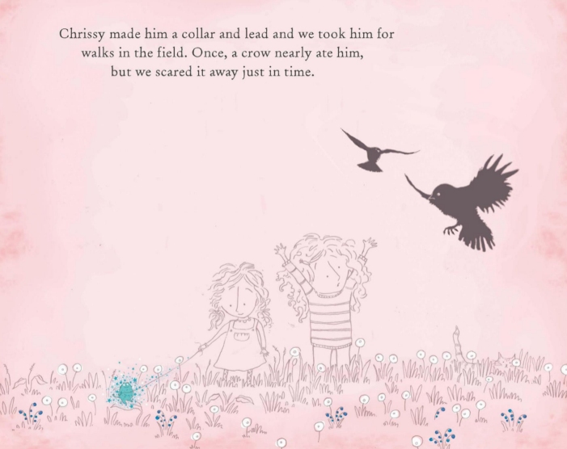

Slide 19
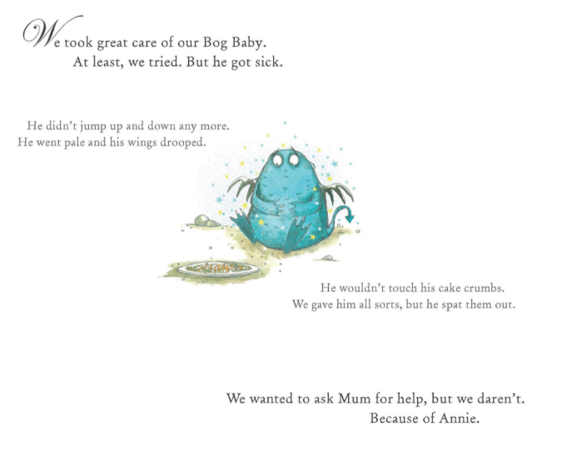

Slide 20
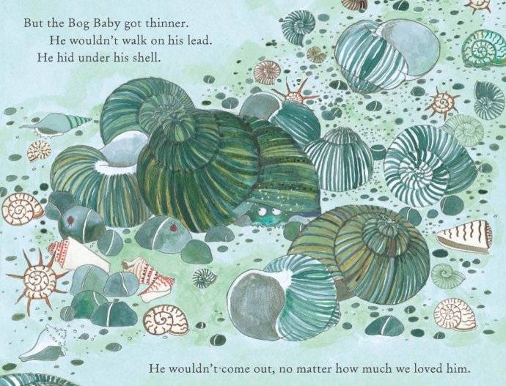

Slide 21
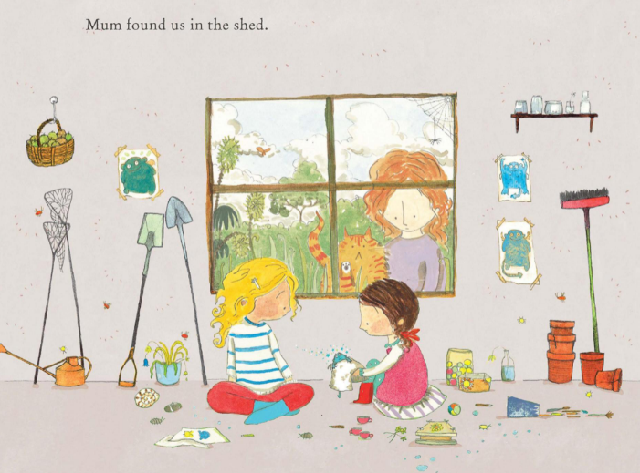

Slide 22
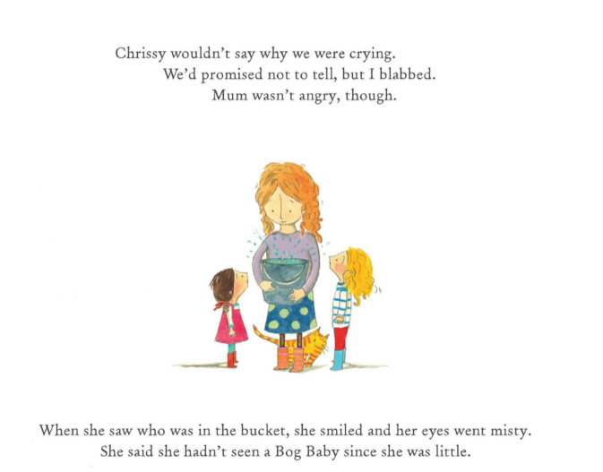

Slide 23
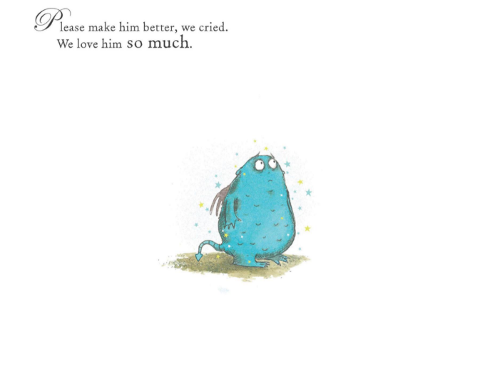

Slide 24
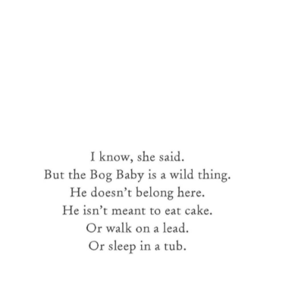

Slide 25
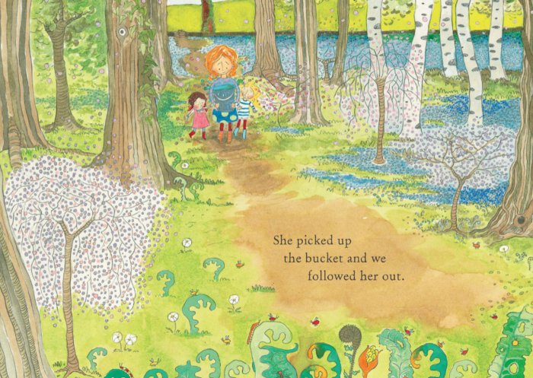

Slide 26
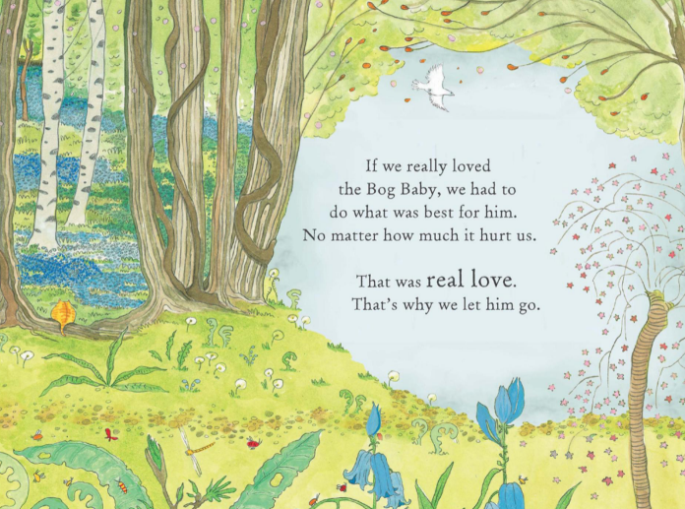

Slide 27


Slide 28
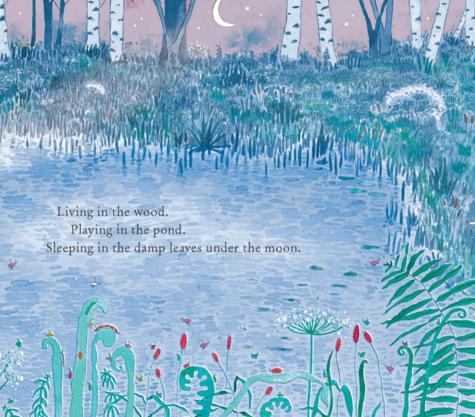

Slide 29
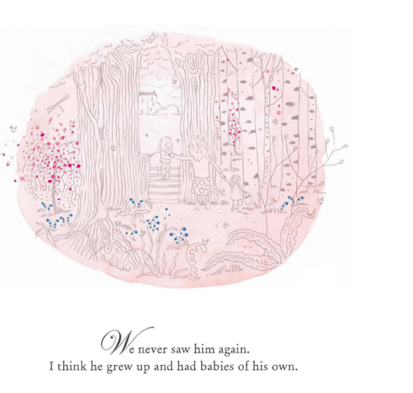

Slide 30
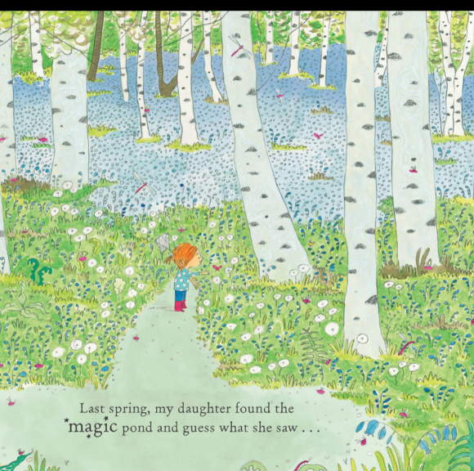

Slide 31
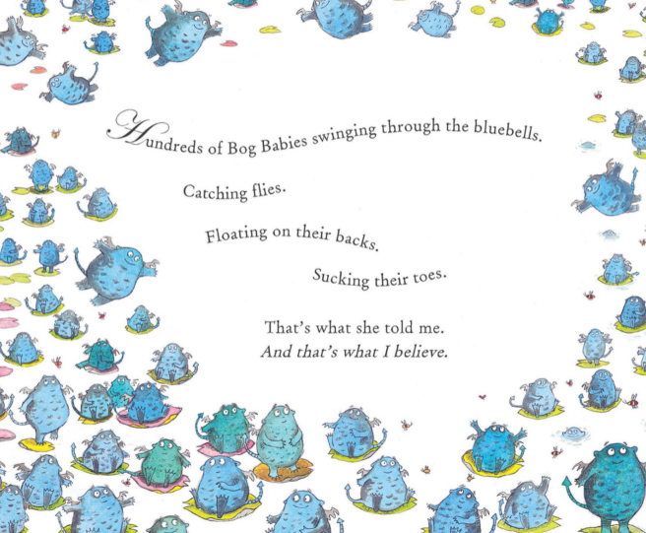
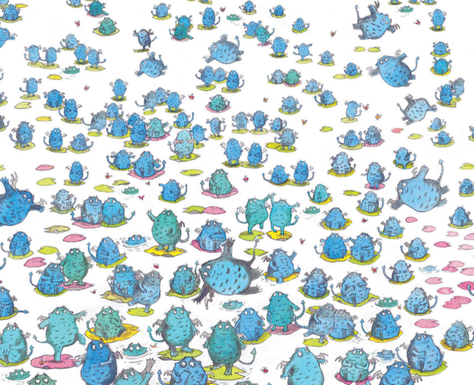

Slide 32
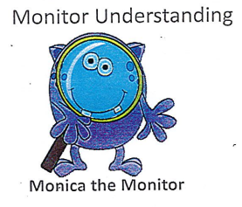
Read the page again that begins ‘Chrissy wouldn’t say why we were crying..’.
Why were the girls crying?
What does blabbed mean?
How does mum feel when she sees what’s in the bucket?
What does misty eyed mean?
What does the phrase: ‘That was real love’ mean? Why are two words in this phrase written in bold?

Slide 33
Your turn:
Read BogBabyText3 with your reading partner.
Look at the sheet on your table (Bog Baby Jumbled sheet.)
Number the events of the story as they happen in the book.
Your teacher will stick them in your blue books.

Slide 34
Session 2
WALT – Write for different purposes
Look at the pictures from the story on the next slide.
Talk in pairs:
What is happening in these pictures?
How may the characters be feeling?
What might they be saying?
Refer to events that have happened in the story so far to back up your answers.

Slide 36
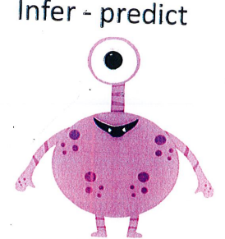
Your turn:
Use the Bog Baby pictures sheets on your table.
Stick the pictures in your blue books (you can decide which one or two you want to use) and add thought bubbles and speech bubbles to show what the characters are feeling.

Slide 37
Session 3
WALT – Discuss the sequence of events in books
Look at the story mountain on the next slide.
How do the events of Bog Baby fit into the story mountain structure?

Slide 38
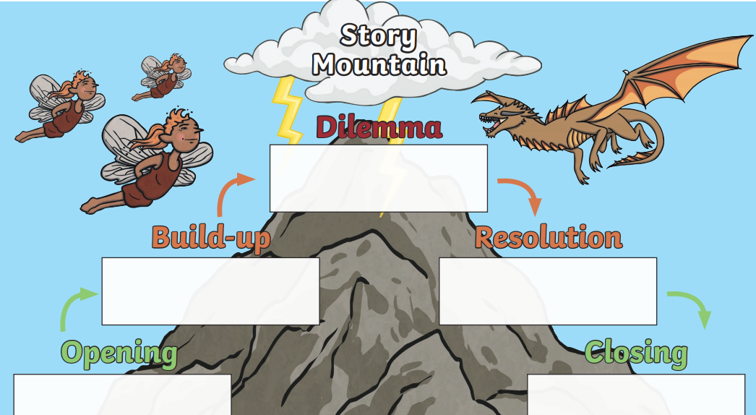

Slide 39
Your turn:

Slide 40
Your turn:
Look at the next 2 slides.
Complete the detailed story mountain to sequence the events of ‘The Bog Baby’.
Cut and stick the events of The Bog Baby
onto the appropriate place on the detailed story mountain.
Your teacher will stick these into your blue books.

Slide 41
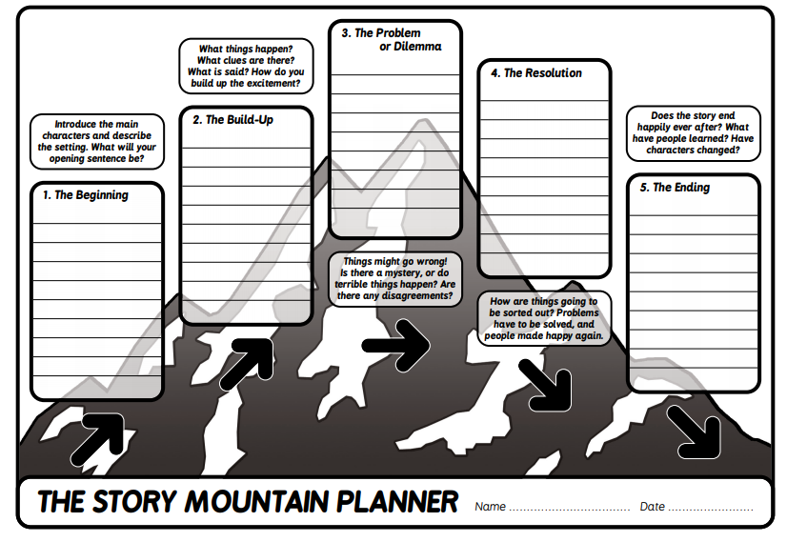

Slide 42
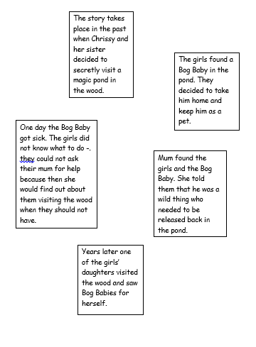

Slide 43
Session 4
WALT – Read aloud books closely matched to their improving phonic knowledge. Discuss the sequence of events in books.
Answer questions about what has been read including those that require inference.

Slide 44
Your turn:
Look at the tricky words on the next slide and then read slides 26-31 again as a class.
Read the final part of the story BogBabyText4 with your reading partner.

Slide 45


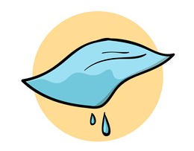
Tricky Words
bluebells
believe
damp

Slide 46
Session 5 SPaG
WALT – to understand apostrophes for possession
Work through the powerpoint as a class.
Complete the sheet on the next slide to go in your red books.

Slide 47


