Slide 1
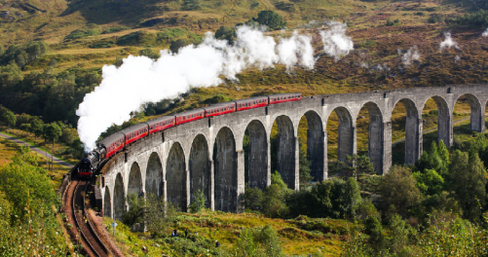

Science - Week 1
Projectiles Investigation
WALT: Gather and record data to help in answering questions.
Knowledge Year 2
WILF: I can record and display data in different ways, using observations and ideas to suggest answers to questions.
The results are information that has been found out from an investigation and can be used to answer a question.

Slide 2
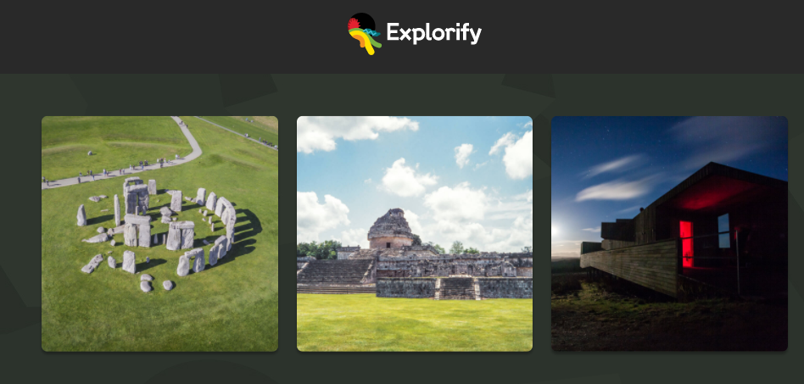
Awesome observing – Explorify
Look at this Odd One Out Science Starter

Slide 3
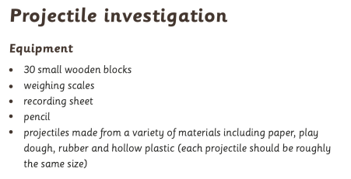
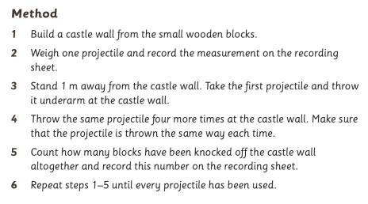

Slide 4


