Slide 1
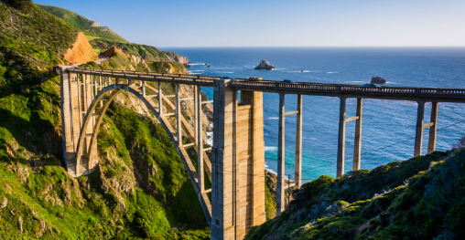

Science - Week 2
Sorting and Grouping Bridges
WALT: Observe objects, sorting and grouping them based on their features and explaining their reasoning.
WILF: I can look at, compare and group objects according to their features and say why I have done it that way.
Burly bridges – Explorify
Click the link to watch this Odd One Out Science Starter

Slide 2
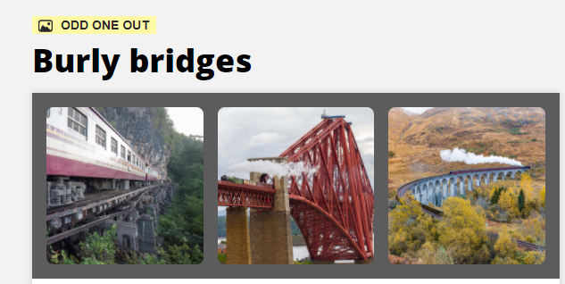

Slide 3
We are going to investigate why bridges are shaped in different ways.
Look at the ppt of different bridges from around the world. (wk 2 bridges.pp)
Then watch the video to learn about why bridges have different shapes.
What Makes Bridges So Strong? - YouTube
What shapes are important when building a strong bridge?
What materials would be good to use for a strong bridge?
Can you think of a good way to sort the pictures of the bridges into different groups?

Slide 4

Teachers: print out bridges ppt pages 2,3,4, & 5 on one sheet of A4 for each child.
We are going to sort pictures of bridges. We are going to make a poster of the bridges and explain how we have grouped them to each other.
Has anyone grouped the bridges in the same way?
What are the different ways we have grouped them?

