Slide 1
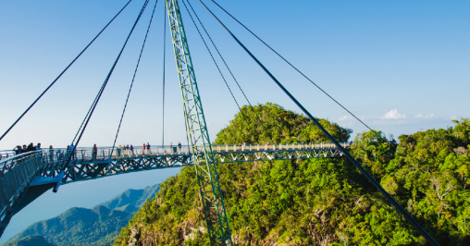

Science - Week 3
Perform Simple Tests
WALT:
- Follow a set of instructions to perform a range of simple tests.
make simple predictions for what might happen and suggest ways to answer questions.
WILF:
I can follow a set of instructions.
I can guess at what might happen in an investigation.

Slide 2
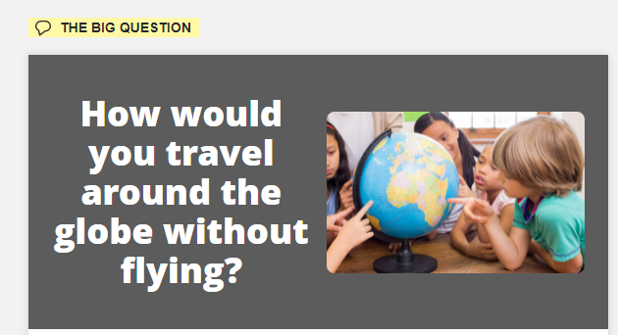

Slide 3
Teachers: Arches are generally much stronger than flat bridges and should hold more pennies. Model the strength of arches and domes by placing a pile of books on four half eggshells (one under each corner).
We are going to work with a partner. Follow these instructions to build your bridge.
Fold a piece of thick cardboard into thirds, to form two ‘legs’ and a flat top.
Anchor the legs in blobs of sticky tack or tape.
Add a penny at a time to the flat top.
Find out how many pennies the bridge can hold before it bends or collapses.
Write some sentences about what you have done.
Draw a picture of your bridge.
Accurately record how many pennies your bridge held.

Slide 4
You have already made a flat bridge. How many pennies did it hold?
Now follow these instructions to make a different bridge. This is an arch bridge. Do you think it will hold more or less pennies?
1. Bend an identical piece of cardboard into an arch shape.
2. Anchor the ends in sticky tack or tape.
3. See how many pennies it can now hold.
4. Draw a picture of your new bridge with the correct number of pennies on it.
5. Talk about which shape was strongest and why you think this.

