Slide 1
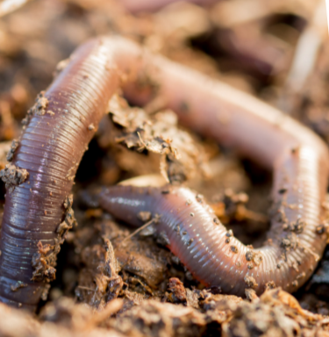

Science - Week 4
Burrowing Animals
WALT: identify and name a variety of animals in their habitats, including microhabitats.
WILF: I can identify and name animals in their habitats.
A habitat is a place where a living thing lives. A microhabitat is a very small habitat.
Hungry hedgehogs – Explorify
Click the link to watch this What’s Going On?
Science Starter

Slide 2
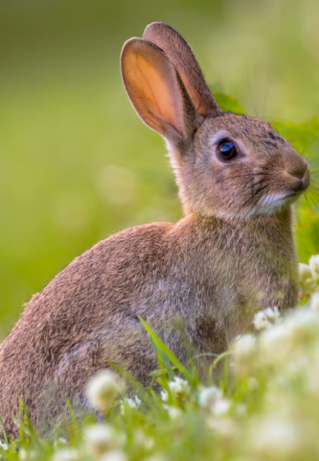
Over the next few weeks we are going to learn about tunnelling animals such as moles, rabbits and ants. This week we are focussing on rabbits - discovering key facts about their life cycles and how tunnelling helps them. Find out whether these animals spend all, or just part, of their time in their tunnels and which physical features help them to dig.
What do you know about rabbits?
Look at the information fact file. Choose three facts to record in your books.
Watch the video and add to your notes.
BBC Two - The Burrowers - Learning Zone, How do rabbit babies live underground?

