Slide 2
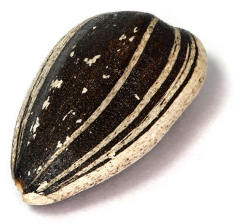
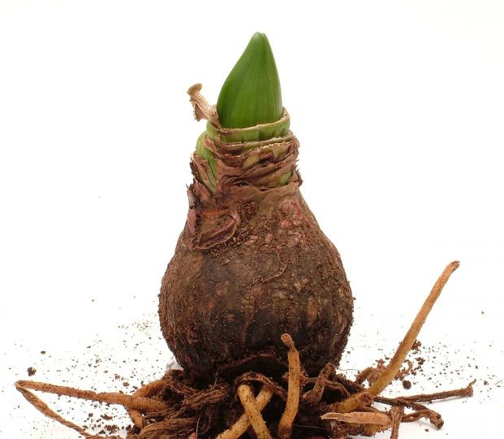
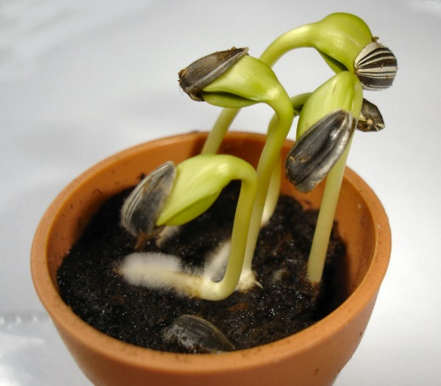
Which is the odd one out?

Slide 3
Aim
Walt:
observe and describe how seeds and bulbs grow into mature plants
To perform simple tests
Success Criteria
I can follow instructions to plant a seed and a bulb.
I can suggest how to care for a plant so it grows well.
I can set up a simple test to show what plants need to grow well.
I can predict which plants will grow well and which will not.

Slide 4
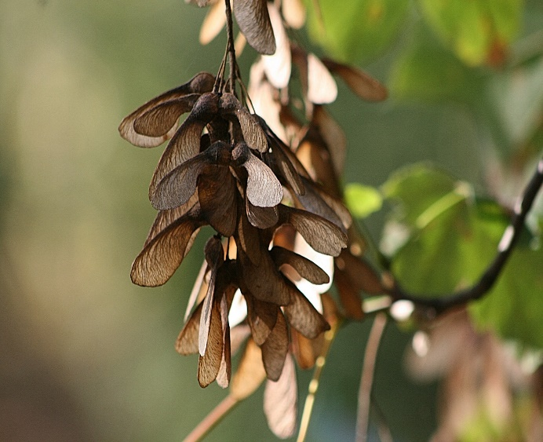
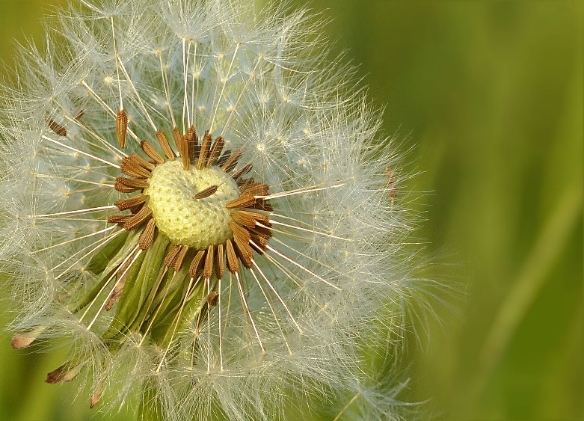
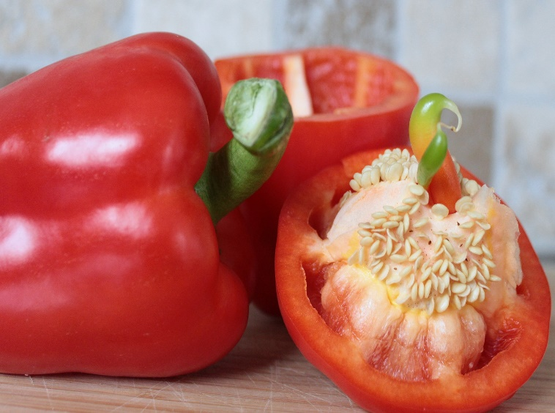
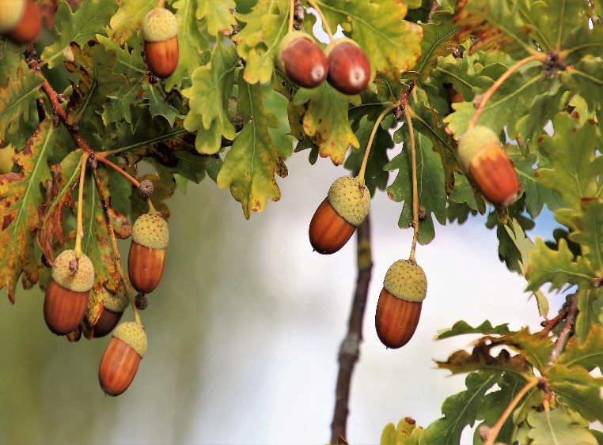
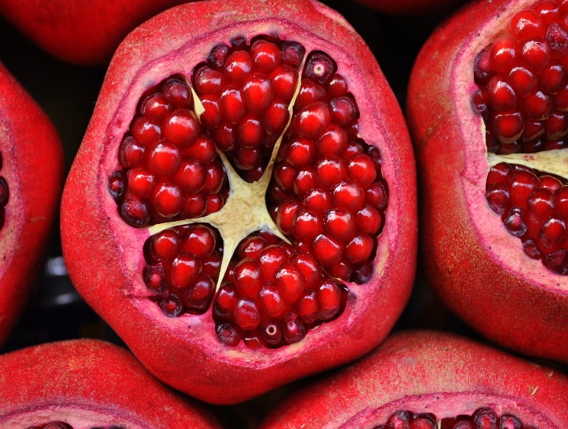
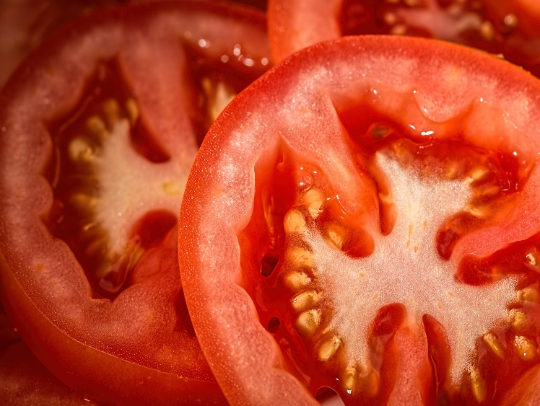
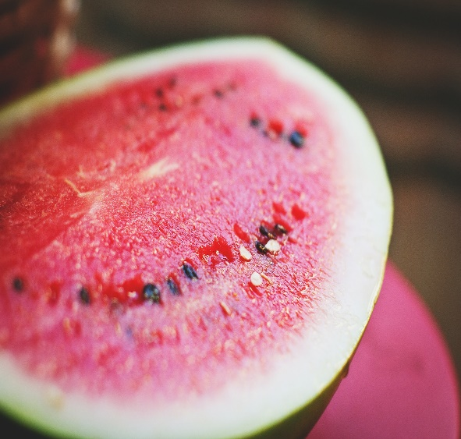
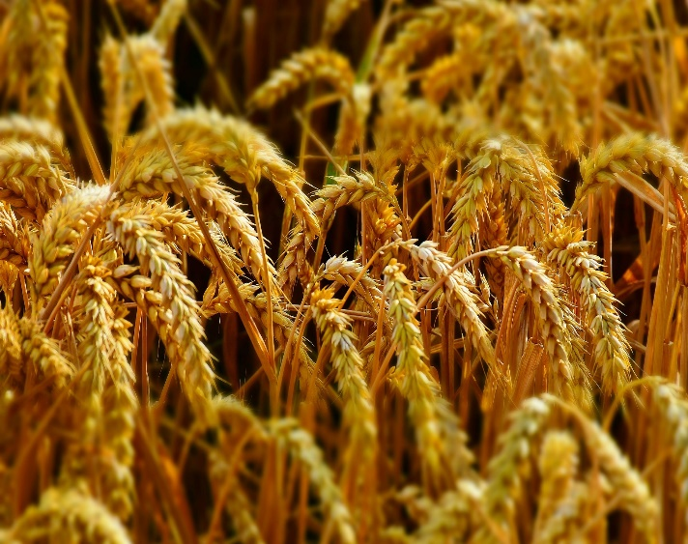
Seeds and Bulbs
The first stage
in the life cycle of most plants is a seed.
Seeds come in all shapes and sizes. Every plant has a different seed.

Slide 5

Seeds and Bulbs
Every single seed has the beginnings of a new plant inside it, along with a little store of food to help it grow.
When the conditions are right, the seed soaks up water and swells, and the tiny new plant bursts out of its shell. This is called germination.
Embryo:
The tiny root and shoot which will grow into the adult plant.
Food Store:
A store of food for the young plant
to use until it has grown enough to make its own food.
Seed Coat:
A tough outer covering.

Slide 6
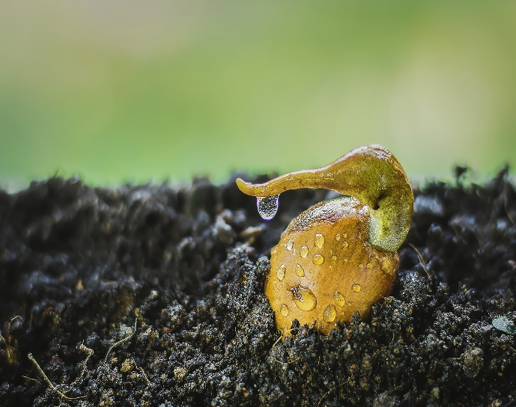
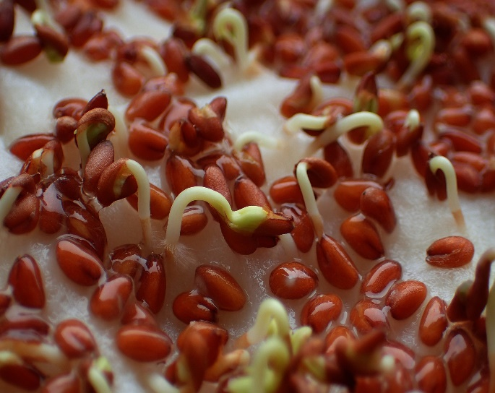
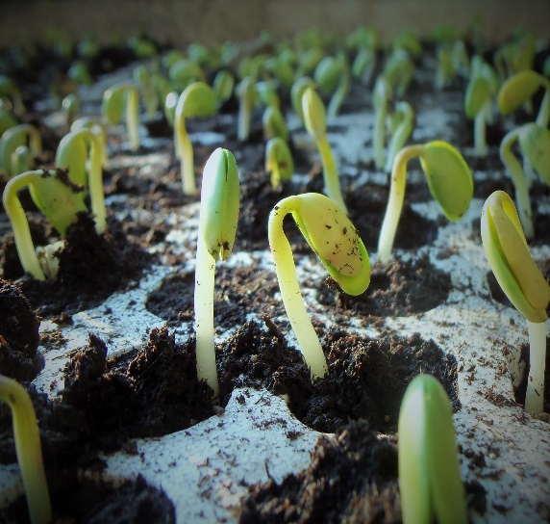
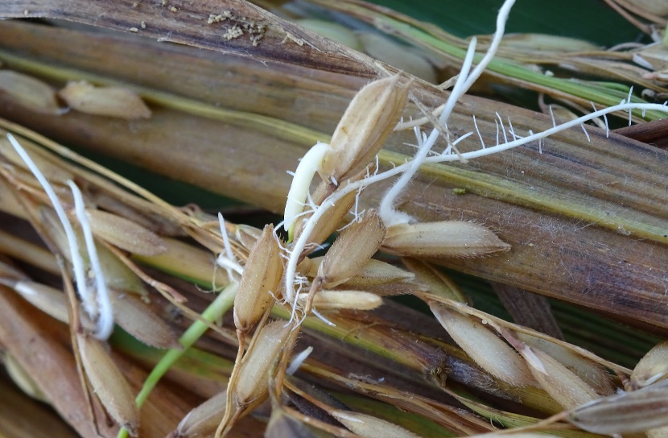
Seeds and Bulbs: Germination
Click the button below to find out more about germination.

Slide 7
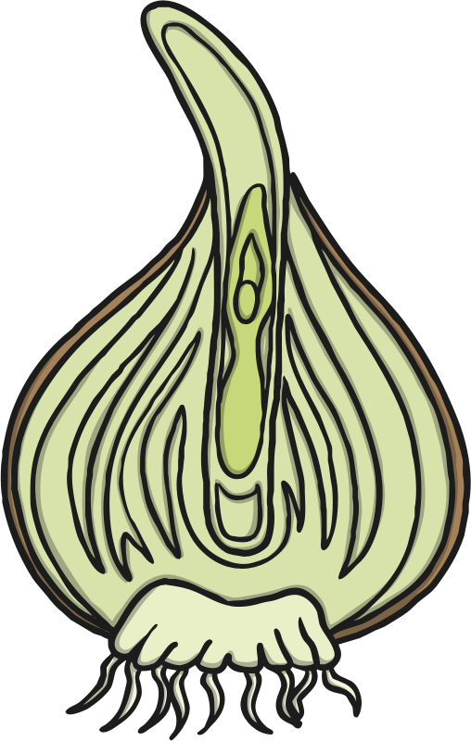
Seeds and Bulbs
Some plants grow first from a seed, and then develop
a bulb that helps them to grow back year after year.
A bulb lets the plant rest underground over the winter when it is too cold, then grow back later in the year when conditions
are right.
Flower Bud:
Future flower stored inside the bulb for protection.
Tunic:
A papery
outer covering.
Scales:
Thick leaves that store the food.
Roots
Stem

Slide 8
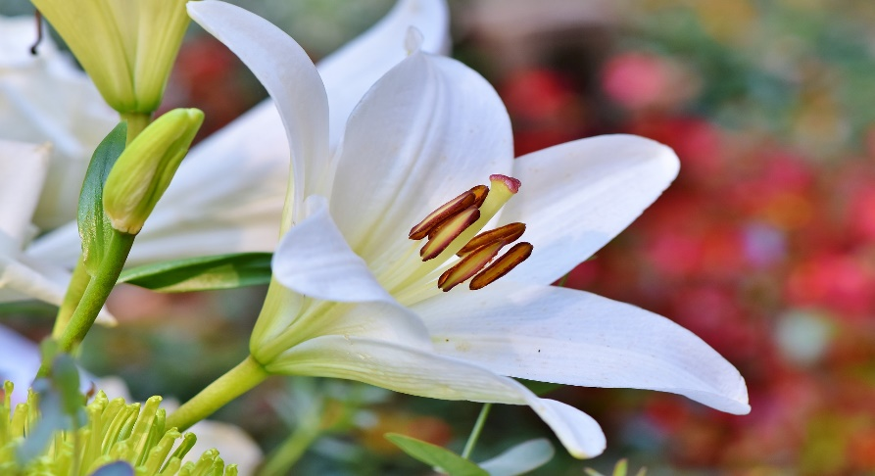
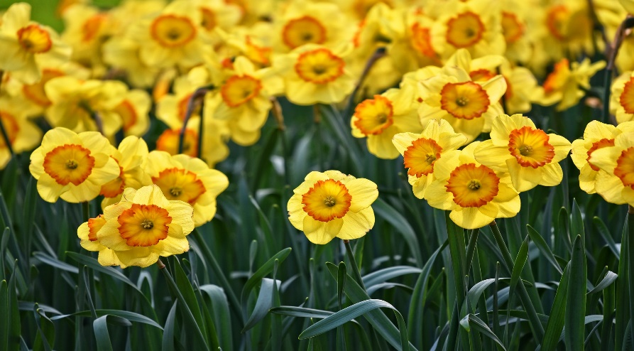
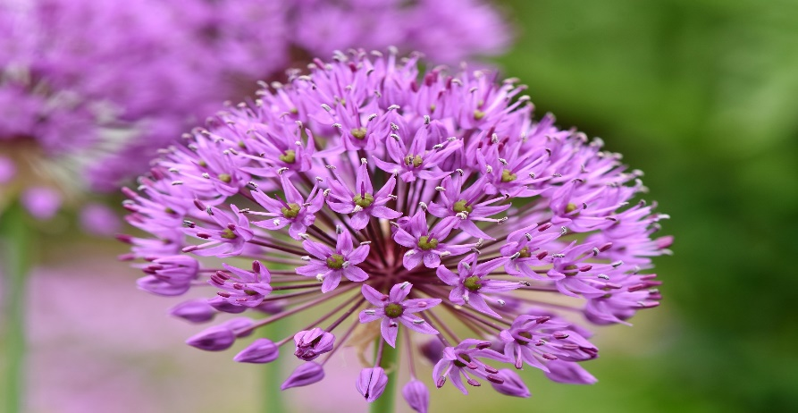
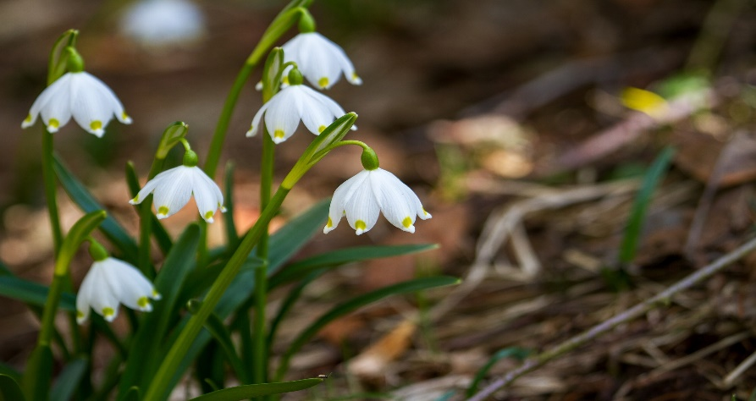
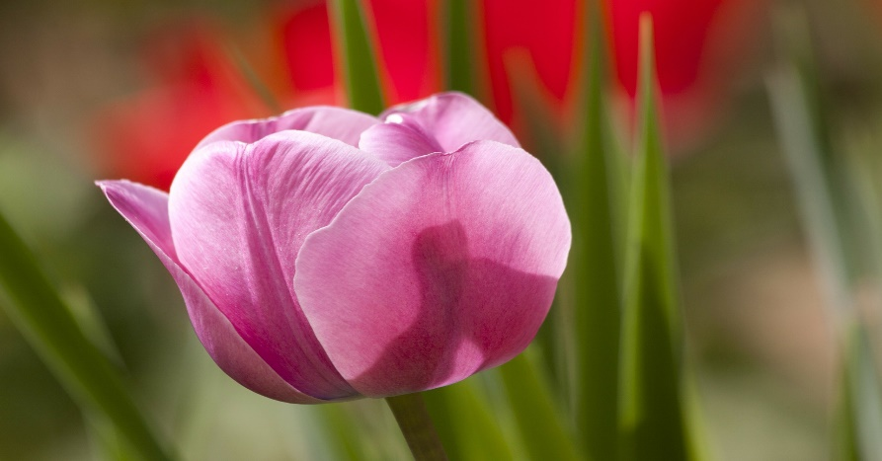
Seeds and Bulbs
Here are some common plants that grow from bulbs.
Lilies
Daffodils
Allium
Snowdrops
Tulips

Slide 9
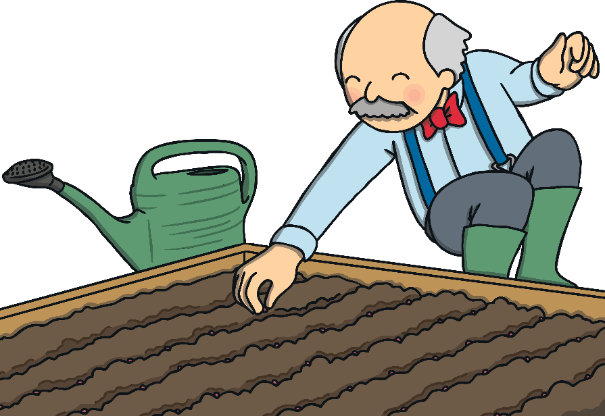
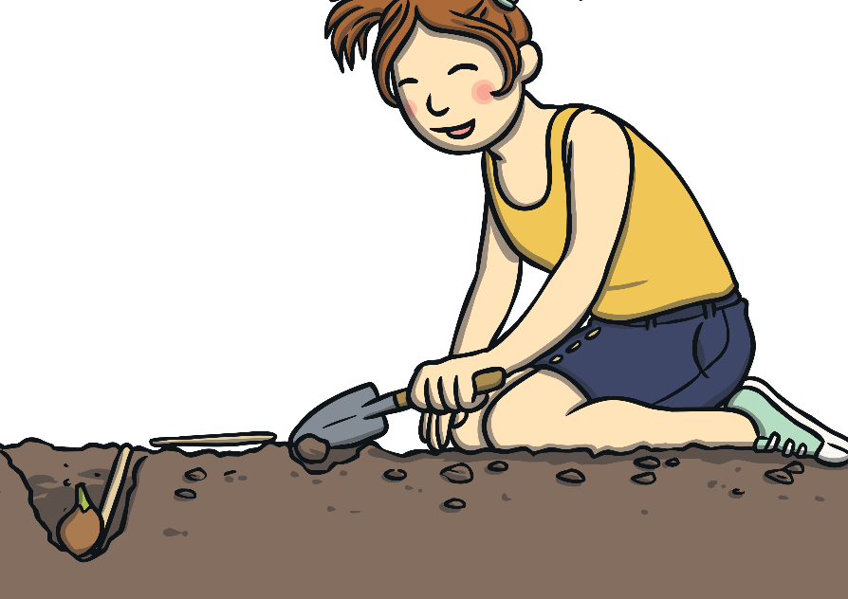
Seeds and Bulbs
We are going to plant a seed and a bulb each,
so we can compare how they grow.
Comparing means looking closely to see what
is similar and what is different.

Slide 10

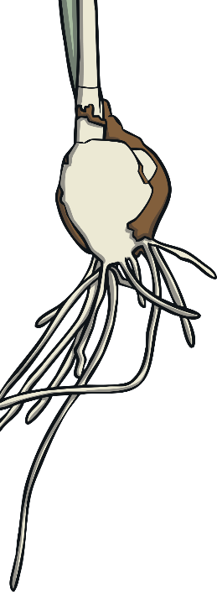




What Do Plants
Need to Grow?
Seeds and bulbs need to wait
for conditions
to be just right
before seeds can germinate and bulbs can sprout new growth.
What do you
think that our plants will need
so they can sprout and grow well?
How can we find out if
you are right?

Slide 11

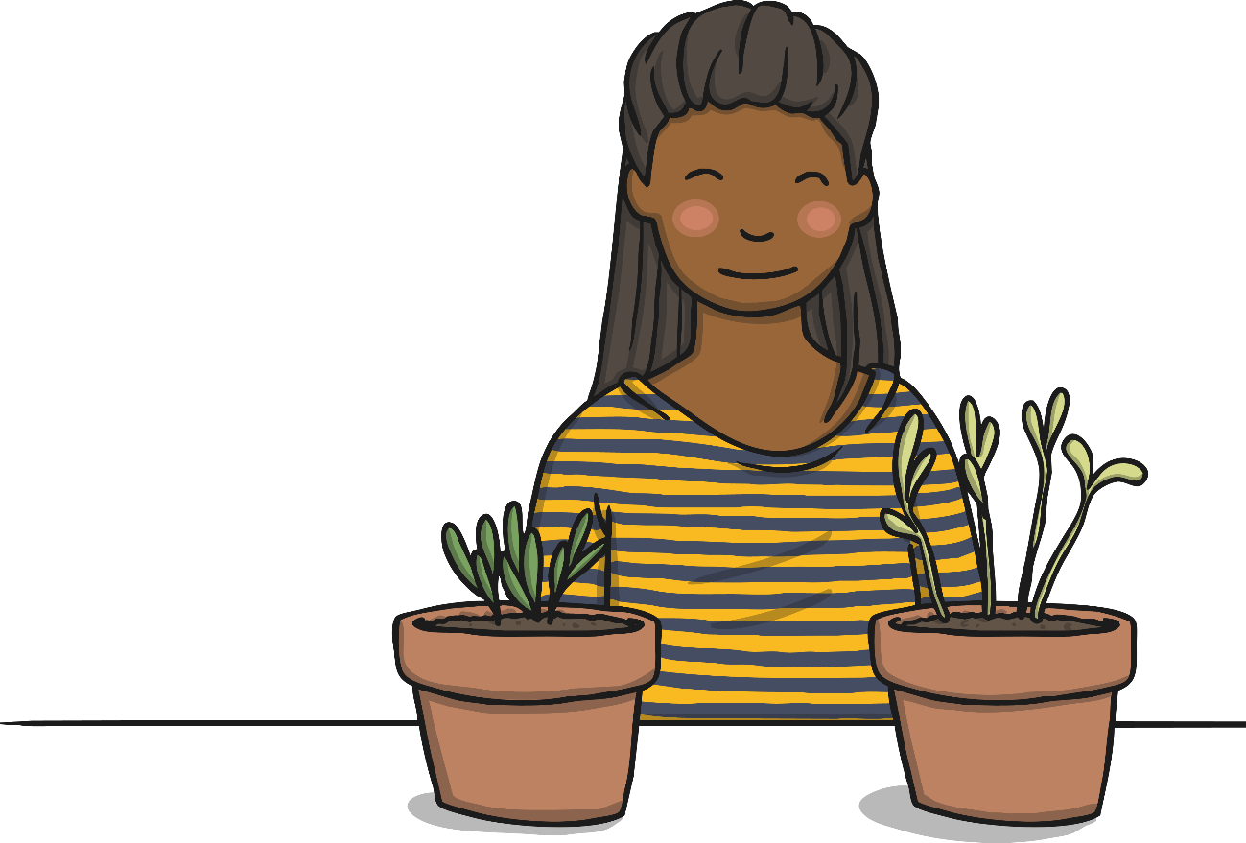
Planting
As well as our seeds and bulbs, we are going to plant some extra seeds and set up a comparative test.
In our comparative test, we are going to plant the same seeds, and compare how they grow under different conditions.
This will help us to learn what plants need to grow well.

Slide 12


Planting
You will need:
4 fast germinating seeds
1 dwarf sunflower seed
1 paperwhite narcissus bulb
6 plant pots
Soil

Slide 13
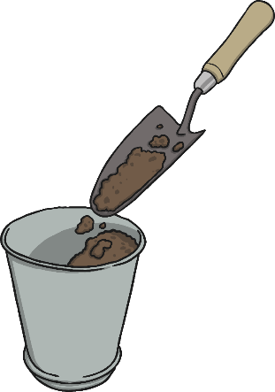
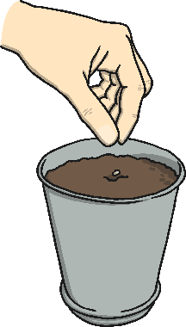
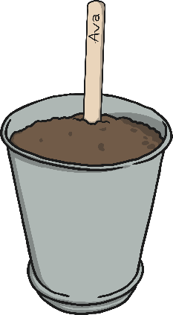

Planting
1
2
Fill your
pot half
full of soil.
Plant the seed or bulb in the soil.
3
4
Cover the seeds and bulbs with more soil.
Put the seeds and bulbs in a warm and sunny spot.

Slide 14
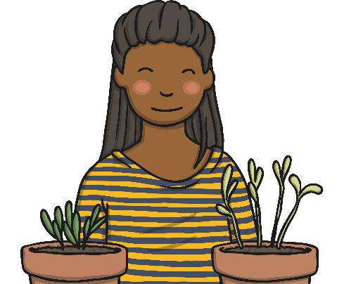
Plant Growth
Comparative Test
In your group, you are going to compare the growth of your test seeds.
One seed will be given water and sunlight.
One seed will be given water but no sunlight.
One seed will be given sunlight and no water.
One seed will be given no sunlight and no water.
What do you think will happen to each of the seeds?

Slide 15


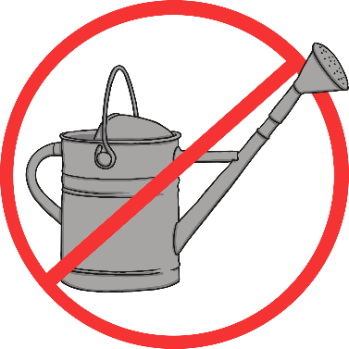
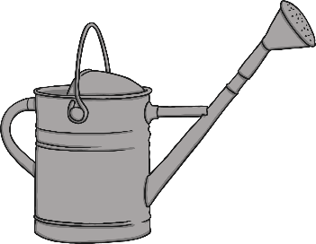

Plant Growth
Comparative Test
What conditions does each plant need? Where should they go?

Slide 16
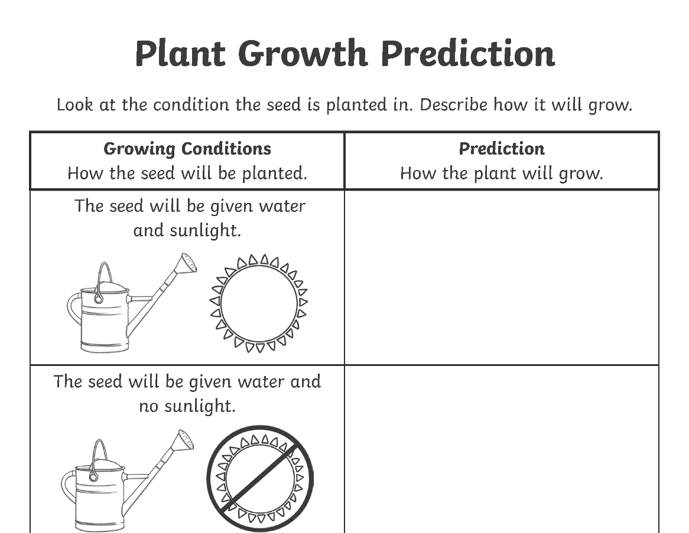
Plant Growth Predictions

Slide 17
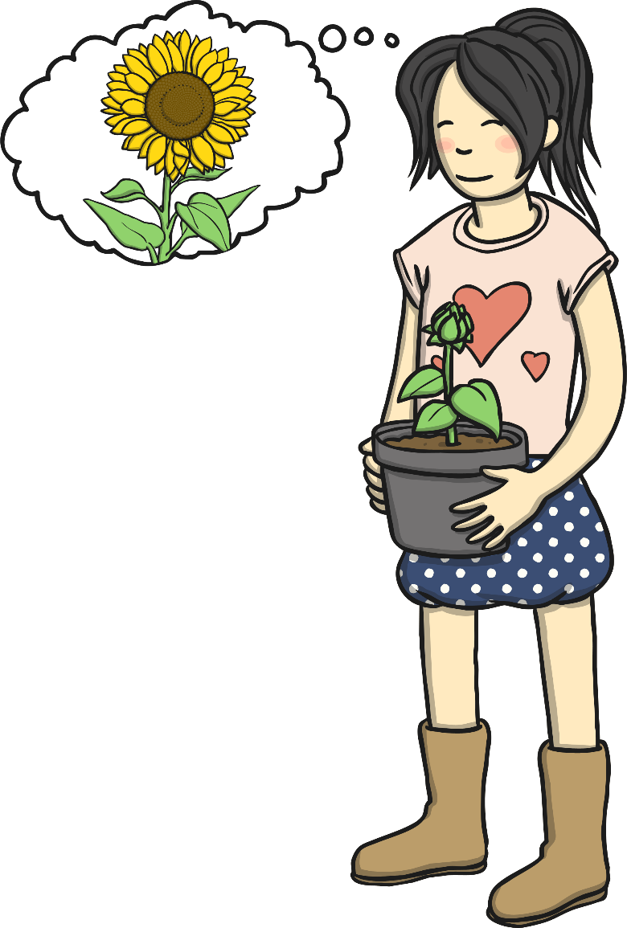
Plant Growth Predictions
Which seed did we predict would grow the best?
What conditions should we give our sunflower
and narcissus plants so that they grow well?

