Slide 1

Year 2 Maths
Multiplication 3

Slide 2
Session 1

Slide 3

How many ways can you think of to make this number in 1 minute?
It could be + - x or ÷
(we haven’t learned about ÷ yet in school, but some of you might know it.)
40
Click to start the 1 minute timer

Slide 4
WALT solve problems using the 2, 5 and 10 times tables

Slide 5

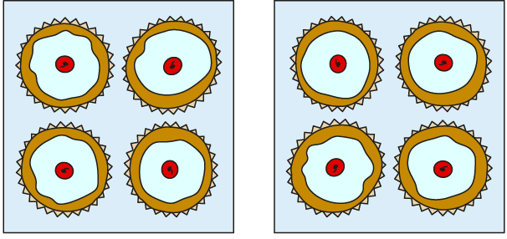

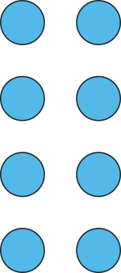

2.5 Commutativity, doubling and halving Step 1:5
There are two boxes of cakes.
Each box contains four cakes.
How many cakes are there altogether?
2 × 4 =
8
2 groups of 4 is equal to 2, four times
There are eight cakes altogether.
I know that 2, four times, is equal to 8,
so I know that 2 groups of 4 is equal to 8.

Slide 6


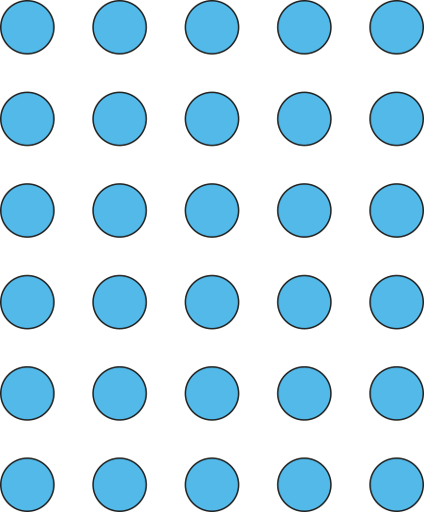


2.5 Commutativity, doubling and halving Step 1:6
There are five sheets of stickers.
Each sheet contains six stickers.
How many stickers are there altogether?
5 × 6 =
30
There are 30 stickers altogether.
5 groups of 6 is equal to 5, six times
I know that 5, six times, is equal to 30,
so I know that 5 groups of 6 is equal to 30.
Notes:
There are five sheets of stickers.
Each sheet contains six stickers.
How many stickers are there altogether?

Slide 7

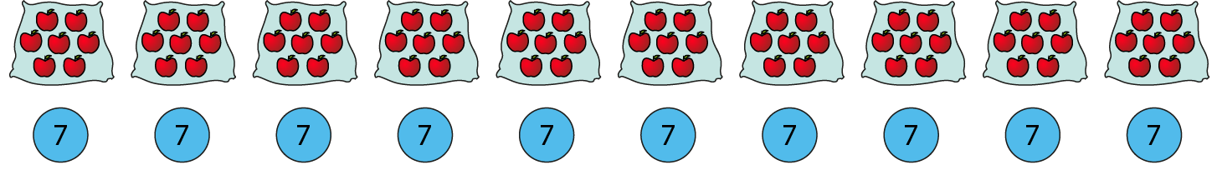
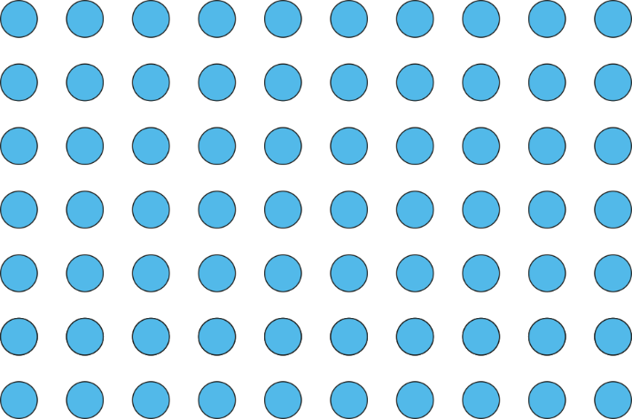
2.5 Commutativity, doubling and halving Step 1:7
There are ten bags of apples.
Each bag contains seven apples.
How many apples are there altogether?
10 × 7 =
70
10 groups of 7 is equal to 10, seven times
There are 70 apples altogether.
I know that 10, seven times, is equal to 70,
so I know that 10 groups of 7 is equal to 70.
Notes:
There are ten bags of apples.
Each bag contains seven apples.
How many apples are there altogether?

Slide 8
2.5 Commutativity, doubling and halving Step 1:8
Your turn… show me on your fingers which times table you could use to solve each problem
Problem | Known times table I can use (2, 5 or 10)
There are 5 children. Each child has 4 conkers. How many conkers are there altogether?
There are 2 teams. Each team has
12 bean bags. How many bean bags
are there altogether?
10 children each have 3 meatballs
on their plate. How many meatballs
are there altogether?
5 children each have 3 balloons.
How many balloons is this
altogether?
10 times table
5 times table
2 times table

Slide 9
2.5 Commutativity, doubling and halving Step 1:8
Put each calculation in the correct column
5 × 4
2 × 9
7 × 5
10 × 12
6 × 2
10 × 8
12 × 5
2 × 7
3 × 10
5 × 11
Can use 2 times table | Can use 5 times table | Can use 10 times table

Slide 10
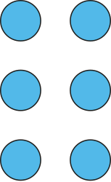
2.5 Commutativity, doubling and halving Step 1:9
3 × 2 = 6
Draw an array to match the equation.
Notes:
This can represent:
Three groups of two
Three, two times

Slide 11
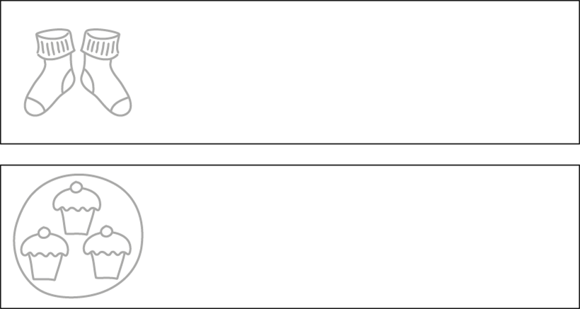


2.5 Commutativity, doubling and halving Step 1:9
3 × 2 = 6
Complete the two pictures to match the equation.

Slide 12

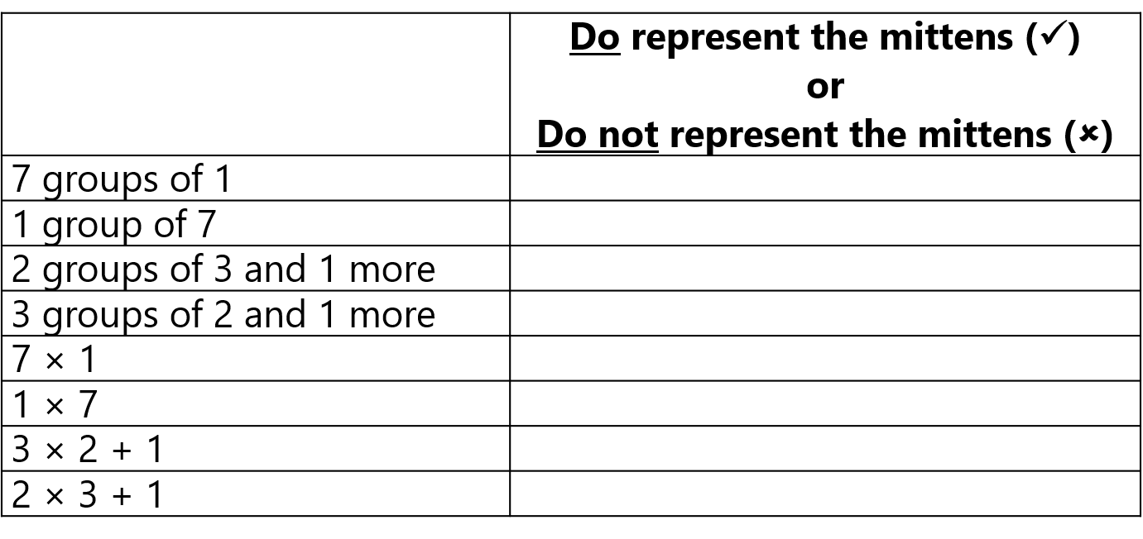


2.5 Commutativity, doubling and halving Step 1:9

Slide 13
2.5 Commutativity, doubling and halving Step 1:9
Your turn… In your yellow maths book solve these problems
Fill in the missing numbers or symbols (<, > or =)
2 x 5 = 5 x __ 7 x __ = 10 x __
0 = 2 x __ 8 x __ = 40
0 = __ x 2 5 x __ = 40
2 x 4 4 x 2 5 x 2 2 x 5
4 x 2 2 x 5
If once ice cream costs £ 2, how much do 4 ice creams cost?
There are eight buckets, each containing 10 litres of water. How many litres of water are there altogether?
Challenge:
Mrs Morgan has two bags. Each bag contains five loaves of bread.
Angie says she can use the 5 times table to solve this.
Ben says he can use the 2 times table to solve this.
Who is correct? Why?

Slide 14
Session 2

Slide 15
Multiply these…
2x10
4x5
7x2
6x10
8x5
4x2

Slide 16
WALT solve problems using the 2, 5 and 10 times tables

Slide 17

2.5 Commutativity, doubling and halving Step 1:10
What’s the same? What’s different?
4 x 3 = 12
3 x 4 = 12
The 4 represents the number of ice-cream cones.
4 groups of 3
The 3 represents the number of scoops of ice-cream in each cone.
3 + 3 + 3 + 3 = 12
4 × 3 = 12
3, four times
3 × 4 = 12

Slide 18
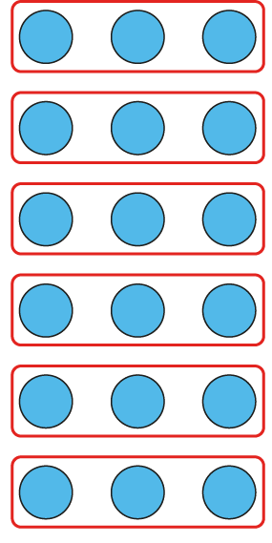

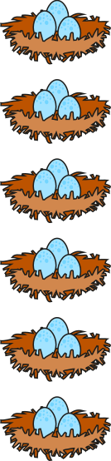
2.5 Commutativity, doubling and halving Step 1:11
There are some eggs in some nests. What situations can the equation represent?
6 × 3 = 18
6 x 3 can represent 6 groups of 3.
The 6 represents the number of nests.
The 3 represents the number of eggs in each nest.
Notes:
There are some eggs in some nests. What situations can the equation represent?

Slide 19
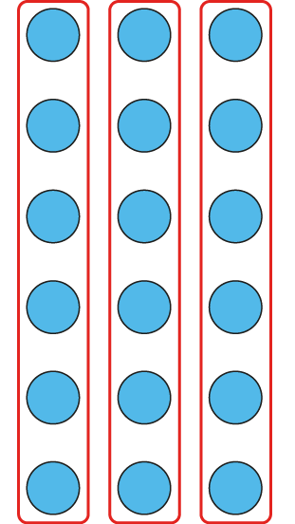


2.5 Commutativity, doubling and halving Step 1:11
6 × 3 = 18
6 x 3 can also represent 3 groups of 6 (or 6, 3 times).
The 6 represents the number of eggs in each nest.
The 3 represents the number of nests.

Slide 20

2.5 Commutativity, doubling and halving Step 1:11
6 × 3 = 18

Slide 21

2.5 Commutativity, doubling and halving Step 1:12
Who has represented the picture correctly?
Sally:
3 × 4
✓
Ahmed:
4 × 3
✓
Kumiko:
4 + 4 + 4
✗
Notes:
Who has represented the picture correctly?
Note: Kumiko’s expression, whilst giving the correct total number of butterflies, does not
represent the grouping shown in the picture.

Slide 22
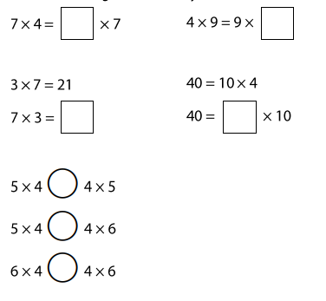
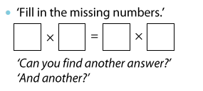
Your turn in your yellow books... Fill in the missing numbers or symbols (<, > or =).

Slide 23
Session 3

Slide 24
Write the fact family for a number bond to 20.
___+___=___
___+___=___
___-___=___
___-___=___

Slide 25
WALT solve multiplication problems

Slide 26


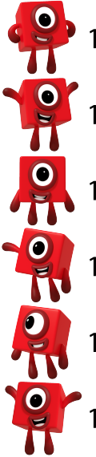
2.5 Commutativity, doubling and halving Step 1:13
6 × 1 = 6
6 x 1 can represent 6 groups of 1.
The 6 represents the number of characters.
The 1 represents the value of the characters.
© 2017 Alphablocks Ltd.
All rights reserved.

Slide 27

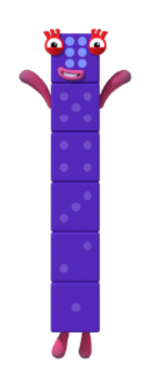

2.5 Commutativity, doubling and halving Step 1:13
6 × 1 = 6
6 x 1 can also represent 1 group of 6. (Or 6, 1 time)
6
The 6 represents the value of character.
The 1 represents the number of characters.
© 2017 Alphablocks Ltd.
All rights reserved.

Slide 28
2.5 Commutativity, doubling and halving Step 1:13
6 × 1 = 6
6
© 2017 Alphablocks Ltd.
All rights reserved.
© 2017 Alphablocks Ltd.
All rights reserved.

Slide 29

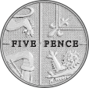
2.5 Commutativity, doubling and halving Step 1:13
1 × 5 = 5
1 group of 5
5, one time
What does the 1 represent?
The 1 represents the number of coins.
What does the 5 represent?
The 5 represents the value of the coins.
5 p

Slide 30
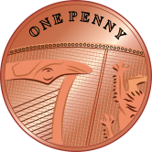

2.5 Commutativity, doubling and halving Step 1:13
1 × 5 = 5
5 groups of 1
1, five times
1 p
What does the 1 represent?
1 p
The 1 represents the value of the coins.
1 p
What does the 5 represent?
1 p
1 p
The 5 represents the number of coins.

Slide 31
2.5 Commutativity, doubling and halving Step 1:13
1 × 5 = 5
1 p
1 p
1 p
1 p
1 p
5 p

Slide 32
Have a chat with someone near you.
Who is right? Explain why…
I
I
I have 10 coins.
I have 1 coin.
Jen
I
Jen must have more money because she has more coins..
Ben
I
I
Ben must have less money because he has only 1 coin
They could both have the same amount of money.
Meg
Libby
Jordan

Slide 33
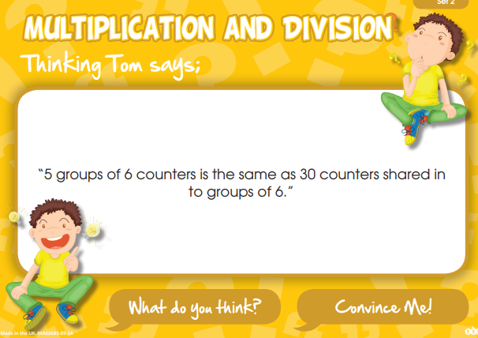
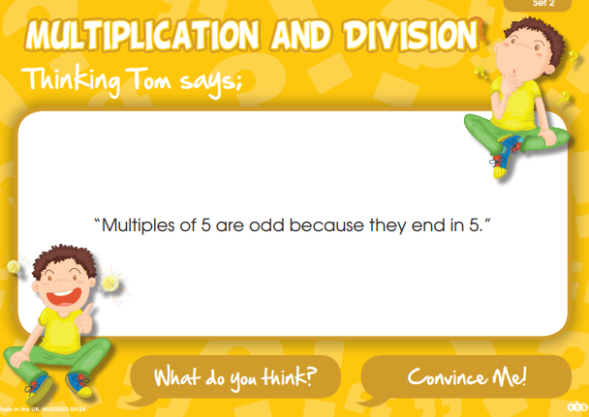
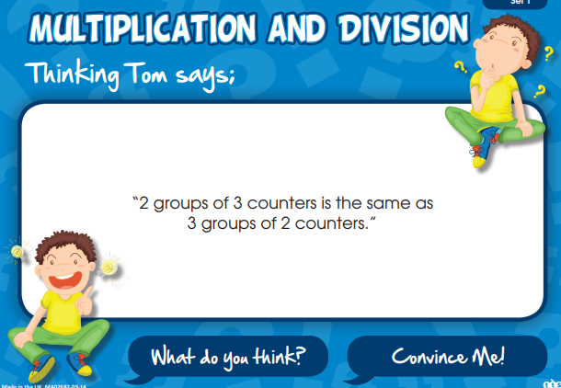
Your turn… Get a thinking Tom card and talk about it with a friend. How would you prove it? Write your ideas in your jotters.

Slide 34
Session 4

Slide 35
6x0
Answer these…
19x0
3x1
6x1
5x0
9x1

Slide 36
WALT double numbers to solve 2 times table questions

Slide 37
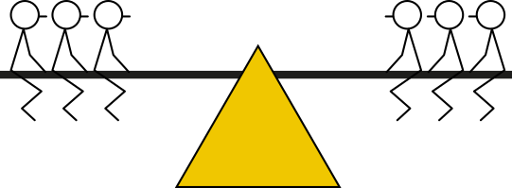
2.5 Commutativity, doubling and halving Step 2:1
How many groups of stick children are there on the seesaw?
How many stick children are there in each group?
How many stick children are there altogether?
2 groups of 3
2 × 3 = 6
3, two times
3 × 2 = 6
3, doubled
3 + 3 = 6

Slide 38

2.5 Commutativity, doubling and halving Step 2:1
How many groups of stick children are there on the seesaw?
How many stick children are there in each group?
How many stick children are there altogether?
2 groups of 5
2 × 5 = 10
5, two times
5 × 2 = 10
5, doubled
5 + 5 = 10

Slide 39
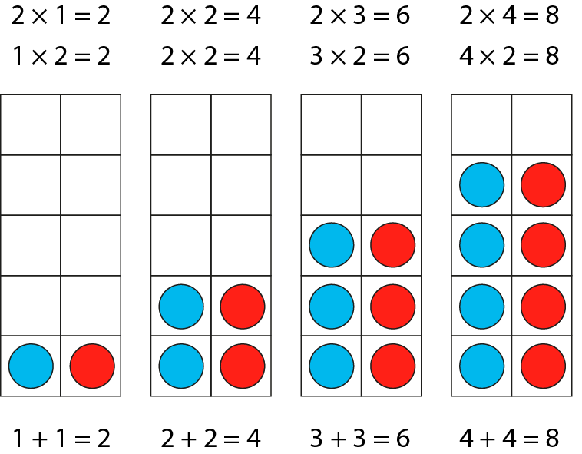
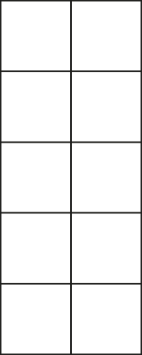


2.5 Commutativity, doubling and halving Step 2:2
___, two times is the same as double ___
1 + 1 = 2
2 + 2 = 4
3 + 3 = 6
4 + 4 = 8
1
2
3
4
2
4
6
2 ×
=
8
2
× 2 =
3
4
1
4
6
8
2

Slide 40
2.5 Commutativity, doubling and halving Step 2:3
6
?
There are two parts.
The parts are equal.
The whole is double one of the parts.
3
3
2 × 3 =
6
2 groups of 3
3, two times
3, doubled

Slide 41
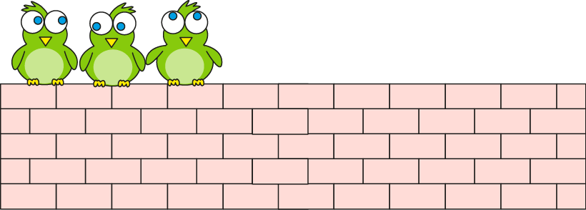
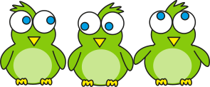
2.5 Commutativity, doubling and halving Step 2:4
There were 3 birds. Now there are double that number.
How many birds now?
Can you draw a bar model to show this?
6
?
Double 3 is the same as
2 groups of 3.
3
3
2 × 3
= 6
Can you write a multiplication expression?
2 times 3 = 6
How would you write it as a double?
Notes:
This morning there were three birds on the wall.
Now there are double that number.
How many birds are on the wall now?

Slide 42
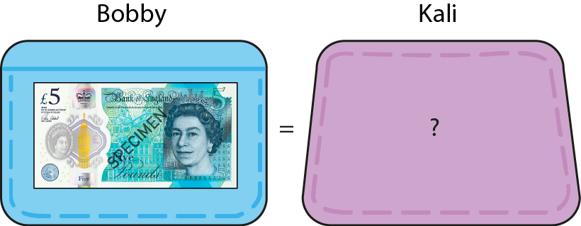

2.5 Commutativity, doubling and halving Step 2:4
How much money does Kali have?
What would the bar model look like?
10
?
twice as much
as Bobby
£10
5
5
Twice as much means double.
2 × 5
= 10
What is the multiplication expression?
If we need to double/ find twice the amount, we can use facts from the 2 times table.
2 times 5 = 10
double 5 = 10
Notes:
Bobby has £5. Kali has twice as much as Bobby. How much does Kali have?

Slide 43
Eg
3 x 2 = 6
Double 3 = 6
Your turn in your yellow books...
Write these as both x2 AND double
5 x 2 =
Double 5 =
4 x 2 =
Double 4=
10 x 2 =
Double 10 =
1 x 2 =
Double 1 =
7 x 2 =
Double 7 =
6 x 2 =
Double 6=
8 x 2 =
Double 8 =
9 x 2 =
Double 9 =

Slide 44
Session 5

Slide 45
16 + 3 =
Add these…
20 + 8 =
10 + 5 =
24+ 4 =
36 + 2 =

Slide 46
WALT double 2 digit numbers

Slide 47
Recap – doubles song

Slide 48
2.5 Commutativity, doubling and halving Step 2:5
10
8
6
4
2
5
1
2
3
4
5
1
2
3
4

Slide 49
2.5 Commutativity, doubling and halving Step 2:5
double 6
12
= 6 + 6
5 + 5 = 10
Six is 5 plus 1,
so double six is double 5 plus double 1
1 + 1 = 2
10 + 2 = 12
Notes:
Six is five plus one more, so double six is double five plus double one.

Slide 50
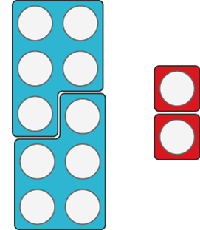


2.5 Commutativity, doubling and halving Step 2:5
double 6
12
= 6 + 6
5 + 5 = 10
1 + 1 = 2
10 + 2 = 12
Notes:
Six is five plus one more, so double six is double five plus double one.

Slide 51
2.5 Commutativity, doubling and halving Step 2:5
double 9
18
= 9 + 9
5 + 5 = 10
Nine is 5 plus 4,
So double nine is double 5 plus double 4.
4 + 4 = 8
10 + 8 = 18
Notes:
Nine is five plus four more, so double nine is double five plus double four.

Slide 52
2.5 Commutativity, doubling and halving Step 2:5
double 9 = 9 + 9
= 18
10 + 10 = 20
Nine is 10 minus 1,
so double nine is double 10 minus double 1.
1 + 1 = 2
Doubling a whole number always gives an even number.
20 − 2 = 18
Notes:
Nine is ten minus one, so double nine is double ten minus double one.

Slide 53
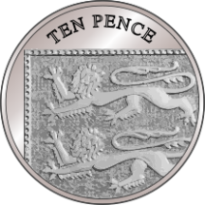
2.5 Commutativity, doubling and halving Step 2:6
Double two 10s is four 10s.
Double three 10s is six 10s.
Double one 10 is two 10s.
Double 20 is 40.
Double 30 is 60.
Double 10 is 20.
20 + 20 = 40
30 + 30 = 60
10 + 10 = 20

Slide 54
2.5 Commutativity, doubling and halving Step 2:6
double 11
= 22
double 10
+ double 1
20 + 2
= 22

Slide 55
2.5 Commutativity, doubling and halving Step 2:6
double 12
= 24
double 10
+ double 2
20 + 4
= 24

Slide 56
2.5 Commutativity, doubling and halving Step 2:6
double 13
= 26
double 10
+ double 3
20 + 6
= 26

Slide 57
2.5 Commutativity, doubling and halving Step 2:6
double 14
= 28
double 10
+ double 4
20 + 8
= 28

Slide 58
2.5 Commutativity, doubling and halving Step 2:6
double 15
= 30
When doubling a 2 digit number with a ones digit of 5, you always make an odd multiple of ten..
double 10
+ double 5
20 + 10
= 30

Slide 59
2.5 Commutativity, doubling and halving Step 2:6
double 25
= 50
10
double 20 + double 5
40 + 10
= 50

Slide 60
2.5 Commutativity, doubling and halving Step 2:6
double 35
= 70
10
double 30 + double 5
60 + 10
= 70

Slide 61


2.5 Commutativity, doubling and halving Step 2:7
There are two packets of dog bones. There are six bones in each packet. How many bones are there altogether?
12
?
6
6
2 × 6 =
12
Double 6 is 12, so 2 groups of 6 is 12.
Notes:
There are two packets of dog bones. There are six bones in each packet. How many bones are there altogether?

Slide 62
Eg
3 x 2 = 6
Double 3 = 6
Your turn in your yellow books...
Write these as both x2 AND double
12 x 2 =
Double 12 =
14 x 2 =
Double 14=
15 x 2 =
Double 15 =
11 x 2 =
Double 11 =
24 x 2 =
Double 24 =
32 x 2 =
Double 32=
45 x 2 =
Double 45 =
33 x 2 =
Double 33 =

