Slide 1

Year 2 Maths
Multiplication

Slide 2
Session 1

Slide 3

How many ways can you think of to make this number in 1 minute?
It could be + - x or ÷
26
Click to start the 1 minute timer

Slide 4
WALT efficiently multiply by 2

Slide 5


What’s the same and what’s different?
They all have 2 as a part
x2
The answer is double what you are multiplying by 2
When one of the factors (parts) is 2, the product (answer) is double the other factor (part)

Slide 6
Quick recap of last week…
There are 13 pairs of socks. How many socks are there altogether?
13 x 2 = ___
As it is x2 we know the answer is double the other factor (part)
Double 13 = double 10 + double 3
= 20 + 6
=26
I know that double 13 is 26, so 13 x 2 is 26
There are 26 socks altogether

Slide 7
2.5 Commutativity, doubling and halving Step 2:9
The parts are equal. Fill in the missing numbers.
10
?
?
5
5
Notes:
In all these diagrams the parts are equal. Fill in the missing numbers.

Slide 8
2.5 Commutativity, doubling and halving Step 2:9
The parts are equal. Fill in the missing numbers.
?
20
10
10
Notes:
In all these diagrams the parts are equal. Fill in the missing numbers.

Slide 9
2.5 Commutativity, doubling and halving Step 2:9
The parts are equal. Fill in the missing numbers.
?
14
7
7
Notes:
In all these diagrams the parts are equal. Fill in the missing numbers.

Slide 10
2.5 Commutativity, doubling and halving Step 2:9
The parts are equal. Fill in the missing numbers.
?
6
3
3
Notes:
In all these diagrams the parts are equal. Fill in the missing numbers.

Slide 11
2.5 Commutativity, doubling and halving Step 2:9
The parts are equal. Fill in the missing numbers.
?
12
?
6
6
Notes:
In all these diagrams the parts are equal. Fill in the missing numbers.

Slide 12
2.5 Commutativity, doubling and halving Step 2:9
The parts are equal. Fill in the missing numbers.
1000
500
?
500
Notes:
In all these diagrams the parts are equal. Fill in the missing numbers.

Slide 13
2.5 Commutativity, doubling and halving Step 2:9
The parts are equal. Fill in the missing numbers.
14
7
?
7
?
Notes:
In all these diagrams the parts are equal. Fill in the missing numbers.

Slide 14
2.5 Commutativity, doubling and halving Step 2:9
The parts are equal. Fill in the missing numbers.
18
?
9
9
Notes:
In all these diagrams the parts are equal. Fill in the missing numbers.

Slide 15
2.5 Commutativity, doubling and halving Step 2:9
Double 4 – true or false?
4 × 2
✓
true

Slide 16
2.5 Commutativity, doubling and halving Step 2:9
Double 4 – true or false?
4 + 4
✓
true

Slide 17
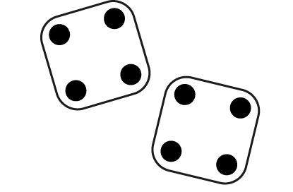
2.5 Commutativity, doubling and halving Step 2:9
Double 4 – true or false?
✓
true

Slide 18
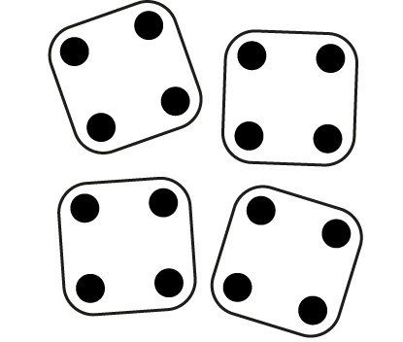
2.5 Commutativity, doubling and halving Step 2:9
Double 4 – true or false?
✗
false

Slide 19
2.5 Commutativity, doubling and halving Step 2:9
Double 4 – true or false?
2 × 4
✓
true

Slide 20
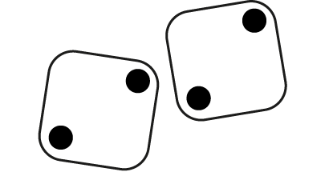
2.5 Commutativity, doubling and halving Step 2:9
Double 4 – true or false?
✗
false

Slide 21
Your turn… In your yellow maths books, fill in the missing numbers
2 x 7 = ____ 7 x 2 = ___
Double 7 = ____
7, twice = ____
Twice 6 = ___ x 6
Double 6 = ____
Double 3 = 2 x ___
Or double 3 = ___ x 2
Double 3 = ___

Slide 22
2.5 Commutativity, doubling and halving Step 2:9
Challenge
There are double the number of children outside
as there are inside. There are 20 children outside.
Which diagram shows this?
40
20
20
20
10
10

Slide 23
Session 2

Slide 24
Multiply these…
7x10
6x5
5x2
4x10
9x5
3x2

Slide 25
WALT relate doubling and halving

Slide 26
2.5 Commutativity, doubling and halving Step 3:1
whole
The whole is split into two equal parts.
half
Each part is one half of the whole.
half

Slide 27



2.5 Commutativity, doubling and halving Step 3:1
There are six stick children who want to play on the seesaw; half of them should sit on each side. How many is half of six?
How many halves make a whole?
How many is half of 6 children?
So how many equal groups of children will there be?
There are six stick-children altogether; half of six is equal to three.
3
2 × = 6
So three children need to sit on each side of the seesaw.
3
× 2 = 6
Notes:
There are six children who want to play on the seesaw.
Half of the children should sit on each side.
How many is half of six children?

Slide 28
2.5 Commutativity, doubling and halving Step 3:2
2
1
1
Half of 2 is equal to 1.
Double 1 is equal to 2.

Slide 29
2.5 Commutativity, doubling and halving Step 3:2
4
2
2
Half of 4 is equal to 2.
Double 2 is equal to 4.

Slide 30
2.5 Commutativity, doubling and halving Step 3:2
6
3
3
Half of 6 is equal to 3.
Double 3 is equal to 6.

Slide 31
Your turn…
You will need some counters and your jotters.
CAREFULLY count out an even number of counters up to 10 (2, 4, 6, 8, 10). If you start with the wrong number of counters you won’t be able to do this!
Halve the counters by splitting them into 2 EQUAL groups.
Write what you find in your jotter like this…
Half of ___ = ___
Double ___ = ___
Half of 2 = 1
Double 1 = 2

Slide 32
Session 3

Slide 33
Write the fact family for a number bond to 10 and the linked bond to 20.
___+___=___
___+___=___
___-___=___
___-___=___
Eg if you know
4+6=10
Then you know
14+6=20

Slide 34
WALT double and halve

Slide 35
2.5 Commutativity, doubling and halving Step 3:3
2
1
1
2 × 1 = 2
Half of 2 is equal to 1.
Double 1 is equal to 2.

Slide 36
2.5 Commutativity, doubling and halving Step 3:3
4
2
2
2 × 2 = 4
Half of 4 is equal to 2.
Double 2 is equal to 4.

Slide 37
2.5 Commutativity, doubling and halving Step 3:3
6
3
3
2 × 3 = 6
Half of 6 is equal to 3.
Double 3 is equal to 6.

Slide 38
2.5 Commutativity, doubling and halving Step 3:3
8
4
4
2 × 4 = 8
4
Half of 8 is equal to .
4
Double is equal to 8.

Slide 39
2.5 Commutativity, doubling and halving Step 3:3
2
4
1
1
2
2
2 × 1 = 2
2 × 2 = 4
half of 2 = 1
half of 4 = 2
double 1 = 2
double 2 = 4
6
8
3
3
4
4
2 × 3 = 6
2 × 4 = 8
half of 6 = 3
half of 8 = 4
double 3 = 6
double 4 = 8

Slide 40

2.5 Commutativity, doubling and halving Step 3:3
double
factor
×
2
=
product
half
When one of the factors (parts) is two, the other factor (part) is half of the product (total)

Slide 41

2.5 Commutativity, doubling and halving Step 3:3
double
2
×
factor
=
product
half
When one of the factors (parts) is two, the other factor (part) is half of the product (total)

Slide 42
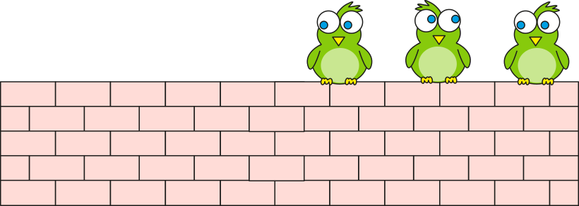

2.5 Commutativity, doubling and halving Step 3:4
This morning there were 6 birds on the wall.
Now there are half that number.
How many birds are on the wall now?
6
?
?
3
3
Half that number of birds.
2, three times, is equal to 6.
3, twice is equal to 6.
3
3
2 × = 6
× 2 = 6
Notes:
This morning there were six birds on the wall.
Now there are half that number.
How many birds are on the wall now?

Slide 43
Your turn in your yellow maths books…
Fill in the missing numbers.
You can use counters if you need to.
2 x ____ = 8 2 x ____ = 0
2 x ____ = 4 2 x ____ = 6 ____ x 2 = 10 ____ x 2 = 2
Challenge:
Can you make up a word problem for one of these – like the bird problem on the last slide?

Slide 44
Session 4

Slide 45
6
Double these…
15
3
8
5
12

Slide 46
WALT halve 2 digit numbers

Slide 47
2.5 Commutativity, doubling and halving Step 3:5
half of 8
= 4
8
4
4
4
4
Double is equal to 8; so half of 8 is equal to .

Slide 48
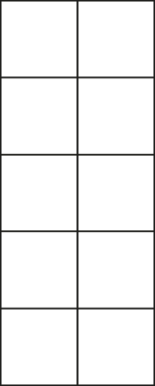
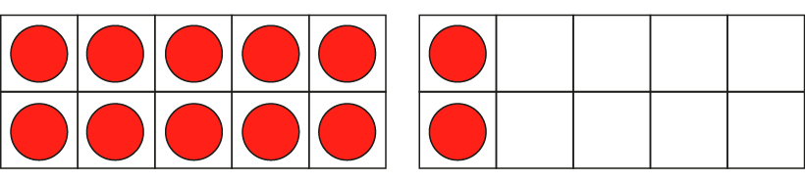

2.5 Commutativity, doubling and halving Step 3:5
half of 12
= 6
12 is ten plus two, so half of twelve is equal to half of ten plus half of two.
half of 10
+
half of 2
5
+
1
= 6

Slide 49
Half of 26
1st –
Partition into 10s and 1s
So 26 = 20 + 6
Next –
Halve each part
Half of 26 = half of 20 + half of 6
=10 + 3
Finally –
recombine
10 + 3 = 13
So half of 26 is 13

Slide 50
Half of 30
When we are finding half of an odd number of tens, partition into 10 and the rest.
So 30 = 10 + 20
Then find half of each part
So half of 30 = half of 10 + half of 20
= 5 + 10
Finally
Recombine
5 + 10 = 15
So half of 30 = 15

Slide 51



2.5 Commutativity, doubling and halving Step 3:6
There are two packets of dog bones. Each packet has the same number of bones. There are twelve bones altogether. How many bones are there in each packet.
12
?
6
?
?
6
?
One of the parts/ factors is two, so the other part/ factor is half of the total/ product
I know that half of twelve is equal to six.
6
2 × = 12
So there are six dog bones in each packet.
6
× 2 = 12
Half of the bones are in each packet.
Notes:
There are two packs of bones.
There are twelve bones altogether.
How many bones are there in each pack?
One of the factors is 2, so the other factor is half of the product.
Half of the biscuits are in each pack.
I know that half of 12 is equal to 6.
So there are 6 biscuits in each pack.

Slide 52
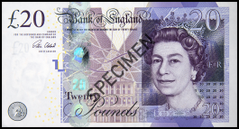

2.5 Commutativity, doubling and halving Step 3:6
Emily has £20 in total, kept in two money-boxes. Each money-box contains the same amount of money. How much is in each money-box?
20
?
10
£10
10
?
?
£10
?
One of the parts/ factors is two, so the other part/ factor is half of the total/ product
I know that half of two tens is equal to one ten.
10
2 × = 20
So there is ten pounds in each money-box.
10
× 2 = 20
Half of the money is in each money-box
Notes:
Emily has £20 in total, kept in two money-boxes.
Each money-box contains the same amount of money.
How much is in each money-box?

Slide 53
Your turn…
There are twenty-six socks. How many pairs is this?
One of the factors/ parts is 2 (as there are 2 socks in a pair), so the other factor/ part is half of the product/ total
2 x __ = 26 ___ x 2 = 26
Half of 26 = half of 20 + half of 6
= 10 + 3
= 13
So there are 13 pairs of socks.

Slide 54
Your turn…
Work out the missing numbers.
2 x 7 = 14
Double 7 is equal to ___
Half of ___ is equal to 7.
6 x 2 = 12
Double 6 is equal to ___
Half of ___ is equal to 6.
2 x 3 = 6
2 x __= 8
2 x __= 10
If I cut an 8m piece of ribbon into 2 equal pieces, how long will each piece be?
I gave half my toy cars to my friend; I have 7 toy cars left. Hoe many did I have to start with?

Slide 55
Session 5

Slide 56
16 - 3 =
Subtract these…
20 - 8 =
10 - 5 =
24- 4 =
36 - 2 =

Slide 57
WALT use doubling and halving to solve 2 times table problems

Slide 58
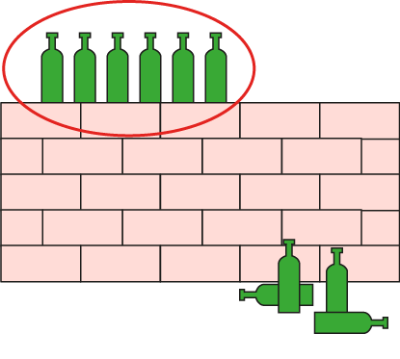
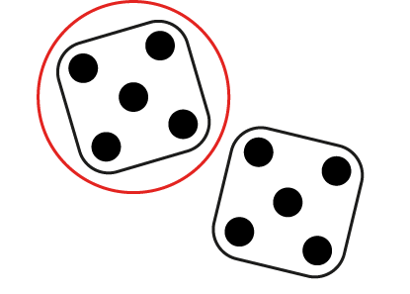
2.5 Commutativity, doubling and halving Step 3:8
True or false – half of 10?
✗
false
5
✓
true
20
✗
false
✓
true

Slide 59

2.5 Commutativity, doubling and halving Step 3:8
Half of these ducks are mine.
How many ducks do I have?
3

Slide 60
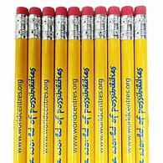
Talk time…
How do we work this out?
What could I use to help me?
I have 10 pencils, which is half as many as Harry. How many does Harry have?

Slide 61
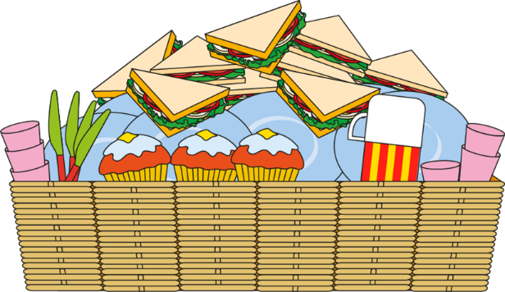
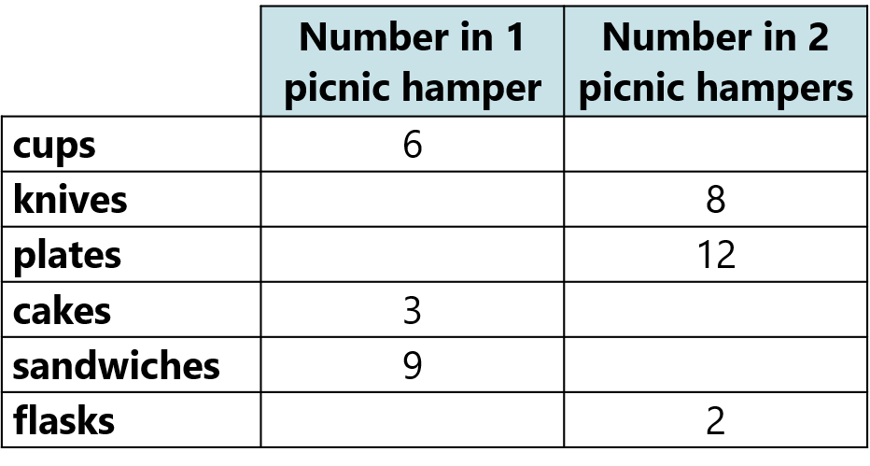
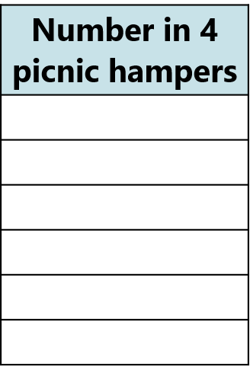








2.5 Commutativity, doubling and halving Step 3:9
Your turn in your yellow books…
A shop sells hampers for people to take on picnics.
Fill in the gaps in the table.

