Slide 1

Multiplication 1
Multiplication

Slide 2
Session 1

Slide 3

How many ways can you partition this number in 1 minute?
73
Click to start the 1 minute timer

Slide 4
WALT explain the relationship between adjacent multiples of 5.

Slide 5
What do you notice?
The answers end with a 0 or a 5
0 × 5 = 0
1 × 5 = 5
2 × 5 = 10
3 × 5 = 15
4 × 5 = 20
5 × 5 = 25
6 × 5 = 30
7 × 5 = 35
8 × 5 = 40
9 × 5 = 45
10 × 5 = 50
11 × 5 = 55
12 × 5 = 60
The ones digit alternates 0, 5, 0, 5
The tens digit has a pattern 0, 0, 1, 1, 2, 2…
When you times an odd number by 5, the answer ends in 5.
When you times an even number by 5, the answer ends in 0.

Slide 6


2.4 The 10 and 5 time tables Step 2:8
 | × 5
0 | 0
1 | 5
2 | 10
3
4 | 20
5 | 25
6 | 30
7
8 | 40
9 | 45
10 | 50
11 | 55
12 | 60
 | × 5
2 | 10
3
35
↑ − 5
↓ + 5
3 × 5 = 2 × 5 + 5
7 × 5 = 8 × 5 − 5
15
 | × 5
7
8 | 40
+ 5
− 5
0
5
10
15
20
25
30
35
40
45
50
Notes:
Adjacent multiples of 5 have a difference of 5. We can use this to find the previous and next multiple.

Slide 7
2.4 The 10 and 5 time tables Step 2:8
 |  | Factor
 | × | 1 | 2 | 3 | 4 | 5
Factor | 1
 | 2
 | 3
 | 4
 | 5
 | 6
 |  | Factor
 | × | 1 | 2 | 3 | 4 | 5
Factor | 1
 | 2
 | 3
 | 4
 | 5
6 × 5 = 5 × 5 + 5
5 × 5 = 25
6 × 5 = 30

Slide 8
2.4 The 10 and 5 time tables Step 2:9
 | These sets of answers are all in the 5 times table. True or false?
25, 60, 55, 10, 5
30, 20, 102, 10, 80, 0, 40
55, 65. 15, 35, 59
80, 85, 58, 90, 95, 59

Slide 9
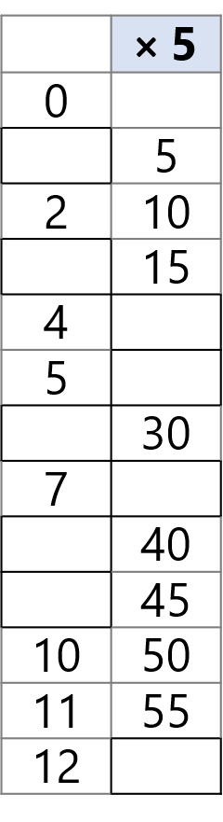
Your turn in your yellow book…
Fill in the missing numbers and solve the problems
10 x 5 = 50
9 x 5 = ___
8 x 5 = ___
7 x ___ = 35
6 x ___ = 30
5 x ___ = 25
___ x 5 = 20
___ x 5 = 15
___ x 5 = 10
5 children can fit around each table at a party. There are 4 full tables. How many children are there altogether?
How many 5p coins will I need to buy a cake that costs 35p?
Becca needs 25p to buy a pen. She has 4 5p coins. How much more money does she need to buy the pen?
How many fingers are on 10 gloves?

Slide 10
Session 2

Slide 11
Add these…
27+10
14+10
83+10
56+10
21+10
49+10

Slide 12
WALT explain how groups of 5 and 10 are related.

Slide 13
2.4 The 10 and 5 time tables Step 3:1
Use this number line to count in 5s.
Now use this number line to count in 10s.
Half the class count in 5s.
Half the class join in with the numbers needed to count in tens.
0
5
10
15
20
25
30
35
40
45
50
55
60
All of the numbers said by the ‘tens’ group are also said by the ‘fives’ group.
Not all of the numbers said by the ‘fives’ group are also said by the ‘tens’ group.
For every number said by the ‘tens’ group, the ‘fives’ group says two numbers.

Slide 14
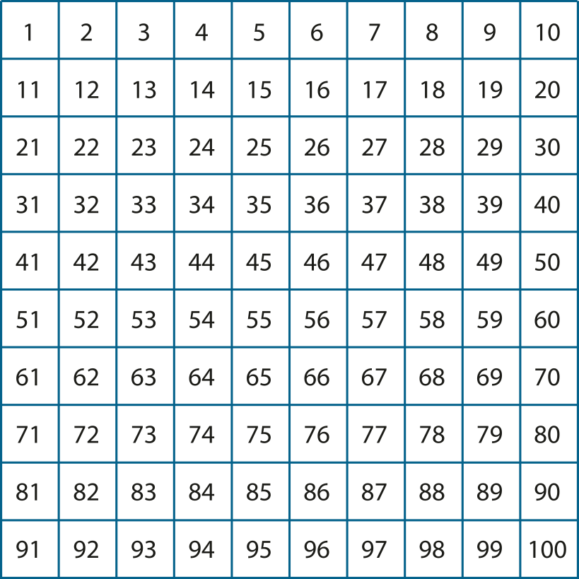


2.4 The 10 and 5 time tables Step 3:1
Half the class count in 5s.
Half the class join in with the numbers needed to count in tens.

Slide 15
2.4 The 10 and 5 time tables Step 3:1
What numbers do we say when counting in 5s and 10s?
Number | 0 | 1 | 2 | 3 | 4 | 5 | 6 | 7 | 8 | 9 | 10 | 11 | 12 | 13 | 14 | 15 | 16 | 17 | 18 | 19 | 20 | 21 | 22 | 23 | 24 | 25
Counting in 5s
Counting in 10s
✓
✓
✓
✓
✓
✓
✓
✓
✓

Slide 16



2.4 The 10 and 5 time tables Step 3:2
How many groups of five are there?
How many groups of ten are there?
For every one group of ten, there are two groups of five.
Notes:
How many groups of five are there?
How many groups of ten are there?

Slide 17
Your turn…
Get 30 counters or objects with a partner. Count carefully!
Split the counters into groups of 5. How many groups do you have?
Now arrange them into groups of 10. (Combine 2 groups of 5 to make each group of 10 rather than starting all over again) How many groups do you have?
Now arrange your counters into groups of 5. (Split each group of ten into 2 groups of 5) How many groups do you have?

Slide 18
2.4 The 10 and 5 time tables Step 3:3
There are three 10cm lengths of ribbon.
How many 5cm lengths can be made?
10 cm
10 cm
10 cm
5 cm
5 cm
5 cm
5 cm
5 cm
5 cm
Notes:
There are three ten centimetre lengths of ribbon.
How many five centimetre lengths can be made?

Slide 19
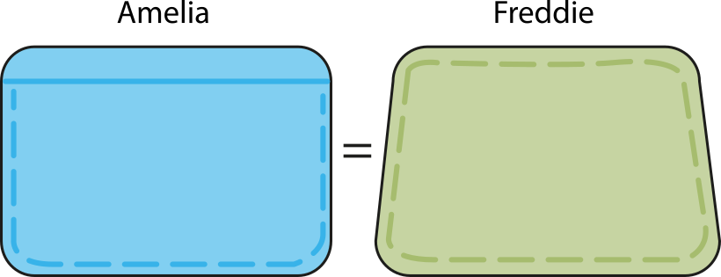


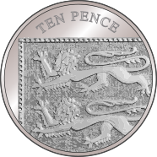
2.4 The 10 and 5 time tables Step 3:3
Amelia has four 5p coins.
Freddie has the same amount of money, in ten pence pieces.
How many ten pence coins does Freddie have?
4 × 5 p
2
× 10 p
Notes:
Amelia has four five-pence coins.
Freddie has the same amount of money, in ten-pence coins.
How many ten-pence coins does Freddie have?

Slide 20
Your turn in your yellow book…
Think about number formation and remember 1 digit in each box.
2 x 5 = ___ x 10
4 x 5 = ___ x 10
6 x 5 = ___ x 10
___ x 5 = 4 x 10
___ x 5 = 5 x 10
___ x 5 = 6 x 10
Can you spot the pattern to help you work out any of your own?

Slide 21
Session 3

Slide 22
Write the fact family for a number bond to 20.
___+___=___
___+___=___
___-___=___
___-___=___

Slide 23
WALT explain the relationship between multiples of 5 and 10

Slide 24




2.4 The 10 and 5 time tables Step 3:4
Write a multiplication sentence to describe the groups of five.
Now write one to describe the groups of 10.
One equation is in the 5 times table and one is in the 10 times table but they both have the same answer.
6 × 5 = 30
3 × 10 = 30

Slide 25
2.4 The 10 and 5 time tables Step 3:4
0 × 5 = 0 | 0 × 10 = 0
1 × 5 = 5 | 1 × 10 = 10
2 × 5 = 10 | 2 × 10 = 20
3 × 5 = 15 | 3 × 10 = 30
4 × 5 = 20 | 4 × 10 = 40
5 × 5 = 25 | 5 × 10 = 50
6 × 5 = 30 | 6 × 10 = 60
7 × 5 = 35 | 7 × 10 = 70
8 × 5 = 40 | 8 × 10 = 80
9 × 5 = 45 | 9 × 10 = 90
10 × 5 = 50 | 10 × 10 = 100
11 × 5 = 55 | 11 × 10 = 110
12 × 5 = 60 | 12 × 10 = 120
Look at the five and ten times tables. What do you notice?
Answers/ totals in the ten times table are also in the five times table.

Slide 26
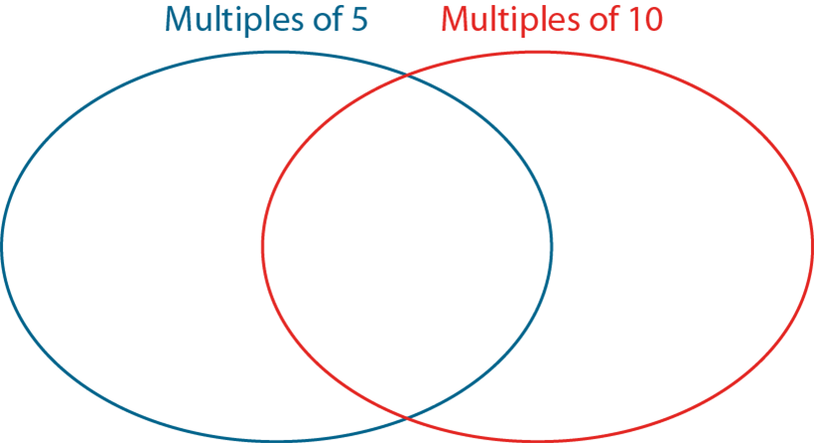
2.4 The 10 and 5 time tables Step 3:5
Your turn... Put the numbers in the diagram.
Multiples of both 5 and 10 go in the overlapping section. Numbers that are neither multiples of 5 nor 10 should go outside the circles.
0
5
10
27
35
31
40
15
100
Which section does not have any numbers in?
What do you notice about the numbers in the overlap section?
What do you notice about the numbers that don’t go in the circles?

Slide 27
2.4 The 10 and 5 time tables Step 3:6
0 | × 5 = | 0 | = 10 × | 0
2 |  | 10 |  | 1
4 |  |  |  | 2
6 |  |  |  | 3
8 |  |  |  | 4
10 |  |  |  | 5
12 |  |  |  | 6
Even multiples of five have a ones digit of 0
Odd multiples of five have a ones digit of 5
20
30
40
50
60
Even multiples of 5 are also multiples of 10.

Slide 28
2.4 The 10 and 5 time tables Step 3:6
Your turn in your yellow books... Fill in the missing numbers.
2 x 5 = 1 x 10
4 x 5 = ___x 10
6 x 5 = ___x 10
8 x 5 = ___x 10
10 x 5 = ___x 10
1 x 10 = 2 x 5
3 x 10 = ___x 5
4 x 10 = ___x 5
5 x 10 = ___x 5
Challenge:
Rishi says that all multiples of five are multiples of 10. Is he correct? Explain.

Slide 29
Session 4

Slide 30
60
What is 10 less than these numbers?
30
16
57
95

Slide 31
WALT explain what happens when we times a number by 1 or 0

Slide 32
2.4 The 10 and 5 time tables Step 4:1
Look at the highlighted questions.
What’s the same and what’s different?
2 times table |  | 5 times table |  | 10 times table
0 × 2 = 0 | 2 × 0 = 0 | 0 × 5 = 0 | 5 × 0 = 0 | 0 × 10 = 0 | 0 × 10 = 0
1 × 2 = 2 | 2 × 1 = 2 | 1 × 5 = 5 | 5 × 1 = 5 | 1 × 10 = 10 | 1 × 10 = 10
2 × 2 = 4 | 2 × 2 = 4 | 2 × 5 = 10 | 5 × 2 = 10 | 2 × 10 = 20 | 2 × 10 = 20
When 0 is a part, the answer is 0.

Slide 33
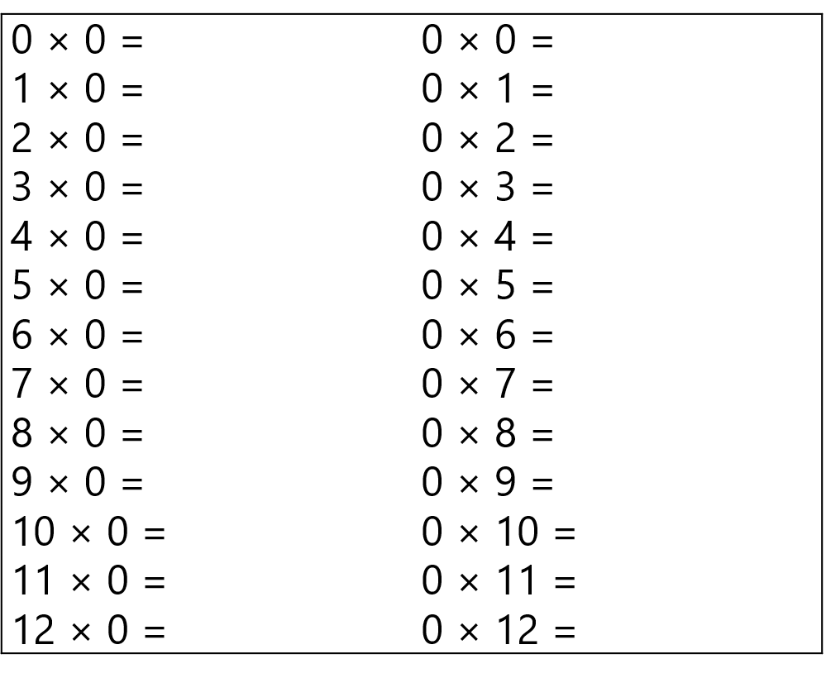
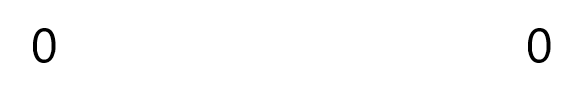
2.4 The 10 and 5 time tables Step 4:2
Complete the 0 times table.

Slide 34
2.4 The 10 and 5 time tables Step 4:4
Look at the highlighted questions.
What’s the same and what’s different?
2 times table |  | 5 times table |  | 10 times table
0 × 2 = 0 | 2 × 0 = 0 | 0 × 5 = 0 | 5 × 0 = 0 | 0 × 10 = 0 | 0 × 10 = 0
1 × 2 = 2 | 2 × 1 = 2 | 1 × 5 = 5 | 5 × 1 = 5 | 1 × 10 = 10 | 1 × 10 = 10
2 × 2 = 4 | 2 × 2 = 4 | 2 × 5 = 10 | 5 × 2 = 10 | 2 × 10 = 20 | 2 × 10 = 20
When one part is 1, the answer and the other part are the same.

Slide 35
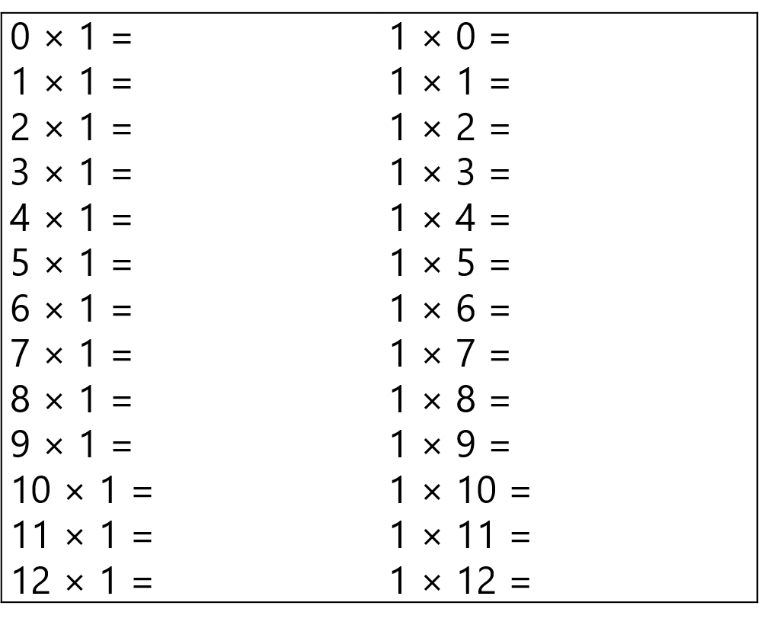
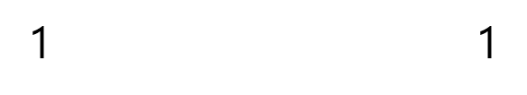
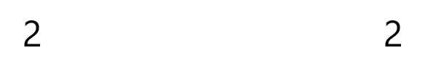
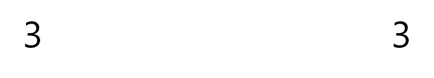
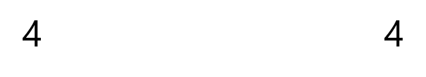
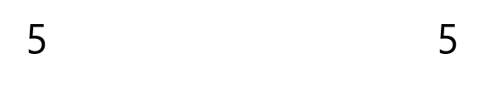
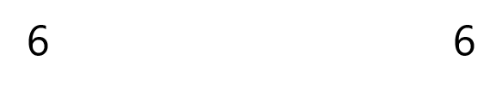
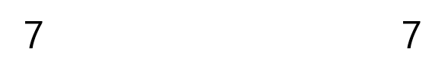
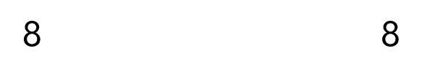
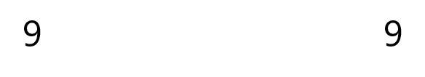
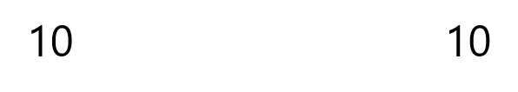
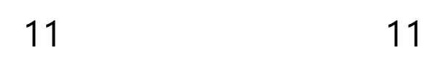
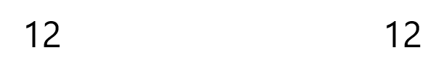
2.4 The 10 and 5 time tables Step 4:5
Complete the 1 times table.

Slide 36
Your turn in your yellow books…
Think about number formation and remember one digit in each box
0 x 0 = ____
4 x 0 = ___
12 x 0 = ___
8 x ___ = 0
0 x 30 = ___
0 x 1 = ____
4 x 1 = ___
12 x 1 = ___
8 x ___ = 8
0 x 30 = ___
1 x 5 6 x 1
0 x 7 0 x 6

Slide 37
2.4 The 10 and 5 time tables Step 4:6
 | factor (part) | factor (part) | product (answer)
factor (part) |  |  | 0
factor (part) |  |  | 5
product(answer) | 0 | 10
Challenge – can you fill in the missing numbers?
0
10
5
1
Notes:
Fill in the missing numbers.

Slide 38
Session 5

Slide 39
Count back in 5s from 60
Count back in 2s from 24
Count back 10s from 120

Slide 40
WALT represent multiplication equations in different ways.
(switchers/ commutativity)

Slide 41

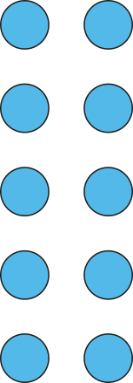
2.5 Commutativity, doubling and halving Step 1:1
How many groups of 2 are there?
How can we represent this with a multiplication equation?
5 × 2 = 10
5 groups of 2
2, five times

Slide 42

2.5 Commutativity, doubling and halving Step 1:1
How many groups of 5 are there?
5 × 2 = 10
2 groups of 5
5, two times

Slide 43
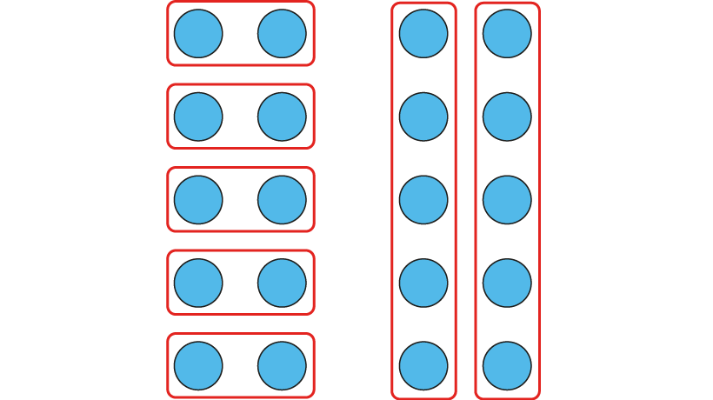
2.5 Commutativity, doubling and halving Step 1:1
What is the same and what is different?
The product/ total remains the same.
Notes:
What’s the same?
What’s different?

Slide 44
2.5 Commutativity, doubling and halving Step 1:2
How many groups of 5 are there?
How can we represent this with a multiplication equation?
2 × 5 = 10
2 groups of 5
5, two times

Slide 45
2.5 Commutativity, doubling and halving Step 1:2
How many groups of 2 are there?
2 × 5 = 10
5 groups of 2
2, five times

Slide 46

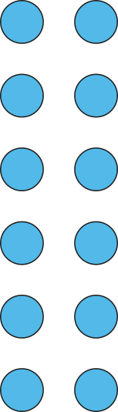
2.5 Commutativity, doubling and halving Step 1:3
What is the same? What is different?
Six times two can represent six groups of two.
It can also represent two groups of six (or six, two times)
6 groups of 2
6 × 2 = 12
6, two times

Slide 47

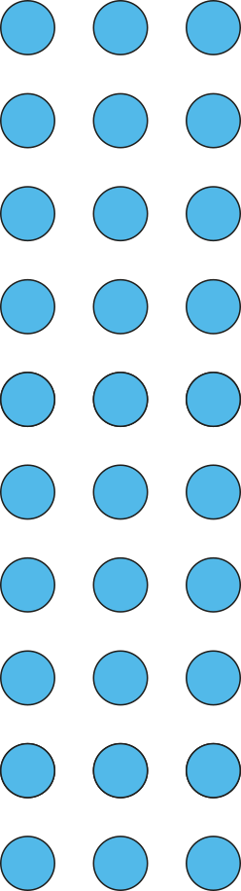
2.5 Commutativity, doubling and halving Step 1:3
Three times ten can represent three groups of ten.
It can also represent ten groups of three (or three, ten times)
3 groups of 10
3 × 10 = 30
3, ten times

Slide 48
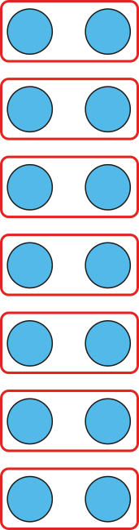


2.5 Commutativity, doubling and halving Step 1:4
There are some eggs in some nests. What situations can this number sentence represent?
7 × 2 = 14
7 groups of 2
2, seven times
Notes:
There are some eggs in some nests. What situations can the equation represent?

Slide 49
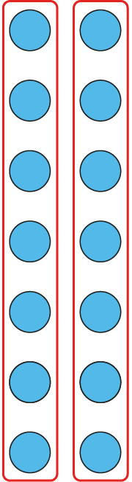


2.5 Commutativity, doubling and halving Step 1:4
Seven times two can also represent two groups of seven (or seven, two times)
7 × 2 = 14
2 groups of 7
7, two times
Notes:
There are some eggs in some nests. What situations can the equation represent?

Slide 50
2.5 Commutativity, doubling and halving Step 1:4
7 × 2 = 14

Slide 51
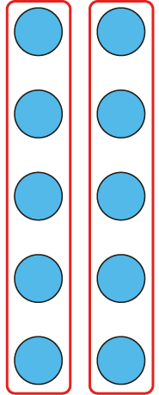

2.5 Commutativity, doubling and halving Step 1:4
I have some coins. What situations can this number sentence represent?
2 × 5 = 10
2 groups of 5
5, two times
5 p
5 p
Notes:
I have some coins. What situations can the equation represent?

Slide 52

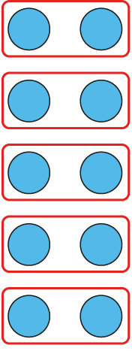
2.5 Commutativity, doubling and halving Step 1:4
Two times five can also represent five groups of two (or two, five times)
2 × 5 = 10
5 groups of 2
2, five times
2 p
2 p
2 p
2 p
2 p
Notes:
I have some coins. What situations can the equation represent?

Slide 53
2.5 Commutativity, doubling and halving Step 1:4
2 × 5 = 10
2 p
2 p
2 p
2 p
2 p
5 p
5 p

Slide 54
Your turn in your yellow books…
Think about number formation and remember one digit in each box
Write the question and the answer in your book, then write the switcher.
Eg
2 x 5 = 10
5 x 2 = 10
4 x 5 = ____
10 x 6 = ____
5 x 7 = ____
8 x 10 = _____
6 x 5 = ____
10 x 3 = ____
3 x 10 = ____
5 x 3 = ____
__ x __ = ____

