Slide 1
Year 2 Maths
Addition and subtraction

Slide 2
Session 1

Slide 3

81
Count back in 10s…
23
65
57
98
50

Slide 4
WALT partition to help with subtraction

Slide 5
1.16 Subtraction: two-digit and two-digit numbers – step 2:1
What’s the same and what’s different?
At first I had forty-five biscuits. Then I sold twenty biscuits, and then I dropped three biscuits. How many are left?
45 − 20 − 3
45 − 23
There were forty-five children in the playground. Then twenty-three of them went into the dinner hall. How many children are still in the playground?
Notes:
At first I had forty-five biscuits. Then I sold twenty biscuits, and then I dropped three biscuits. How many are left?
vs.
There were forty-five children in the playground. Then twenty-three of them went into the dinner hall. How many children are still in the playground?

Slide 6






1.16 Subtraction: two-digit and two-digit numbers – step 2:2
45
− 23
We can take away the 23 all in one go.

Slide 7
1.16 Subtraction: two-digit and two-digit numbers – step 2:2
45
− 23
Or we can take away 20 and take away 3.

Slide 8
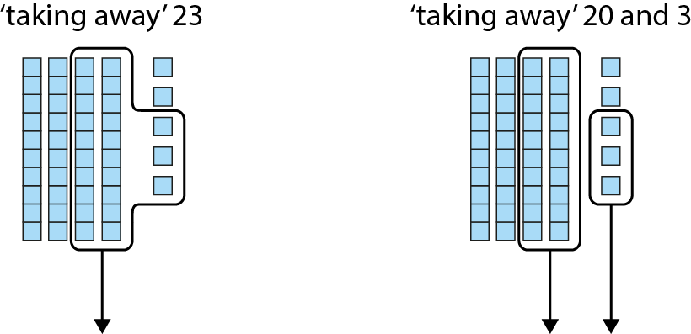
1.16 Subtraction: two-digit and two-digit numbers – step 2:2

Slide 9
1.16 Subtraction: two-digit and two-digit numbers – step 2:2
To subtract 23, we can subtract 20 and then subtract 3.
45 – 23 = 45 – 20 – 3

Slide 10
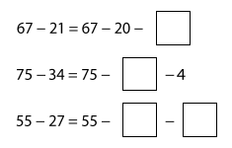
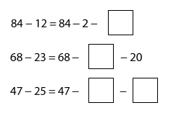
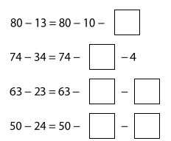
Your turn…
Solve these problems
You are not finding the answer, just saying how to work it out.
In your yellow maths books.
Remember – 1 digit in each box.

Slide 11
Session 2

Slide 12
Name and describe these 2D shapes

Slide 13
WALT subtract a 2 digit number from a 2 digit number
Not crossing 10

Slide 14







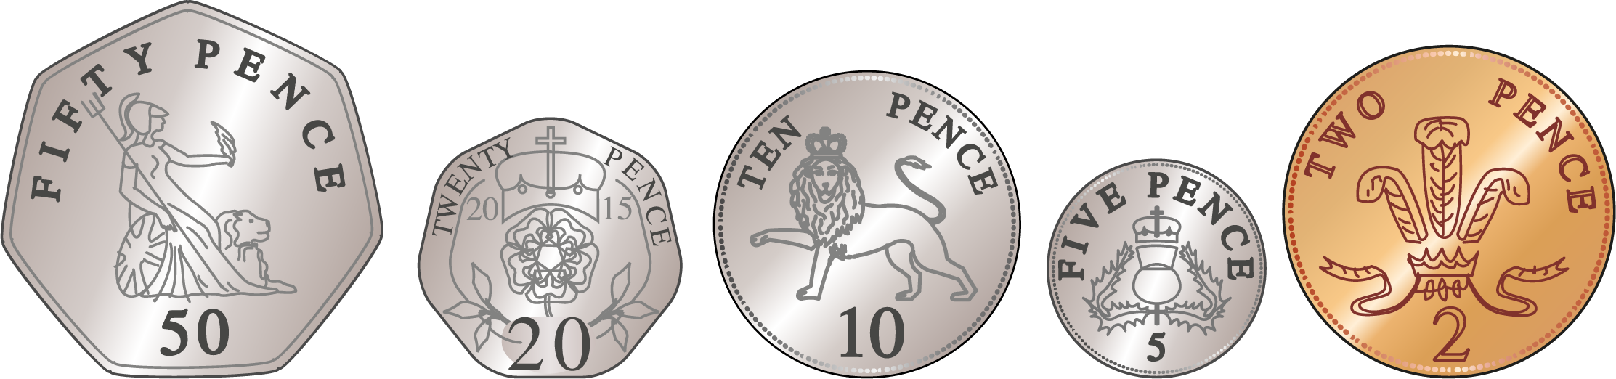





1.16 Subtraction: two-digit and two-digit numbers – step 2:3
I had 87p. Then I spent 15p. How much do I have now?
It is not possible to remove a 15p coin but it is possible to remove coins to the value of 15p

Slide 15
Get a white board and a pen and let’s have a go at this together…
23
Teachers may want to go through some more as they feel needed with their class.
35 – 12 =
10
2
-2
-10
23
25
35

Slide 16
Your turn…
Solve these problems, setting it out with the number line as we have just done together
In your yellow maths books.
Remember – 1 digit in each box.
27 – 14 =
56 – 12 =
43 – 21 =
66 – 25 =
39 – 13 =
Partition the 2nd number
Draw a blank number line
Write the 1st number at the right hand side
Count back the 10s
Count back the 1s

Slide 17
Session 3

Slide 18
Count back in 10s from these numbers when they appear
75
66
84
92
42
80

Slide 19
WALT subtract a 2 digit number from a 2 digit number
Not crossing 10

Slide 20












1.16 Subtraction: two-digit and two-digit numbers – step 2:4

Slide 21

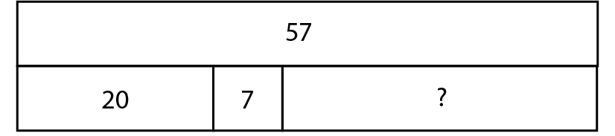


1.16 Subtraction: two-digit and two-digit numbers – step 2:4
Can you remember how to do this?

Slide 22
Your teacher may spend a bit more time practising these with you before you have a go yourself.
65 – 13 =
42 – 11 =

Slide 23
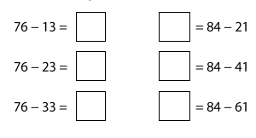
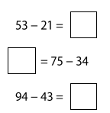
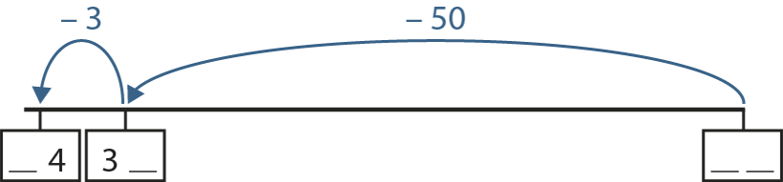
Your turn…
Solve these problems, setting it out with the number line as we have just done together
In your yellow maths books.
Remember – 1 digit in each box.
Partition the 2nd number
Draw a blank number line
Write the 1st number at the right hand side
Count back the 10s
Count back the 1s
Fill in the missing numbers…

Slide 24
Session 4

Slide 25
Write the fact family for this fact.
7 x 2 = 14
__ x __ = __
___÷___=___
___÷___=___

Slide 26
WALT subtract a 2 digit number from a 2 digit number
Crossing 10

Slide 27











1.16 Subtraction: two-digit and two-digit numbers – step 2:6
Difference is a multiple of 10.

Slide 28









1.16 Subtraction: two-digit and two-digit numbers – step 2:6
Think about the last slide. Can that help you?
You can partition the ones further.
59
1
59

Slide 29

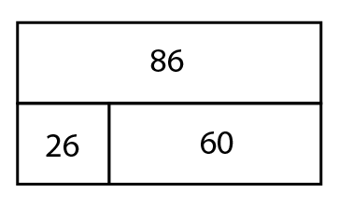
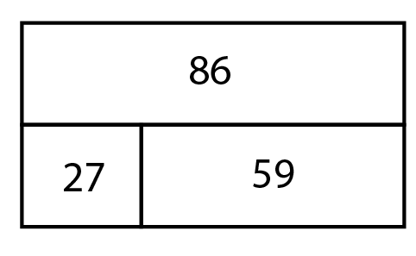
1.16 Subtraction: two-digit and two-digit numbers – step 2:6
59
1
59

Slide 30













1.16 Subtraction: two-digit and two-digit numbers – step 2:7

Slide 31













1.16 Subtraction: two-digit and two-digit numbers – step 2:7

Slide 32
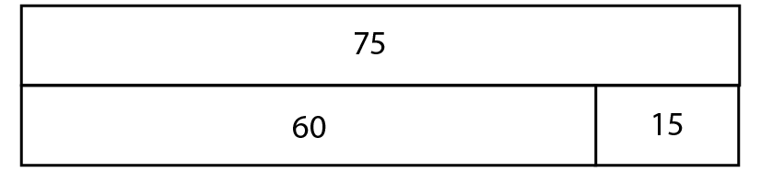
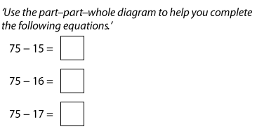
1.16 Subtraction: two-digit and two-digit numbers – step 2:8

Slide 33
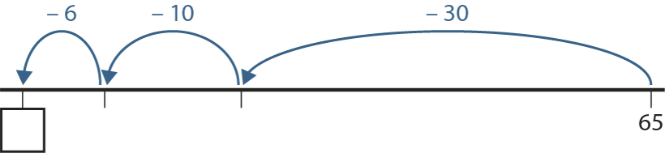

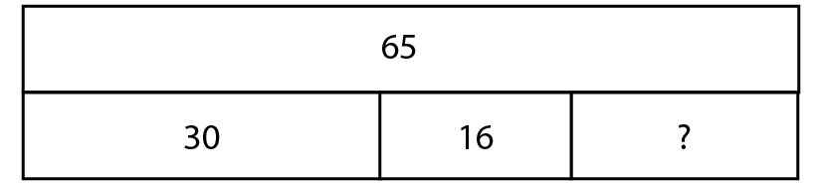

1.16 Subtraction: two-digit and two-digit numbers – step 2:8
Paul had sixty-five stickers. He gave thirty stickers to Andrew and sixteen stickers to Alicia. How many stickers does Paul have left?’
25
35
Notes:
Paul had sixty-five stickers. He gave thirty stickers to Andrew and sixteen stickers to Alicia. How many stickers does Paul have left?’

Slide 34
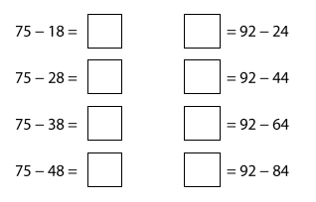
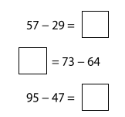
Your turn…
Solve these problems, setting it out with the number line as we have just done together
In your yellow maths books.
Remember – 1 digit in each box.
Partition the 2nd number
Draw a blank number line
Write the 1st number at the right hand side
Count back the 10s
Partition the ones to get back to the previous 10.
Count back the rest of the 1s

Slide 35
Session 5

Slide 36
81
Partition these…
23
65
57
98
50

Slide 37
WALT subtract efficiently using knowledge of 2 digit numbers

Slide 38
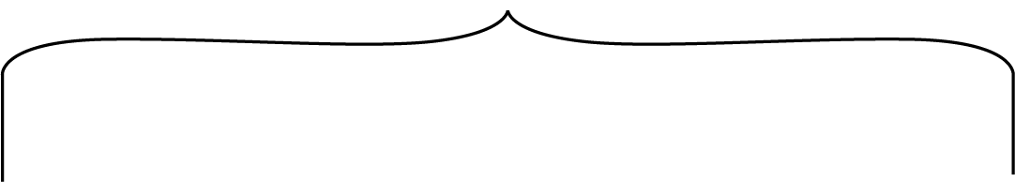


1.16 Subtraction: two-digit and two-digit numbers – step 2:9
35 − 34
= 1
We know that consecutive numbers have a difference of 1 so we don’t need to partition to subtract the tens then the ones.

Slide 39








1.16 Subtraction: two-digit and two-digit numbers – step 2:9

Slide 40
2AS-4 Add and subtract within 100 – part 2
Complete these calculations, thinking about when you need to partition. Write the partitioned numbers before you calculate. Think do you need to partition the first number when you subtract?
40 – 20 =
42 – 20 =
54 – 2 =
54 – 22 =
65 – 44 =
66 – 44 =
44 – 21 =
44 – 22 =
44 – 23 =
52 – 11 =
68 – 15 =
66 – 22 =

Slide 41
2AS-4 Add and subtract within 100 – part 2
Arranging Additions and Sorting Subtractions
https://nrich.maths.org/14726

Slide 42
Session 6
There are enough old quiz questions to use over as many lessons as you have left before Easter!

Slide 43
WALT add and subtract two 2 digit numbers

Slide 44





We have now spent quite a while learning to add and subtract. Let’s check to see how much you can remember…
How do we solve these?

Slide 45
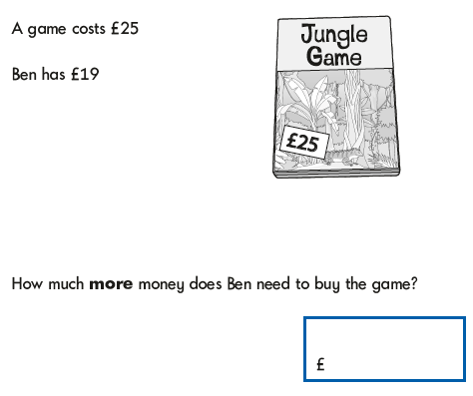
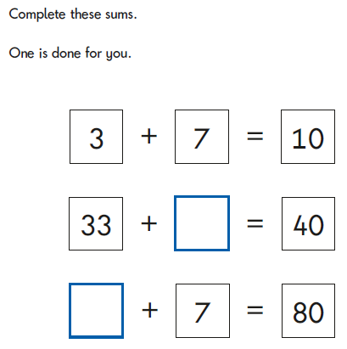
Listen carefully to these word problems. How do we solve them?

Slide 46
Your teacher will print out some addition and subtraction questions for you to have a go at answering in your books.
Note to teachers – you can work through as many as you want to as a class/ small groups or let your class have a go independently if they can.

