Slide 1


Portway Infant School
Active schools programme – A whole school approach to physical activity
 | March 2018 – April 2019
The Active school programme supports the following key indicators: Key indicator 1: The engagement of all pupils in regular physical activity – Chief Medical Officer guidelines recommend that primary school children undertake at least 30 minutes of physical activity a day in school Key indicator 2: The profile of PE and sport being raised across the school as a tool for whole school improvement Key indicator 3: Increased confidence, knowledge and skills of all staff in teaching PE and sport Key indicator 4: Broader experience of a range of sports and activities offered to all pupils This year we have accessed through the Active School programme:
April - Aug | Sept - Dec | Nov - March | April to June
Staff meeting – Active School programme launch Audit and development plan produced Baseline assessments across school Height, weight, fitness and physical activity levels measured Teacher audit to capture staff confidence in delivering PA in the curriculum ‘Active School’ assembly to launch programme and an active challenge set for children Lunchtime games sessions and resource | Second staff meeting (training session) Universal Daily Physical Activity programmes: making our school day more active Rammie’s Daily Mile Active learning ideas for across the curriculum Interventions: Physical Literacy intervention year 2 + Play to learn – curriculum resource to support physical literacy and fundamental movement skills in KS1. Rammie’s Healthy hero lunchtime club - Healthy lifestyle programme for targeted pupils who are overweight and/or inactive (8 weeks) | Continuation of universal programmes Access to Live IT programme – to support children who are overweight, and their families (one year support) End Feb – Re assessment across school to measure impact | Data analysed and fed back to schools Outcomes for Sport premium reporting identified Next steps identified
Ongoing 6 x support and planning meetings Development of physical activity policy Parent workshops/events – linked to Live IT programme Support from DCCT partners: School Sport Partnership and Premier League Primary Stars

Slide 2
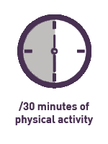

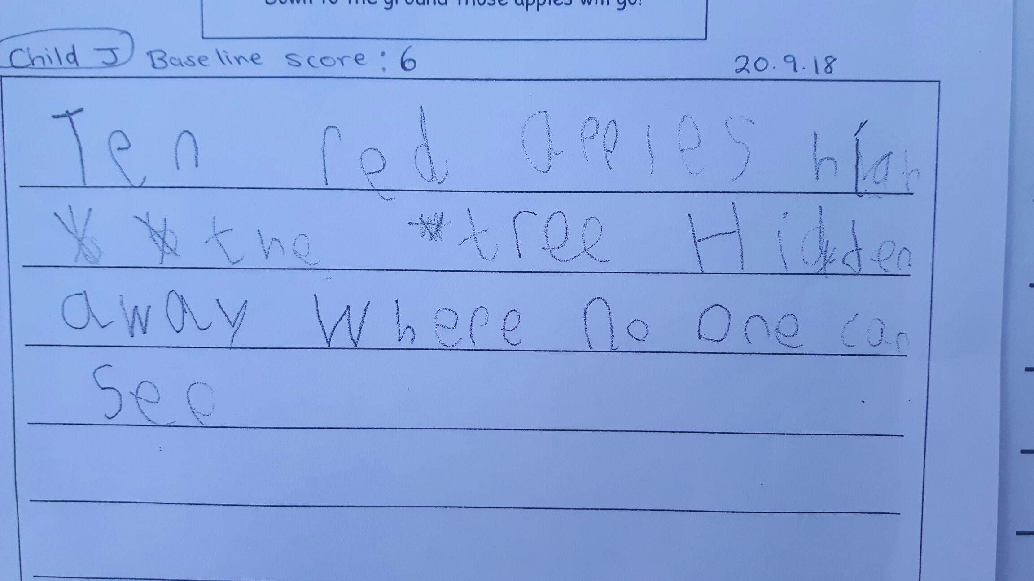
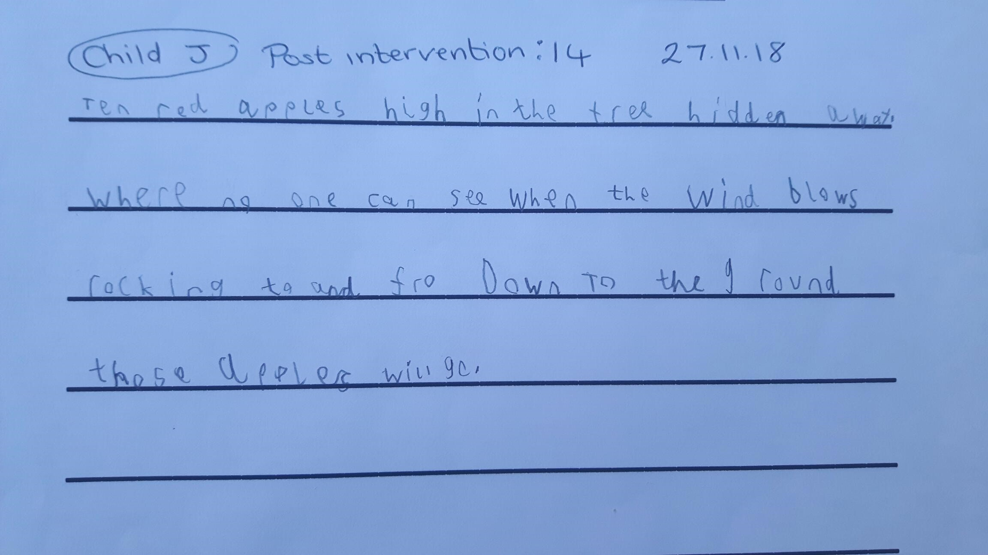
Active School report
Active schools programme – Impact
Under the Ofsted Schools Inspection Framework, inspectors will assess how effectively leaders use the Primary PE and Sport Premium and measure its impact on outcomes for pupils, and how effectively governors hold them to account for this.
Key indicator 1: The engagement of all pupils in regular physical activity
Daily physical activity increased by 21 minutes across the school day
11 out of 11 year 2 children improved their physical development through the physical literacy programme
72% of pupils were at age appropriate physical development after the intervention
Average baseline score = 9.1 (out of 19)
Average post intervention score = 14.6 (out of 19)
Example of impact on handwriting pre and post physical literacy intervention
Child J: Baseline score 6
20.9.18
Child J: Post 6 week intervention score 14
27.11.18

Slide 3
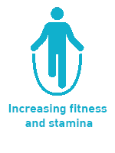
Active School report
Active schools programme – Impact
Under the Ofsted Schools Inspection Framework, inspectors will assess how effectively leaders use the Primary PE and Sport Premium and measure its impact on outcomes for pupils, and how effectively governors hold them to account for this.
Key indicator 1: The engagement of all pupils in regular physical activity
54 % of children increased the distance run in ten minutes by the second assessment
10 minute run | Distance run metres | % of children
Baseline | Below 799 m | 53%
 | 800 m to 1599 m | 47%
 | 1600 m + | 0%
Second measure | Below 799 m | 42%
 | 800m to 1599 m | 58%
 | 1600 m + | 0%
Table to show the % of pupils who ran below and above the average distance of 1176m (from the Active school cohort of 6 schools) | Percentage of children (Baseline) | Percentage of children (Second measure)
Below average | 98% | 93%
Above average | 2% | 7%

Slide 4


Active School report
Active schools programme – Impact
Under the Ofsted Schools Inspection Framework, inspectors will assess how effectively leaders use the Primary PE and Sport Premium and measure its impact on outcomes for pupils, and how effectively governors hold them to account for this.
Key indicator 2: The profile of PE and sport being raised across the school as a tool for whole school improvement Pupil wellbeing scores after Rammie’s Healthy Heroes went from 3.7 (where 5 is very happy) to 4.7 after the 8 weeks Key indicator 3: Increased confidence, knowledge and skills of all staff in teaching PE and sport Key indicator 4: Broader experience of a range of sports and activities offered to all pupils
% of staff saw the following changes in pupil behaviour after physical activity
More alert and ready to learn 100%
Increased concentration 80%
Happier 80%
Increased stamina 80%
70% of staff said they felt more confident to deliver physical activity as a result of the Active school programme
Two staff meetings to increase staff knowledge and understanding of the importance of physical activity and ways to increase physical activity across the school day
Daily Mile introduced across school
Short bursts of physical activity introduced in lessons as part of learning or an active brain boost
New lunchtime games introduced as part of Rammie’s Healthy Heroes
15 children attended Rammie’s Healthy Hero lunchtime club
5 children attend the Live IT programme

Slide 5
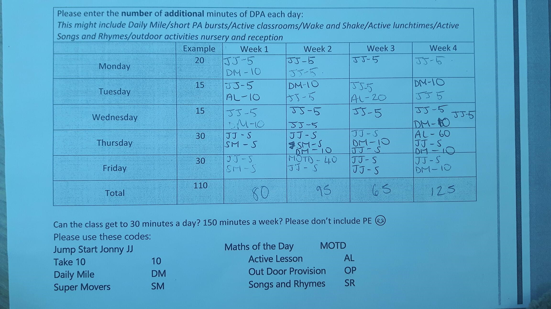
Active school report
Active schools programme – Impact
Key indicator 4: Broader experience of a range of sports and activities offered to all pupils Example of DPA record sheet:
Next Steps:
Continue with physical literacy intervention as it has had a real impact on physical development. Continue to look at ways to roll out the Daily Mile more consistently to increase fitness levels. The improvement in physical development should also support those children who were initially very unstable running. Continue with short bursts as part of learning and as active brain boosts. Karen has introduced a huge variety of ideas that should appeal to different members of staff. Share findings from Active school report with all staff

